Slide 1
Echelon Technologies EDS Sprayer
Team: Nathan Wichser (ME), Cody McKinstry (ME), Joe Haj (EE),
Chelsea Bates (ME), Kenji Olund (ME)

Slide 2
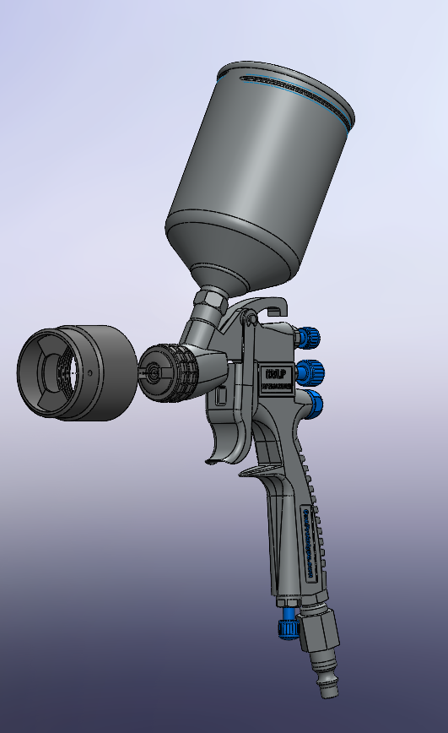
Basic Device Functionality
Portable Electrostatic Disinfectant Sprayer
Charges atomized disinfectant to provide more complete coverage and less waste.
Adapts to pre-existing HVLP paint sprayers for a more available and cost-effective solution.
Consists of a portable component cart to house user-supplied turbine and battery cell/electronics.
Electrode array adapts to air cap retainer on spray gun for compatibility without permanent changes to the equipment.
Minimum run time of 3 hours on a full charge with wall power redundancy options.
At the end of winter quarter, we will have a functional prototype ready for testing and refinement.

Slide 3
Functional Specifications-Mechanical
Spec ID | Threshold | Objective | Validation
MS001: Sprays Disinfectant | Finely atomize disinfectant to a VMD≥40 µm per EPA guidelines. | N/A | Manufacturer specifications converted to account for lower viscosities of disinfectant.
MS002: Compatibility | Shall be compatible with 4 different HVLP models. | Should be compatible with airless sprayers and compressed air sprayers. | Design the threads of our adapter to be compatible with the design of other HVLP/non-HVLP sprayers.
MS003: Component Cart dimensions | Shall be no bigger than 35x50x48in (WxHxL). | Should be no bigger than 33x38x40in (WxHxL). | Using tape measurements of the dimensions.
MS004: Load Analysis | A fully loaded component cart shall weigh less than 175 lbs. | Should weigh less than 100 lbs. | Use a scale to measure the fully loaded component cart.

Slide 4
Functional Specifications - Mechanical
Spec ID | Threshold | Objective | Validation
MS005: Component Cart Tipping Resistance | The fully loaded component cart shall pose no risk of tipping over when a weight of 30lbs is cantilevered 1.5 feet from the side of the cart. | The fully loaded component cart should pose no risk of tipping over when a weight of 40lbs is cantilevered 1.5 feet from the side of the cart. | Using testing apparatus and weights to hang weight from the side of the cart.
MS006: Disinfectant Coverage | The system shall increase the surface area covered while using electrostatic by 20%. | The system should increase the surface area covered while using electrostatic by 60%. | Rejected null hypothesis with statistical confidence interval of 90% and report of percentage increase comparison of charge/no charge.
MS007: Affordability | Production cost shall be ≤$1000. | Production cost should be ≤$700. | Final bill of materials. Production of the prototype fits within the allocated budget for materials and initial testing.

Slide 5
Functional Specifications - Electrical
Spec ID | Threshold | Objective | Validation
ES001: Safety Factor | The system will not pose any risk of injury via electrical shock to the user. | N/A | Recording static output of the attachment with a grounded probe. Compare to UL standards for high voltage exposure.
ES002: System Runtime | The sprayer shall run for 3 hours on full charge. | The sprayer should run for 8 hours on full charge. | Connecting the battery to a sprayer equivalent circuit and recording how long and at what charge the battery output before drained.
ES003: Kill Switch | The Component cart shall have a kill switch to cut power in the system. | The wire connected to the ionizer should have a kill switch to cut power in the system. | Operate system and while in use hit kill switch to show that power is no longer going to the device.

Slide 6
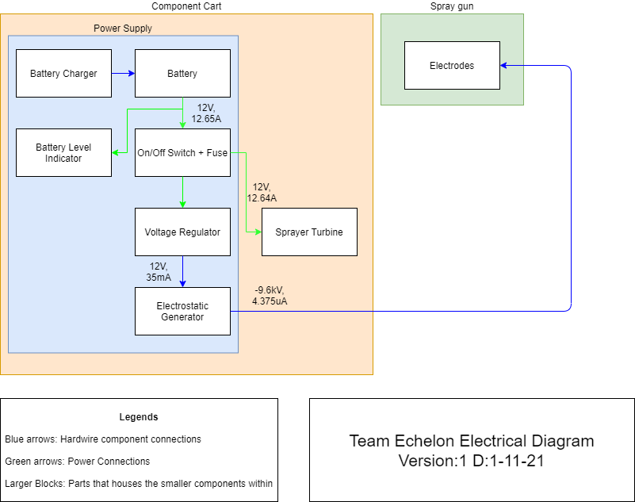
Electrical Block Diagram

Slide 7
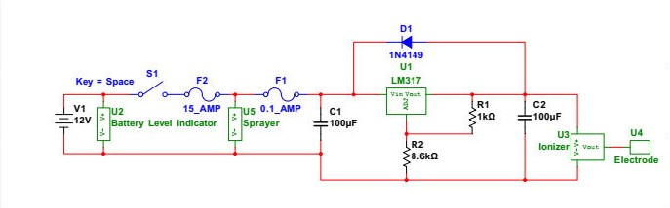
Electrical Schematic

Slide 8
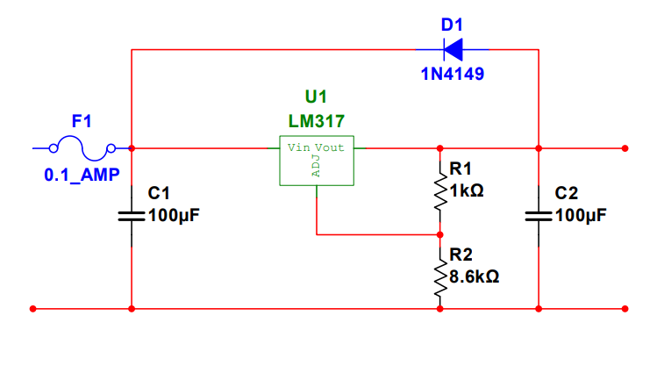
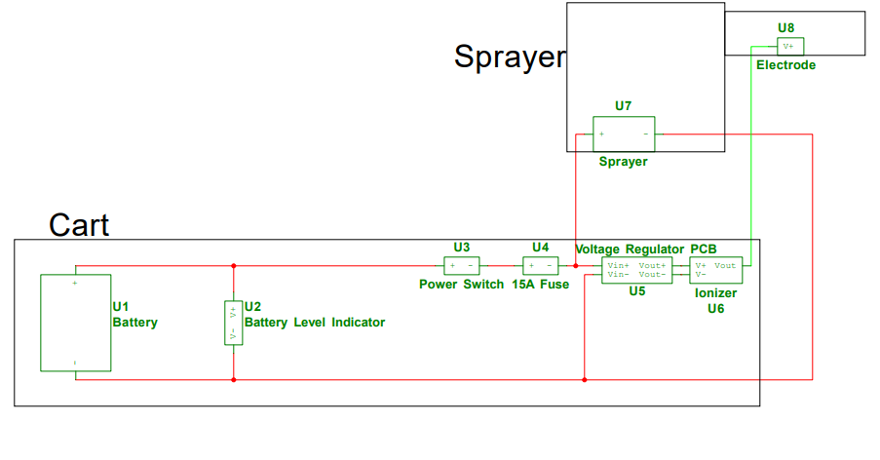
Wiring Diagrams

Slide 9
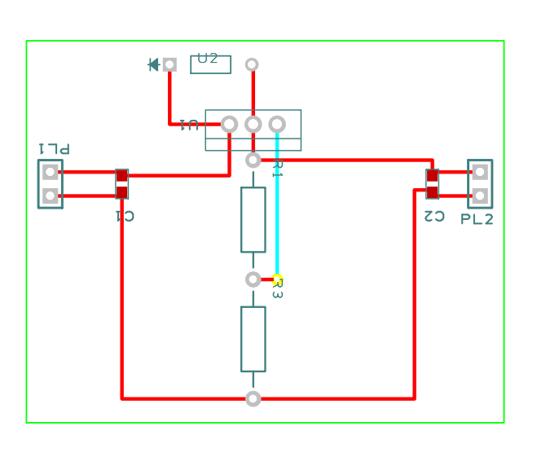
PCB Design

Slide 10
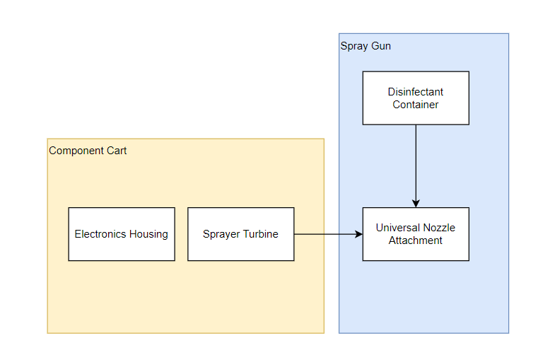
Mechanical Block Diagram
STR001: Component Cart
Pre-assembled frame with wheels on which the turbine (STR003), batteries, and electronics housing (STR002) will be mounted.
STR002: Electronics Housing
Contains the supporting electrical components that are too large to fit within the housing attached directly to the spray gun itself. Isolates and protects electrical components from environmental hazards and mishandling. Attached to the component cart (STR001).
STR003: Turbine Mounting
Universal mounting system designed to safely secure the user supplied HVLP turbine to the component cart (STR001) without causing any damage to the turbine.
STR004: Nozzle Attachment
Universal attachment designed to mate to the front of HVLP sprayers and house the electrodes.

Slide 11
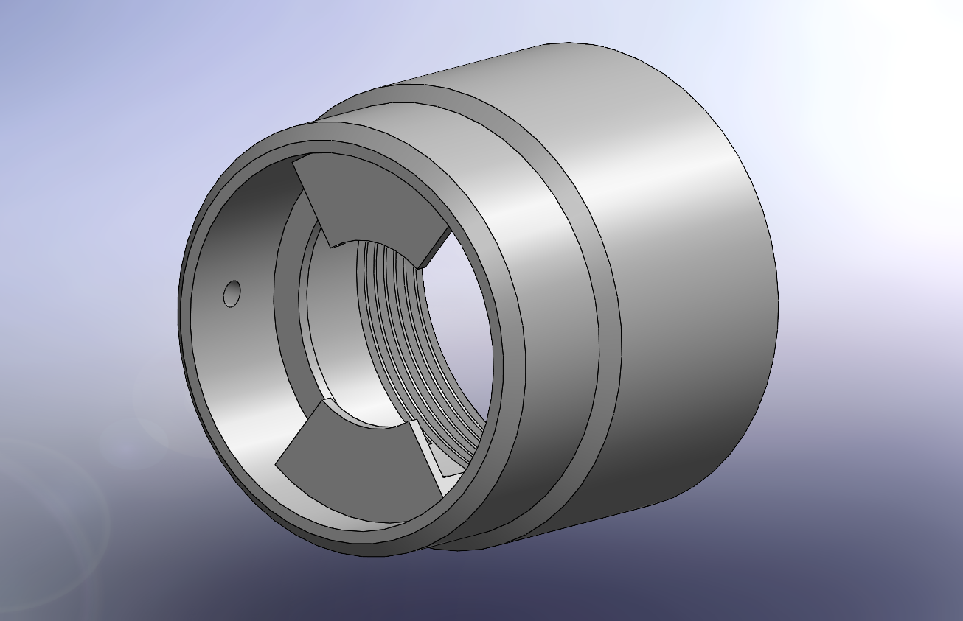
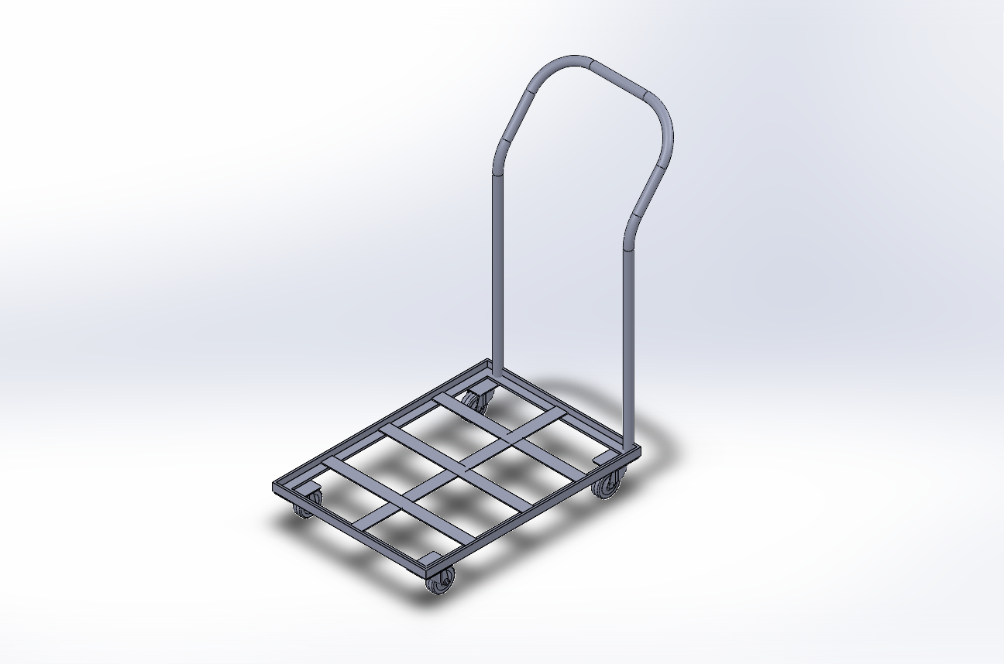
CAD Designs

Slide 12
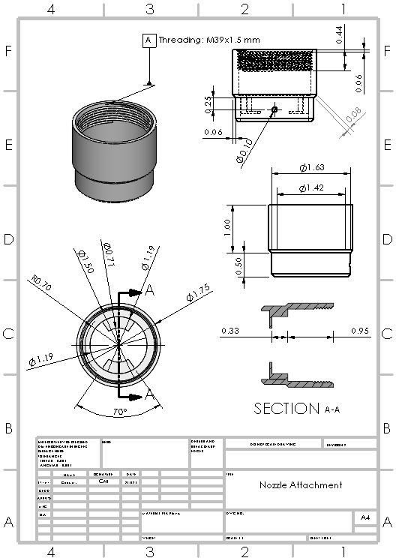
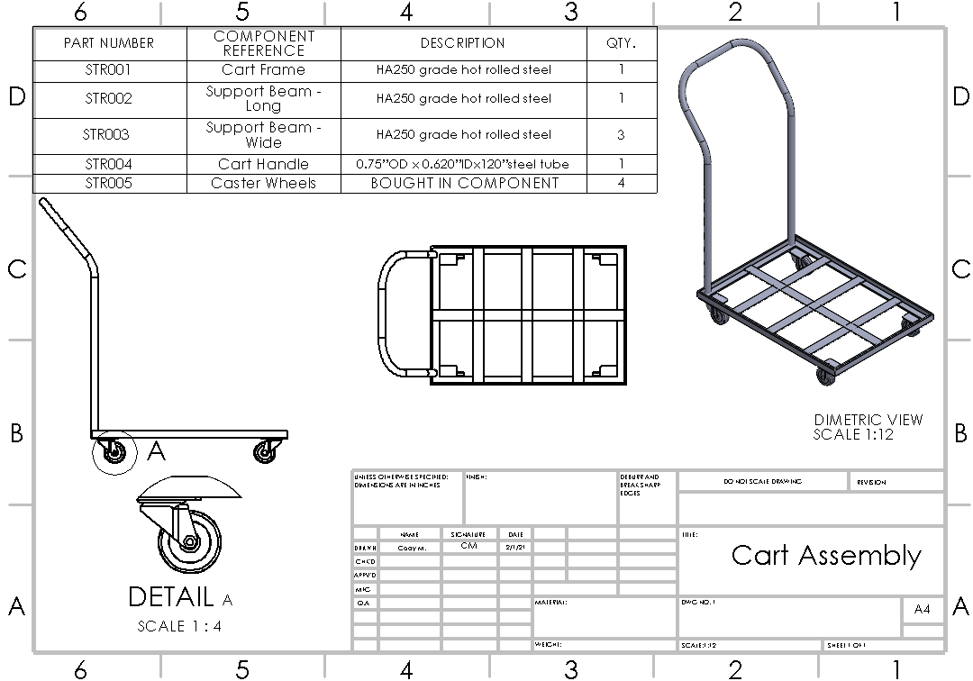
Detailed Drawings

Slide 13
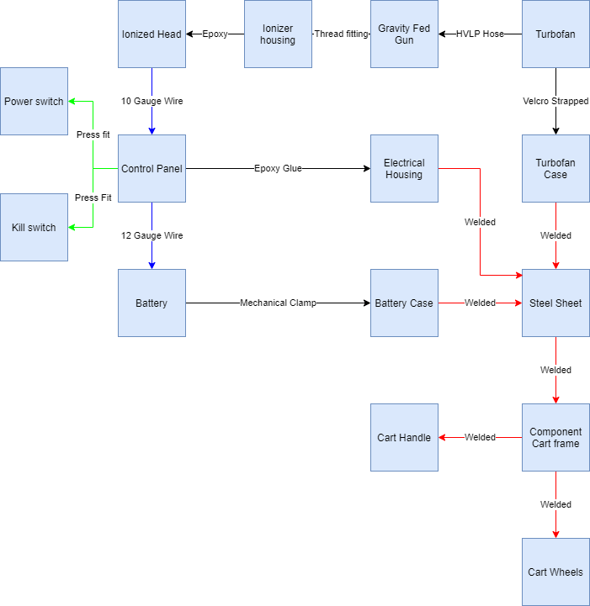

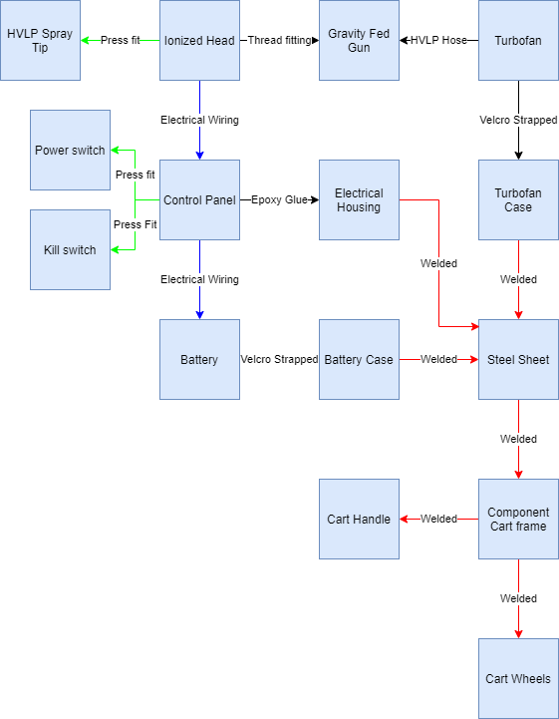
Mechanical Interfaces

Slide 14
Manufacturing Plan
Part ID # | Name | Part Connections | Manufacture process | Material Stock | Purchasing Source
STR001 | Cart Frame | STR002 STR003 STR004 STR005 STR006 STR007 | In house steel fabrication | 1”x1”x6’ L plain hot rolled steel 24”x36”x22ga Cold rolled steel sheet metal | Lowes Lowes
STR002 | Support Beam Long | STR001 STR003 | In house steel fabrication | 1-½"x4’ plain hot rolled steel solid. | Lowes
STR003 | Support Beam Wide | STR001 STR002 | In house steel fabrication | 1-½"x4’ plain hot rolled steel solid. | Lowes
STR004 | Cart Handle | STR001 | In house Steel Fabrication | 0.75”ODx 0.620”IDx120”steel tube | Metals Depot
STR005 | Caster Wheels | STR001 | COTS Purchase |  | Lowes
STR006 | Electronics Housing/ battery mounting | STR001 | In house steel fabrication | 22ga cold rolled steel sheet metal. 3/8” Threaded Rod | Lowes Lowes
STR007 | Turbine Mounting | STR001 | COTS purchase |  | Amazon
STR008 | Nozzle Attachment |  | In-house 3-D printing | ABS printing filament | Amazon

Slide 15
Engineering Analyses
Quarter 1:
Cart Stress Analysis
Spray Cone Analysis
Compatibility Analysis
Material Research Analysis
Power Source Analysis
Quarter 2:
Spray Cone Analysis: revised for higher accuracy
Viscosity Atomization Analysis: ensures that HVLP sprayers will effectively atomize disinfectant
Compatibility Analysis: for other sprayer models

Slide 16
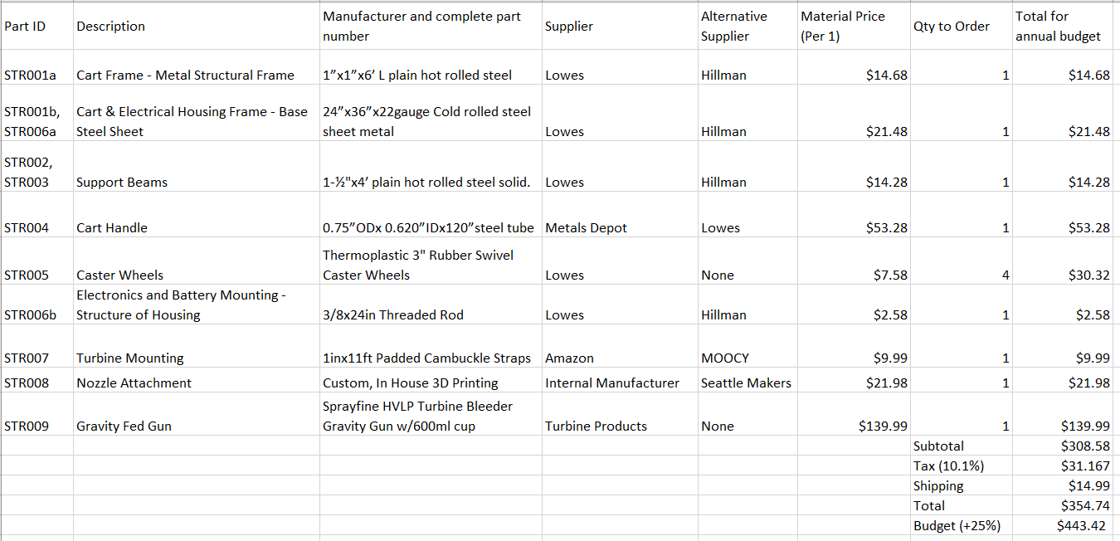
BOM Mechanical

Slide 17
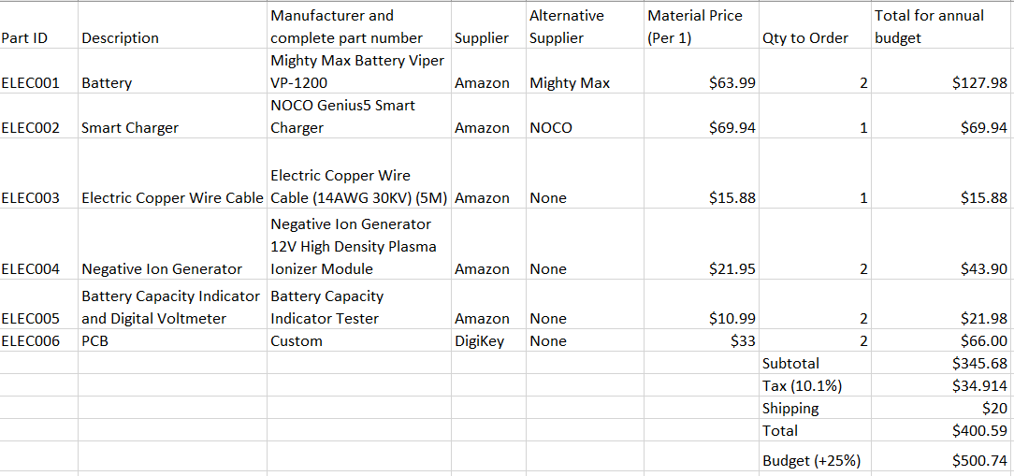
BOM Electrical

Slide 18
Questions?

