Slide 1
Echelon Technologies: Electrostatic Disinfectant Sprayer
The Team:
Mechanical: Nathan Wichser, Chelsea Bates, Cody McKinstry, Kenji Olund
Electrical: Joe Haj
Notes:
Kenji

Slide 2

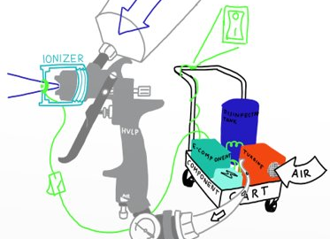
Original Project Demonstration Plan
Have a proof-of-concept prototype that will power on and is ready for testing to confirm our specifications.
This would include our component cart and electrical system being integrated together and able to be powered on but no testing for full functionality.
Notes:
Kenji

Slide 3
Component Cart & Nozzle Adapter
The component cart prototype has been completed
All mounting systems besides a fluid reservoir are also completed and attached to the cart
The portability size dimensions, and weight capacity of the cart have been met as specified
The nozzle adapter has been tested for adaptability but is waiting final printing
Notes:
Nathan

Slide 4
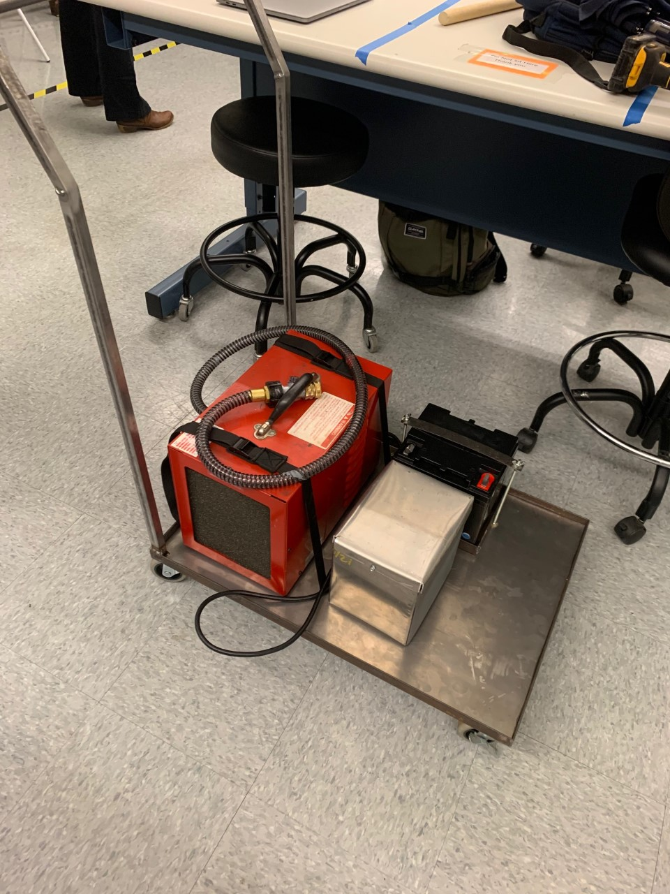
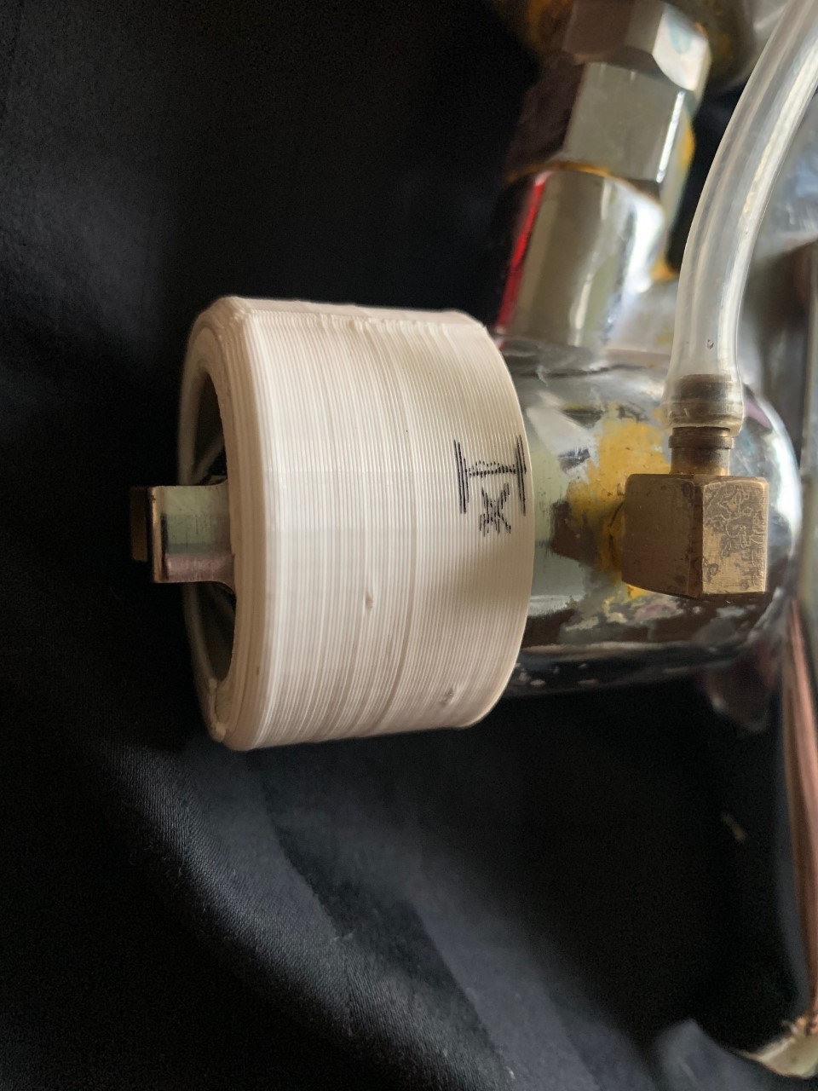
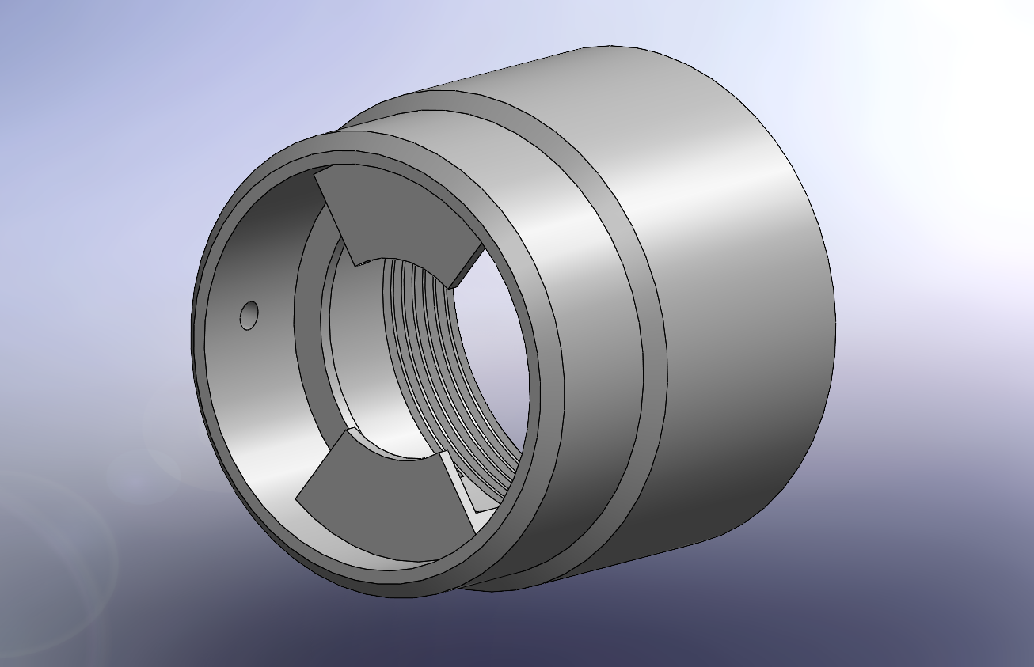
Component cart/nozzle adapter
Notes:
Nathan

Slide 5
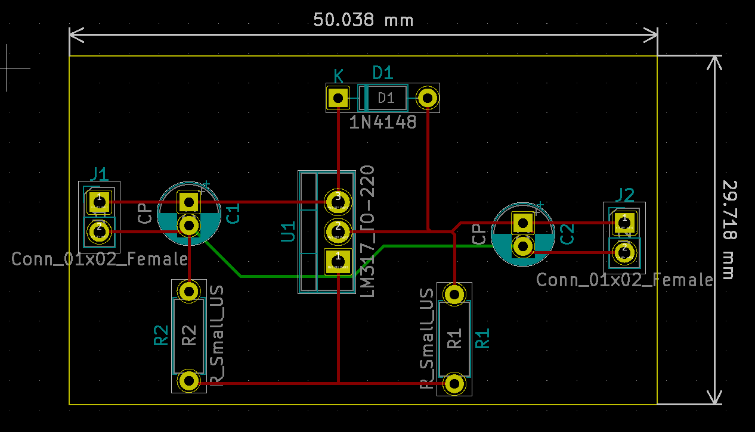
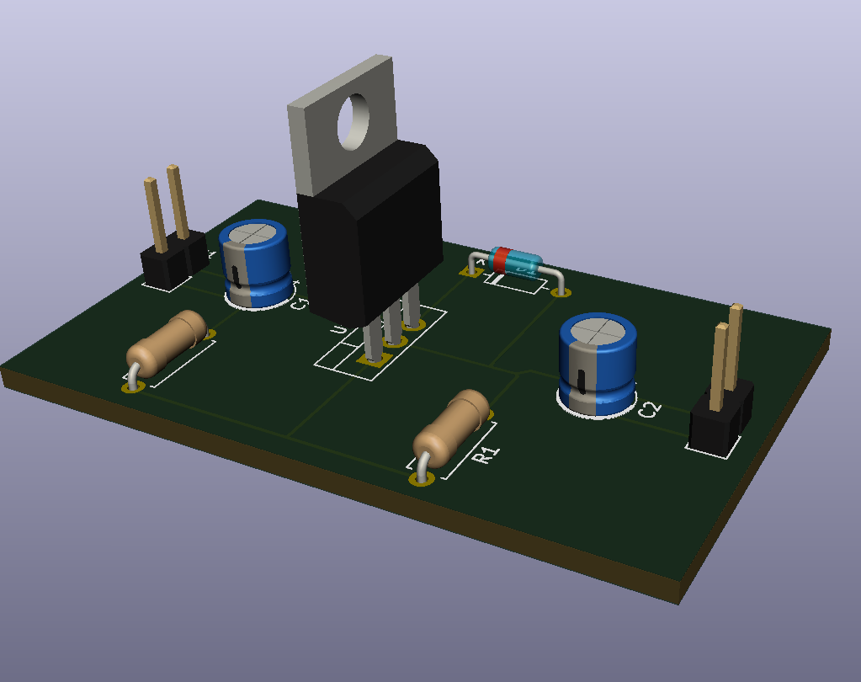
Ionizer System
Voltage Regulation PCB laid out and printed.
Soldered and ready for additional testing over spring break.
Notes:
Joe

Slide 6
Mechanical Specifications
Specification Number | Specification | Status | DR 2.2 Justification | Plans To meet full specs
MS001 | Will finely atomize disinfectant to a VMD≥40 µm per EPA guidelines. | Fulfilled per HVLP manufactured specifications | Per EPA guidelines all sprayers must have a VMD≥40 µm , calculations have been made to adjust for the fluid density difference between paint and disinfectant/water. | Validated and met
MS002 | Shall be compatible with four different HVLP models. | Compatibility analysis and testing shows it to be compatible with different models. | Custom threading shows our mating system is compatible with 1 model of HVLP sprayers and similar models. | Need to compare the mating features to other sprayers and test it on different HVLP models.
MS003 | Shall fit through a 32” wide door with dimensions of 32”x50”x48” (WxHxL). | Current measured dimensions meet this | Allows system to fit through doorways, designed and built to specification. | Tested and met.
MS004 | A fully loaded component cart shall weigh less than 175 lbs. | Load analysis and weight test confirms but need to test with everything on it still. | Determined approximate weights of all components and cart itself to theoretically calculate weight. | Weigh fully loaded component cart with entire system in place.
MS005 | The fully loaded component cart shall pose no risk of tipping over when a weight of 30lbs is cantilevered 1.5 feet from the side of the cart. | Initial analysis shows that the cart should be very stable. | The component cart has been designed to have a high moment of inertia to resist tipping. | We will conduct both a mathematical analysis of tipping and a physical test.
Met and tested Met, untested, have confidence in Unmet, have confidence meeting Unmet, will not meet
Notes:
Chelsea

Slide 7
Mechanical Specifications (cont.)
Specification Number | Specification | Status | DR 2.2 Justification | Plans To meet full specs
MS006 | The system shall increase the surface area covered while using electrostatics by 20%. | Preliminary testing has started. Percent coverage of non-electrostatic shows radial coverage at 25%. | Testing and use of image processing software shows radial coverage in the ranges expected. | Testing and analysis of electrostatic coverage will begin after EDS is fully assembled.
MS007 | Production cost shall be ≤$1000. | Current BOM shows we’re meeting this. Don’t have final cost yet but we’re confident in meeting it. | Have all major components purchased with plenty of budget still available for miscellaneous purchases during testing. | Will maintain accurate BOM through spring quarter to ensure we do not exceed budget.
MS008 | Initial push force shall be less than 50lbs with a sustained push force of less than 40lbs. | Analysis says we should be fine but haven’t tested things yet. | Determined the forces acting on the cart and calculated the friction force on the wheels. | Will test and analysis the first week with a force gauge.
MS009 | Pull force shall allow 75% of workers to pull the cart and its contents. | Analysis says we should be fine but haven’t tested things yet. | Comparison of calculated mass in respect to UO’s ergonomic standards. | The first week we will measure the mass and pull/push force with a force gauge.
MS010 | Disinfectant and Water storage shall contain 1 gallon of fluid. | No physical reservoir obtained, or testing completed. | Have designated space on component cart for reservoir. | Will order or design reservoir that is compatible with available space on component cart.
Met and tested Met, untested, have confidence in Unmet, have confidence meeting Unmet, will not meet
Notes:
Chelsea

Slide 8
Electrical Specifications
Specification Number | Specification | Status | DR 2.2 Justification | Plans To meet full specs
ES001 | The system will not pose any risk of injury via electrical shock to the user. | Electrical system is yet to be integrated. We haven’t been able to test yet. | Proper grounding of metal surfaces should be sufficient to prevent electrical shock from static charges that may build up while the ionizer is active, but further testing is still required. | Integrate system, ground sprayer, and then test surfaces for voltage with multimeter in series with a high RC constant circuit to keep get voltage reading.
ES002 | The sprayer shall run for 3 hours on full charge. | Most worrying electrical spec due to the high current draw of the sprayer. Analysis suggests that we will not reach even with the large battery. | Ongoing constraint to keep working on, not ready to drop quite yet though will confer with Professor Howe sometime over the break or first week to confirm my analysis is correct and ask if there are other methods to attain the spec time. | Unknown at this time, will continuing working on this portion over break.
ES003 | The component cart shall have a stop switch. | Bought and tested parts for operation. Haven’t integrated yet though. | We have the button purchased, it just hasn't been integrated yet, keeping it from being on the physical cart. Sticking this on the cart would be enough to make it green. | To meet this spec, we need to integrate the electrical components into our system.
Met and tested Met, untested, have confidence in Unmet, have confidence meeting Unmet, will not meet
Notes:
Joe

Slide 9
Analysis Status
Finished/Unchanged
Material Research Analysis:
  Verified and met material requirements
Spray Cone Analysis:
  Determined size/position of electrodes
Cart Stress Analysis:
  Calculated maximum load on component cart
Cart Dimension Analysis:
  Designed/built cart to dimensions specified for portability
In-progress
Compatibility Analysis:
  Threading dimensions tested for 1 HVLP sprayer model
Spray Coverage Analysis:
  Radial coverage of non-charged spray at 25%
Push/Pull Analysis:
  Force is projected to be less than maximum allowed force
Battery Life:
  14-19 minutes.
Notes:
Cody

Slide 10
Schedule - Mechanical
Scheduled Date | Deliverable(s)
Spring Break | Electrode design/purchase, purchase liquid sensitive paper
Week 1 | Print updated Nozzle Attachment, Push/Pull analysis, Electrical Integration: Electronics cart layout
Week 2 | Tipping Test, No Charge Coverage Testing, Electrical Integration: Wire cart electronics layout
Week 3 | Electrical Integration: PCB (If reorder not necessary) + Ionizer System, Charge Coverage Testing
Week 4 | Coverage Analysis
Week 5 | Compatibility Refinement
Week 6-7 | TBD
Notes:
Cody

Slide 11
Schedule - Electrical
Scheduled Date | Deliverable(s)
Spring Break | Confer with mechanical engineers on electrode, test PCB, reorder if necessary, and confer with Professor Howe on cart Power System.
Week 1 | Finalize Cart Power System, test electrode and Mechanical Integration: work on cart electronic layout.
Week 2 | Mechanical Integration: Wire cart electronics layout
Week 3 | Mechanical Integration: PCB (if not reorder necessary) + Ionizer System
Week 4 | Test Specs, and (If necessary) Resolder PCB then Integrate PCB
Week 5-7 | Buffer
Notes:
Joe

Slide 12
Thank You
Questions?
Notes:
Everyone

