Slide 1
Echelon Technologies:
Electrostatic Disinfectant Sprayer
Team: Cody McKinstry, Chelsea Bates, Kenji Olund, Suliman Buzakouk, Nathan Wichser

Slide 2

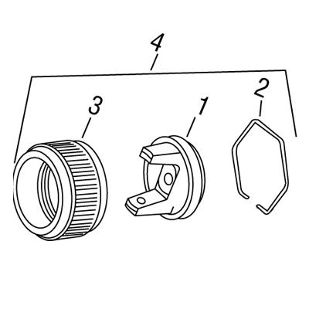
Electrostatic Disinfectant Sprayer
Echelon Engineers: Nathan Wichser (ME), Chelsea Bates (ME), Kenji Olund (ME), Cody
McKinstry (ME), Suliman Buzakouk (EE)
Objective:
To design a cheaper and more readily available Electrostatic Disinfectant sprayer.
Current market shortages of EDS systems due to high demand from the current Pandemic.
Current market competitors value their products from $600 for a handheld system to $5,000 for a large capacity rolling system.
Concept:
The EDS is a sprayer that will positively charge water-soluble disinfectant fluids to "cling" on to surfaces. Reducing waste and making the solution cover a more complete surface area.
Approach:
Creating a user modification to existing paint sprayers:
Electrostatic nozzle attachment for an existing commercially available sprayer.
Mobile utility cart to power the sprayer
Analyses and RRP:
Analyses
•Fluid particle charge analysis
•Focus group for portability
•Visual coverage test
•Compare to dimensions of paint sprayers on the market to ensure compatibility
RRP
Mechanical: Adapter that fits to existing paint sprayers.
Electrical: Electrodes configuration and properly charging the disinfectant.

Slide 3
Research and Problem Space
$18.9 billion market, estimated $27.99 billion by 2026
Increase in sanitization standards
Businesses need application systems
Advantages of EDS systems
Current system prices range from $600-$5,000
Why an adaption system?

Slide 4
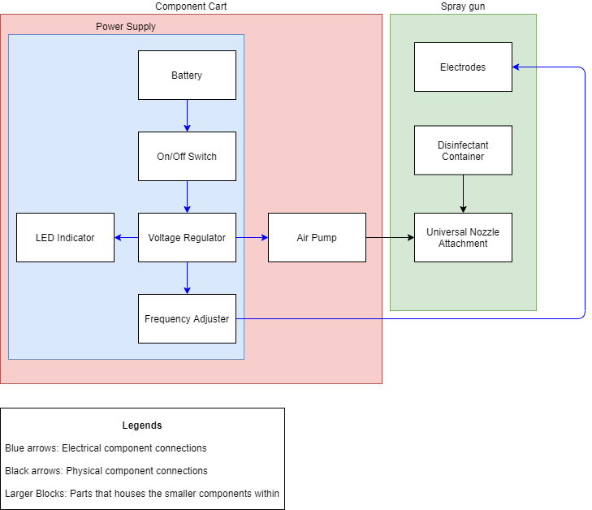
Block Diagram

Slide 5
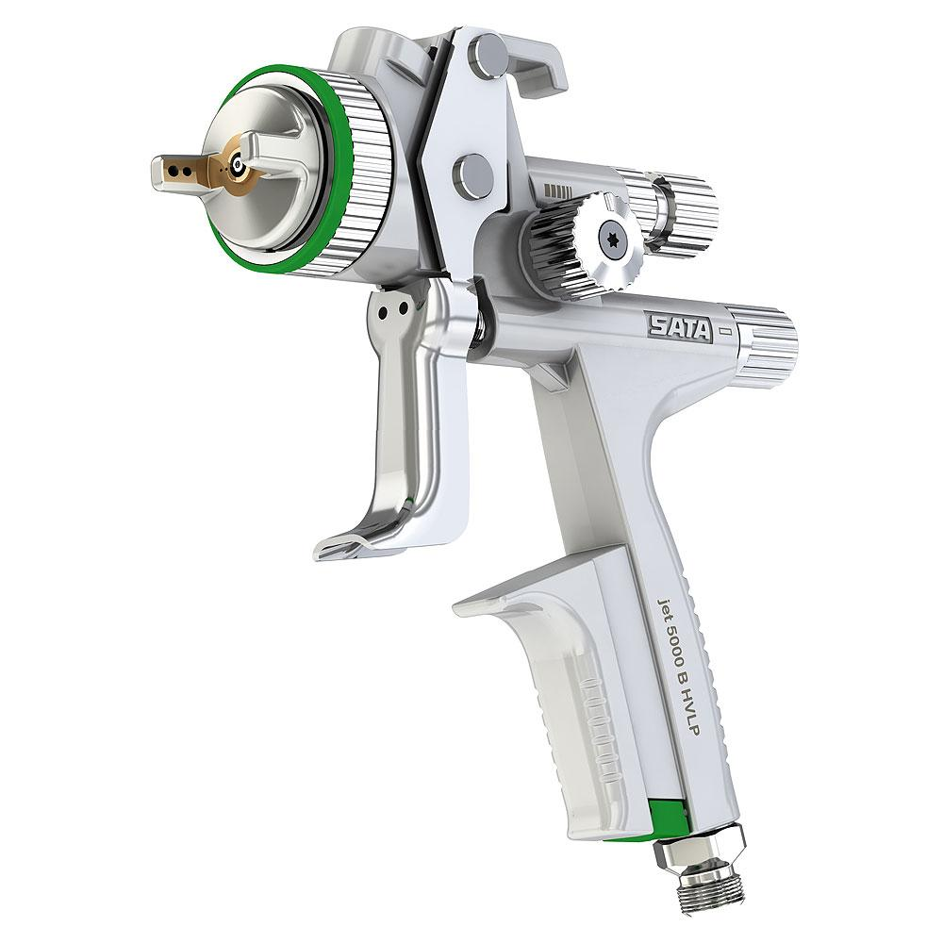
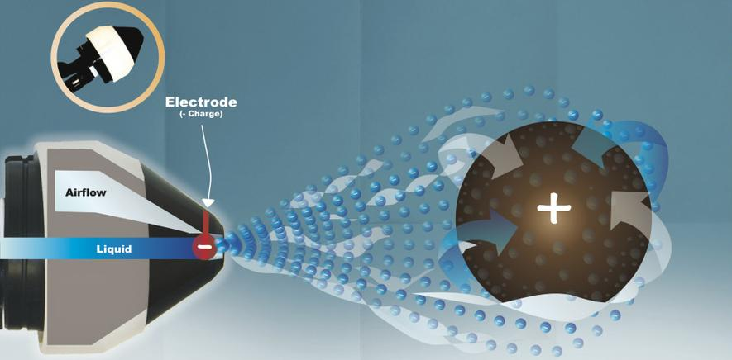
Critical Path
Ability to charge disinfectant
Adapting to wide variety of sprayers

Slide 6
Q1 Specifications
Spec ID | Requirement | Threshold (Shall) | Objective (Should) | Validation Method | Why this threshold value | Relates to critical feature(s)
RRP001 | Disinfectant application | N/A | Finely atomize disinfectant to a VMD≥40 µm per EPA guidelines. | Value specified by sprayer manufacturer. | Demonstrates functionality of sprayer system | 1
RRP002 | Functioning electrical system | Apply an appropriate positive charge to the disinfectant | N/A | Charge analysis on fluid particles | Demonstrates the electrical systems ability to charge the disinfectant for proper adhesion | 2
RRP003 | Components readily available to the consumer | Adapt to 50% of paint spraying systems on the market | Adapt to 85% of paint sprayers on the market | Research dimensions of various sprayers on the market | Must be available to people to combat the shortage of existing EDS systems | 1,3
RRP004 | Cart width and height limits | The cart shall be no wider than 35 in. And no taller than 80 in. | The cart should be no wider than 33 in and be no taller than 60 in. | Direct recording with a tape measure | Cart needs to fit through doorways to fulfill its purpose of disinfecting interiors and being able to see beyond the cart itself increases customer utility. | 3

Slide 7
Q1 Specifications: continued
Spec ID | Requirement | Threshold (Shall) | Objective (Should) | Validation Method | Why this threshold value | Relates to critical feature(s)
RRP005 | Battery Power | Battery shall power up the system for 1 hour of use time. | Battery should power up the system for 2 hours of use time. | Current measurement | Needs to power the sprayer as well as charge the disinfectant. | 2
RRP006 | User interface | The system shall have an LED indicator for ON/OFF. | The system should have an LED indicator for ON/OFF and Battery status. | Observation | Must have a visual indicator for the status of the system. | 2
RRP007 | System will fit within custom attachment | The system shall fit within part specifications | The system shall not exceed specified dimensions | 3-D model part in SolidWorks | The custom part attached to front of paint sprayer must fit the subsystems inside without being too large | 3
RRP008 | Affordability | The system shall cost less than $1000 to produce | The system should cost less than $700 to produce | Compare total value of receipts to the specified cost | The total value should not exceed lower end values of similar products in the market as well as be within the budget given to us. | 3

Slide 8
Engineering Analyses
Fluid particle charge analysis
Focus group for portability
Coverage Test
Compare to dimensions of paint sprayers on the market to ensure compatibility
Current Measurement

Slide 9
Schedule
Week | Mechanical | Electrical
5 | Preliminary CAD designs Research Market Compatibility | Research Electrodes and electrostatic charging
6 | Cart stress analysis Load calculations Finalize CAD designs | Make a list of electrical components needed Calculate power consumption and battery size
7 | Research materials for cart and nozzle attachments Order materials | Order electrical components Assemble and test parts
8 | Weld/assemble frame 3-D print/order Nozzle attachments | Assemble and test parts
9 | Test compatibility to sprayers Integrate with electronics | Integrate with Nozzle attachment
10 | Collect and present test data and results

Slide 10
Proposed Critical Path
Mechanical: Design and build an adapter that will fit most commercial HVLP spray guns and house the electrodes. Build a portable utility cart that will hold the electronics and air pump components.
CAD designed and 3-D printed based on research of common sprayers
Metal framed cart on wheels with appropriate room for most turbofan air pumps and interfaced electronics
Electrical: Design and build an electrical system to power up the air pump as well as the electrostatic charging system. Integrate a power button and LED indicators for the status of the system and the battery.

Slide 11
References
General water attraction principle:
https://www.physicscentral.com/experiment/physicsathome/sink.cfm#:~:text=Water%20molecules%20are%20polar%3B%20one,a%20negatively%20charged%20oxygen%20atom.&text=This%20electrostatic%20attraction%20is%20strong,stream%20by%20a%20noticeable%20amount.
5 Common Disinfectants:
https://www.pjponline.com/top-5-chemical-disinfectants-used-in-hospitals/#:~:text=Currently%2C%20there%20are%20five%20main,%2C%20Phenolics%2C%20and%20Peracetic%20Acid.
Analysis of the market demand for electrostatic sprayers (2019-2025):
https://www.prnewswire.com/news-releases/electrostatic-disinfectant-sprayer-market-size-to-reach-revenues-of-1-9-billion-by-2025--arizton-301120964.html
https://www.grandviewresearch.com/industry-analysis/antiseptics-and-disinfectants-market
Possible competitors:
UV Lamp markets are unreliable: https://www.discovermagazine.com/health/uv-light-wands-are-supposed-to-kill-viruses-but-do-they-really-work
FDA info on UV lamps: https://www.fda.gov/medical-devices/coronavirus-covid-19-and-medical-devices/uv-lights-and-lamps-ultraviolet-c-radiation-disinfection-and-coronavirus
Electrostatic charging:
https://iopscience.iop.org/article/10.1088/1742-6596/1322/1/012032
https://www.processoperations.com/Electrostatic/ES_Chp02d.htm
https://www.physicsclassroom.com/class/estatics/Lesson-2/Charging-by-Induction
https://www.researchgate.net/publication/286975453_Characterization_of_spray_liquids_for_electrostatic_charging

Slide 12
Questions?

