Slide 1
Echelon Technologies:
Electrostatic Disinfectant Sprayer
Design Review 1.2
Team: Cody McKinstry, Chelsea Bates, Kenji Olund, Suliman Buzakouk, Nathan Wichser
Notes:
Chelsea

Slide 2

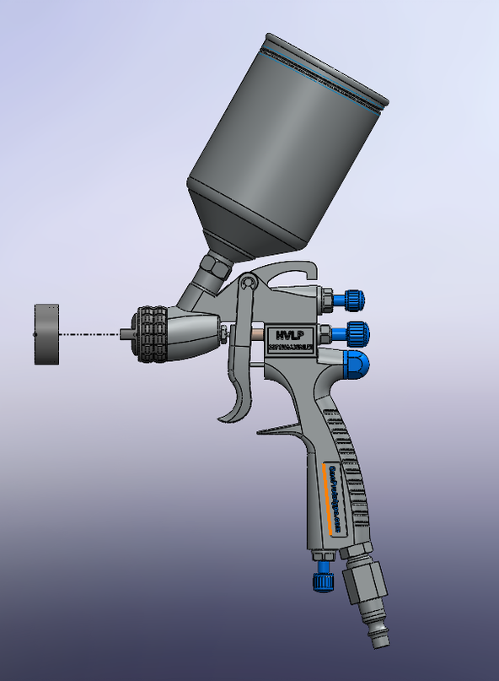
Electrostatic Disinfectant Sprayer
Echelon Engineers: Nathan Wichser (ME), Chelsea Bates (ME), Kenji Olund (ME), Cody
McKinstry (ME), Suliman Buzakouk (EE)
Objective:
To design a cheaper and more readily available Electrostatic Disinfectant sprayer.
Current market shortages of EDS systems due to high demand from the current Pandemic.
Current market competitors value their products from $600 for a handheld system to $5,000 for a large capacity rolling system.
Concept:
The EDS is a sprayer that will positively charge water-soluble disinfectant fluids to "cling" on to surfaces. Reducing waste and making the solution cover a more complete surface area.
Approach:
Creating a user modification to existing paint sprayers:
Electrostatic nozzle attachment for an existing commercially available sprayer.
Mobile utility cart to power the sprayer
Projected Schedule and Budget:
Schedule:
February - DR2.1: Subsystem Demonstration
March - DR2.2: Prototype Demonstration
May – DR3.1: Revised Prototype Demo and Test Results
June – Final Product Demonstration
Estimated Development Cost:
•Materials: $700
•Labor: 1050 person-hours at $18/hour: $18,900
Notes:
Chelsea

Slide 3
Proposed Critical Path
Mechanical: Design and build an adapter that will fit most commercial HVLP spray guns and house the electrodes. Build a portable utility cart that will hold the electronics and air pump components.
CAD designed and 3-D printed based on research of common sprayers
Metal framed cart on wheels with appropriate room for most turbofan air pumps and interfaced electronics
Electrical: Design and build an electrical system to power up the air pump as well as the electrostatic charging system. Integrate a power button and LED indicators for the status of the system and the battery.
Notes:
Chelsea

Slide 4
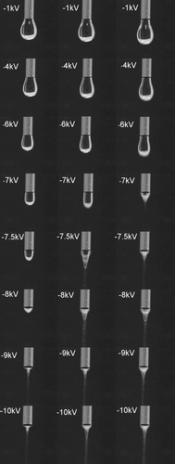
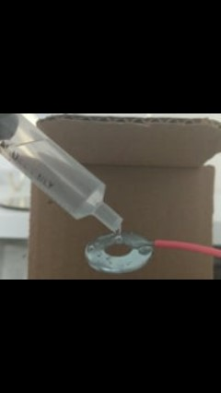
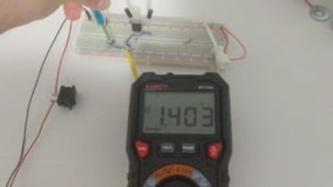
RRP Specification Demonstration
ID | Threshold | Objective | Observed
RRP001: Disinfectant application | N/A | Finely atomize disinfectant to a VMD≥40 µm per EPA guidelines. | 76.2µm-152.4µm
RRP002: Functioning electrical system | Apply an appropriate positive charge to the disinfectant | N/A | A positive Voltage charge
Notes:
Suliman

Slide 5
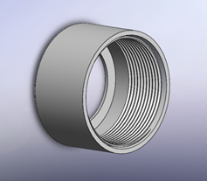
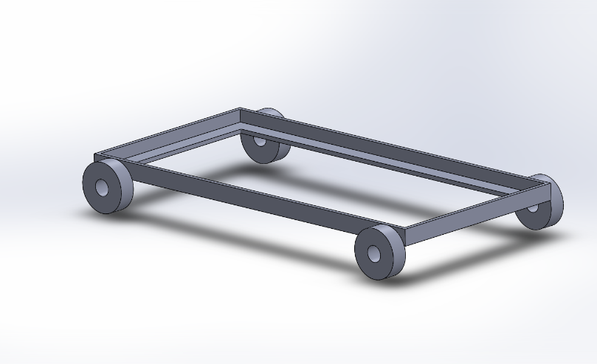
RRP Specification Demonstration
ID | Threshold | Objective | Observed
RRP003: Components readily available to the consumer | Adapt to 50% of paint spraying systems on the market | Adapt to 85% of paint sprayers on the market | Unknown, switched to HVLP sprayers
RRP004: Cart width and height limits | The cart shall be no wider than 35 in. And no taller than 80 in. | The cart should be no wider than 33 in and be no taller than 60 in. | 28 in. long by 20 in. wide
Notes:
Cody

Slide 6
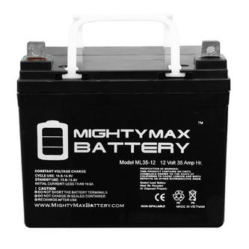
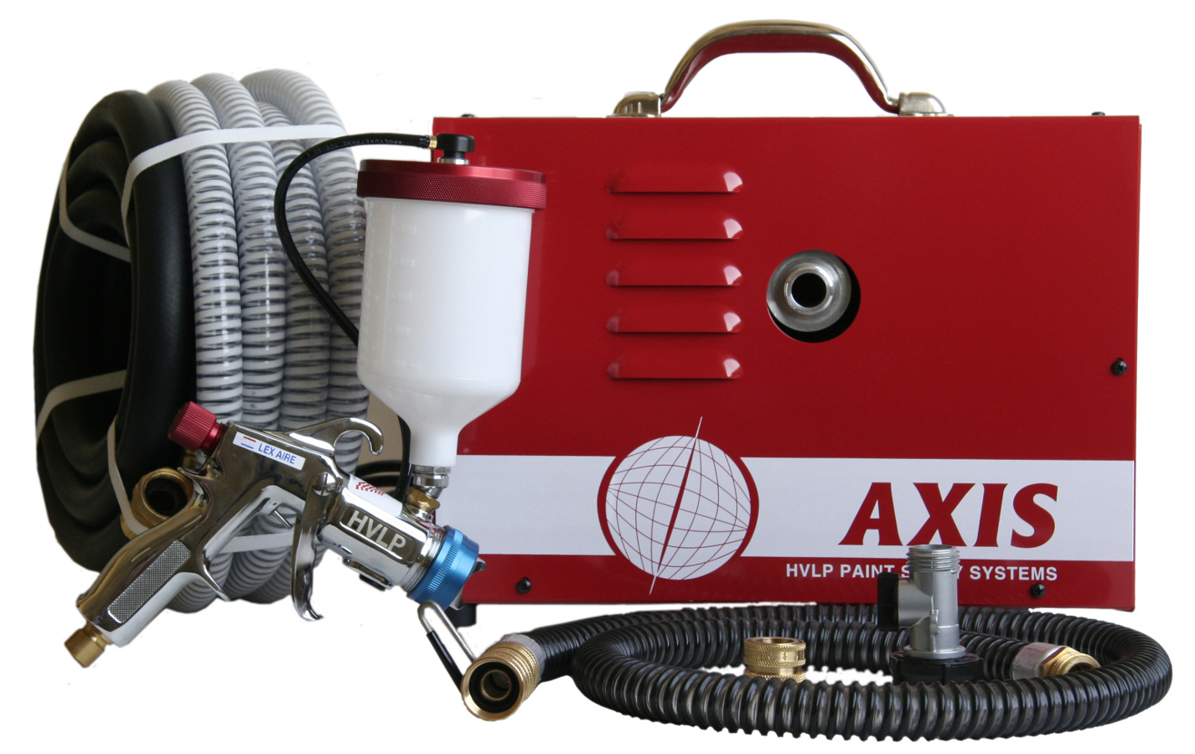
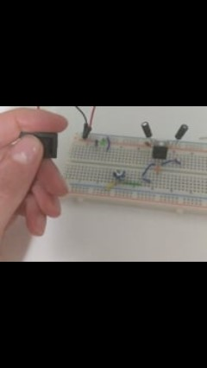
RRP Specification Demonstration
ID ​ | Threshold ​ | Objective​ | Observed
RRP005: Battery Power​ | Battery shall power up the system for 1 hour of use time | Battery should power up the system for 2 hours of use time. | Unknown
RRP006: User interface​ | The system shall have an LED indicator for ON/OFF. | The system should have an LED indicator for ON/OFF and Battery status. | Visual Verification of LED indicator
Notes:
Kenji

Slide 7
RRP Specification Demonstration
ID | Threshold | Objective | Observed
RRP007: System will fit within custom attachment | The system shall fit within part specifications | The system shall not exceed specified dimensions | Part of system was allocated to the cart
RRP008: Affordability | The system shall cost less than $1000 to produce | The system should cost less than $700 to produce | $288.40-$352.39
Notes:
Chelsea

Slide 8
Critical Design Specifications
ID | Threshold | Objective | Verification | Met?
RRP001: Disinfectant application | N/A | Finely atomize disinfectant to a VMD≥40 µm per EPA guidelines. | Value specified by sprayer manufacturer | Yes
RRP002: Functioning electrical system | Apply an appropriate positive charge to the disinfectant | N/A | Charge Analysis on fluid particles | Yes
RRP003: Components readily available to the consumer | Adapt to 50% of paint spraying systems on the market | Adapt to 85% of paint sprayers on the market | Research dimensions of various sprayers on the market | Unknown
RRP004: Cart width and height limits | The cart shall be no wider than 35 in. And no taller than 80 in. | The cart should be no wider than 33 in and be no taller than 60 in. | Tape measure | Yes
Notes:
Nathan

Slide 9
Critical Design Specifications
ID | Threshold | Objective | Verification | Met?
RRP005: Battery Power​ | Battery shall power up the system for 1 hour of use time | Battery should power up the system for 2 hours of use time. | Current measurement | Unknown
RRP006: User interface​ | The system shall have an LED indicator for ON/OFF. | The system should have an LED indicator for ON/OFF and Battery status. | Visual | Yes
RRP007: System will fit within custom attachment | The system shall fit within part specifications | The system shall not exceed specified dimensions | 3-D model part in SolidWorks | Unknown
RRP008: Affordability | The system shall cost less than $1000 to produce | The system should cost less than $700 to produce | Bill of Materials | Unknown
Notes:
Nathan

Slide 10
Engineering Analyses
Market Compatibility
Material Research
Spray Cone
Cart Stress
Electrostatic Generator Circuitry
Power Source Research
Notes:
Cody

Slide 11
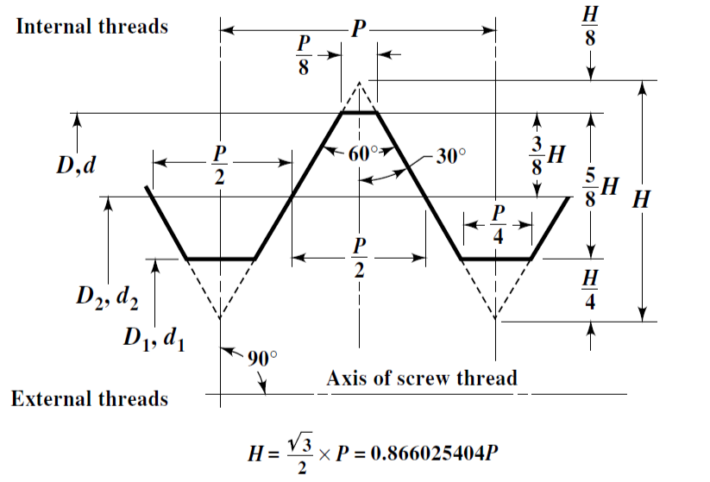
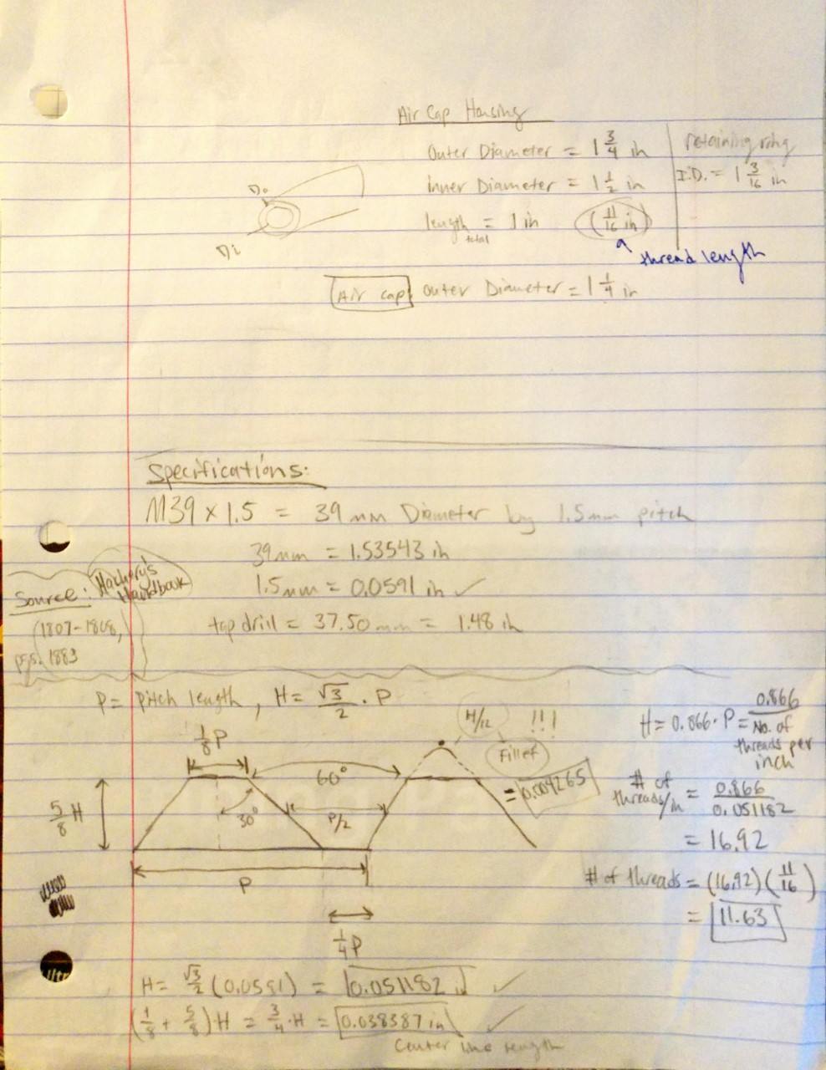
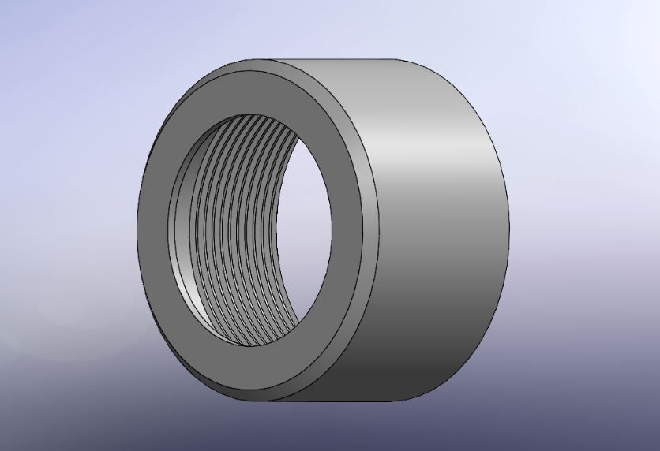
Market Compatibility Analysis
Determine whether our design can successfully mate with the HVPL sprayers on the market.
Determine standard threading of the paint spray’s air cap
Thread Spacing Calculations
SolidWorks modeling of the attachment
Notes:
Cody

Slide 12
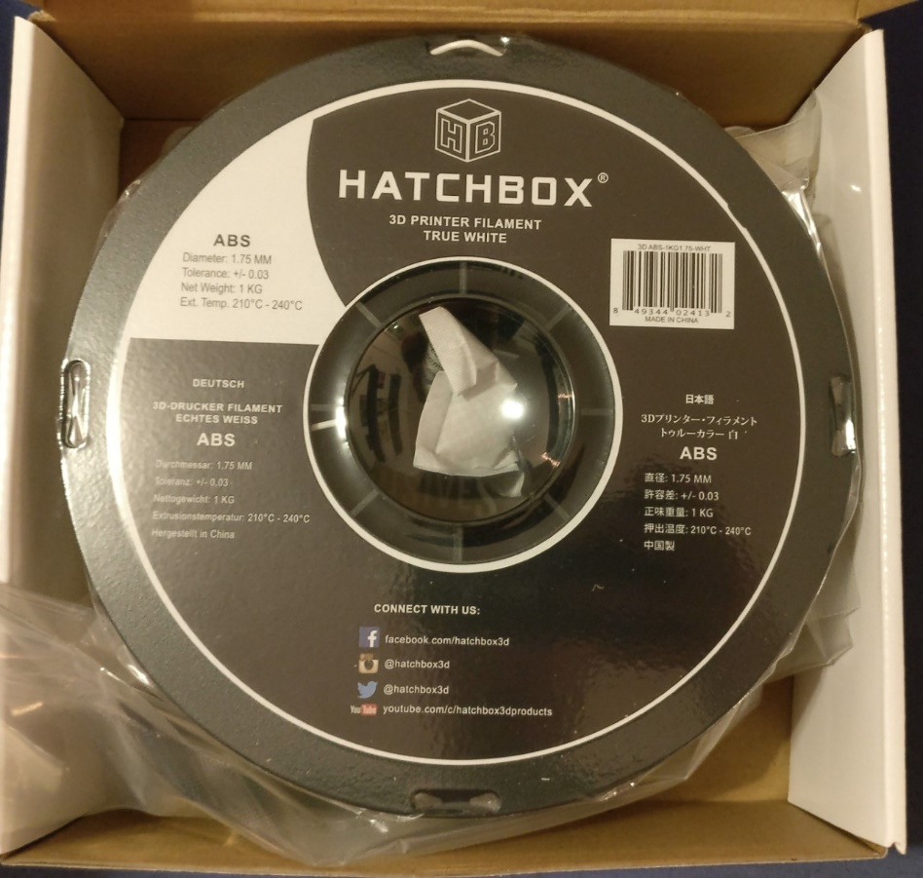
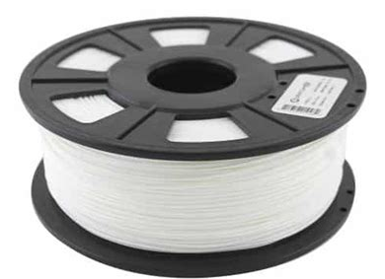
Material Research and Analysis
The Paint Spray Attachment houses high voltage components within and needs to be of a durable and non-conductive material to protect the users of this product.
ABS
PLA
Vs.
Notes:
Cody

Slide 13
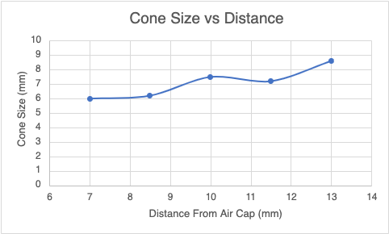
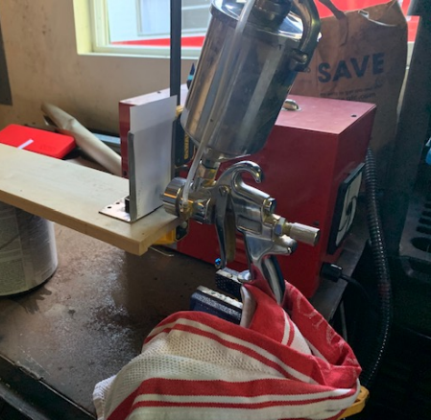
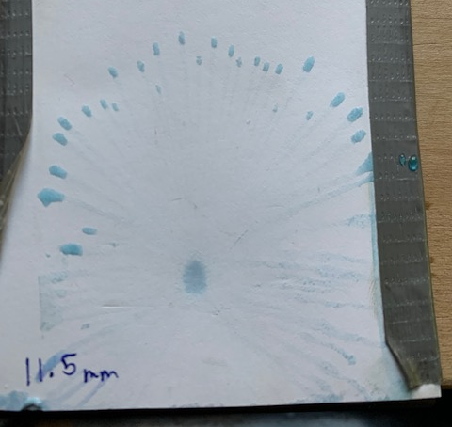
Spray Cone Analysis
Another factor in the elevated voltage within the electrodes are the spacing between the two plates, the smaller the spacing, the lower the voltage, lowering risks to the user and increasing the battery life as the electrodes consume less power as a result.
Test setup
Resulting Spray Cone
Notes:
Nathan

Slide 14
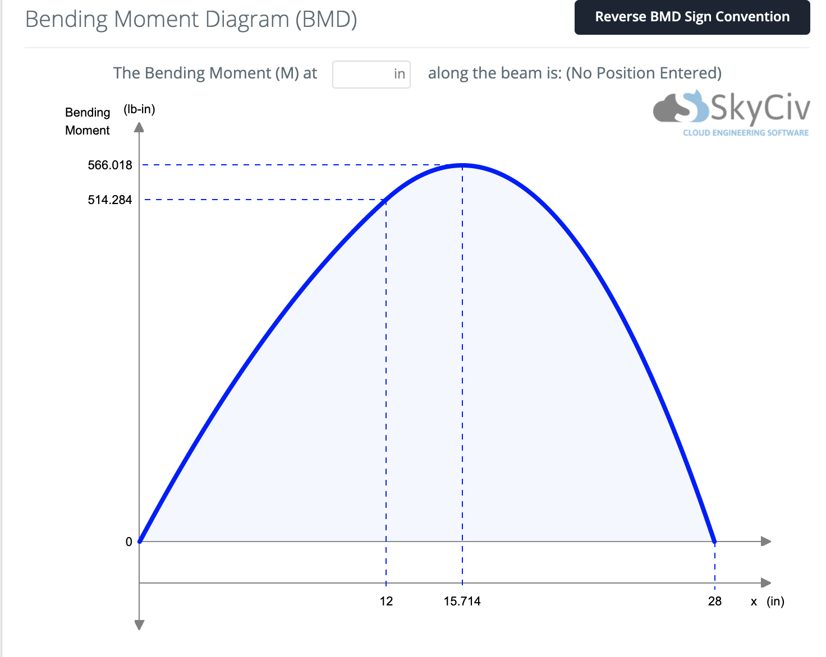
Cart Stress Analysis
To determine if the chosen materials would be sufficient to support the estimated loads on our cart with the current design parameter
Notes:
Nathan

Slide 15
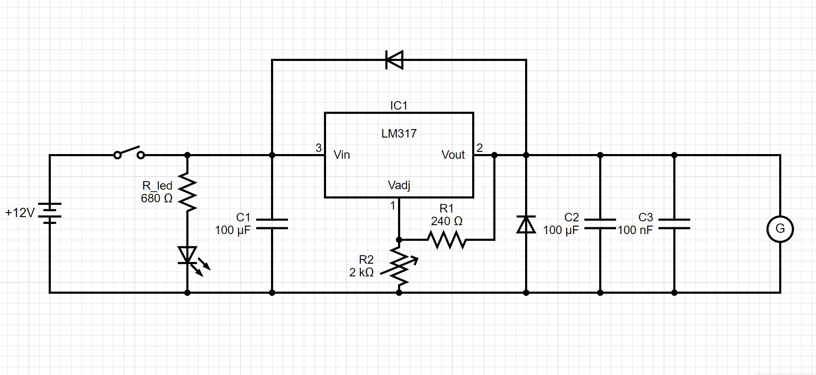
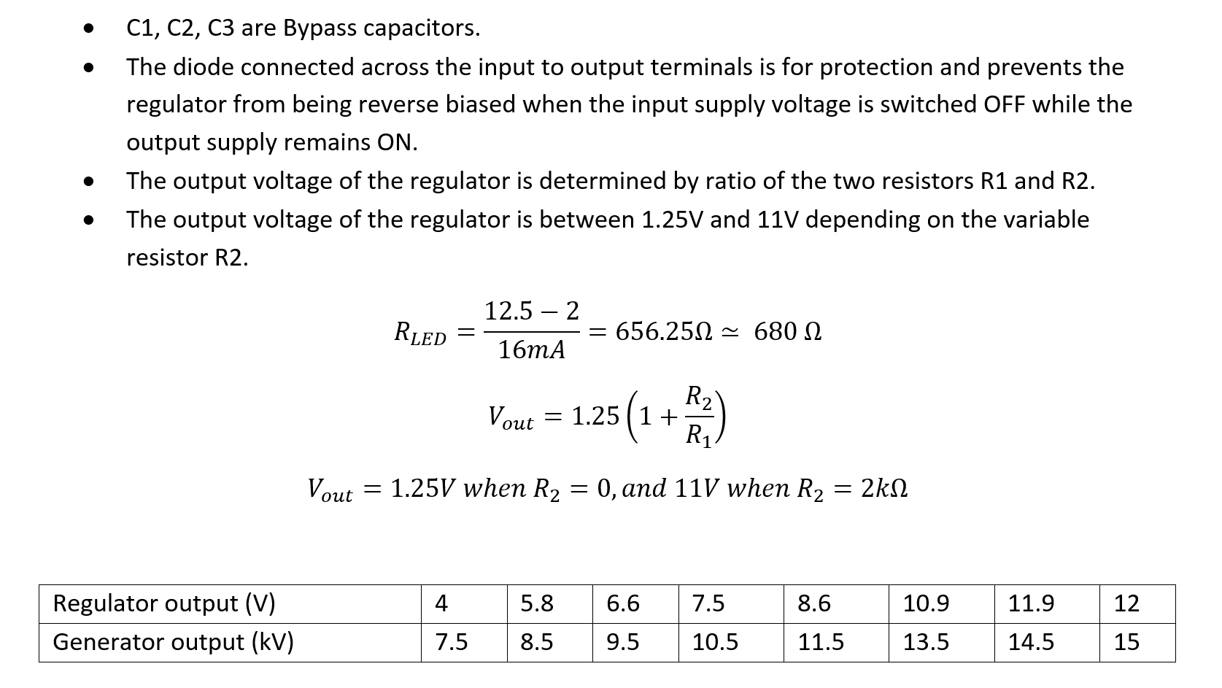
Electrostatic Generator Circuit Analysis
Notes:
Suliman

Slide 16
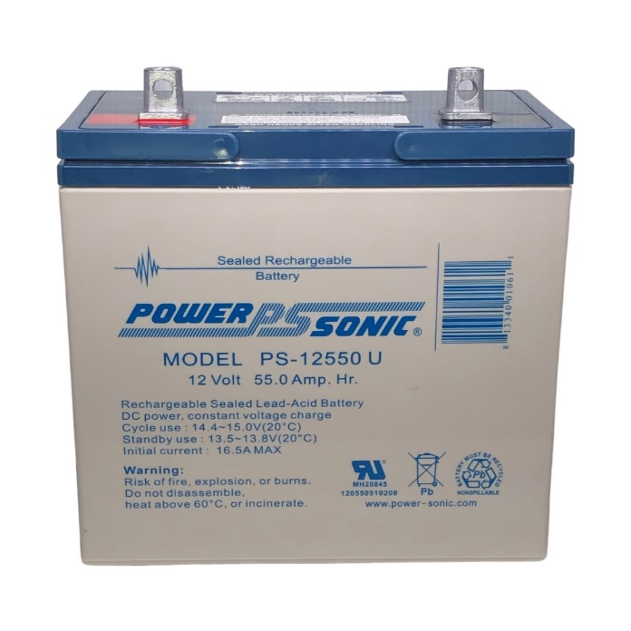
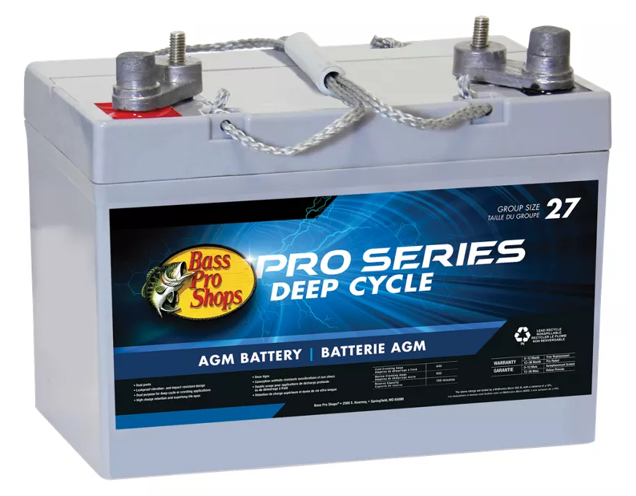
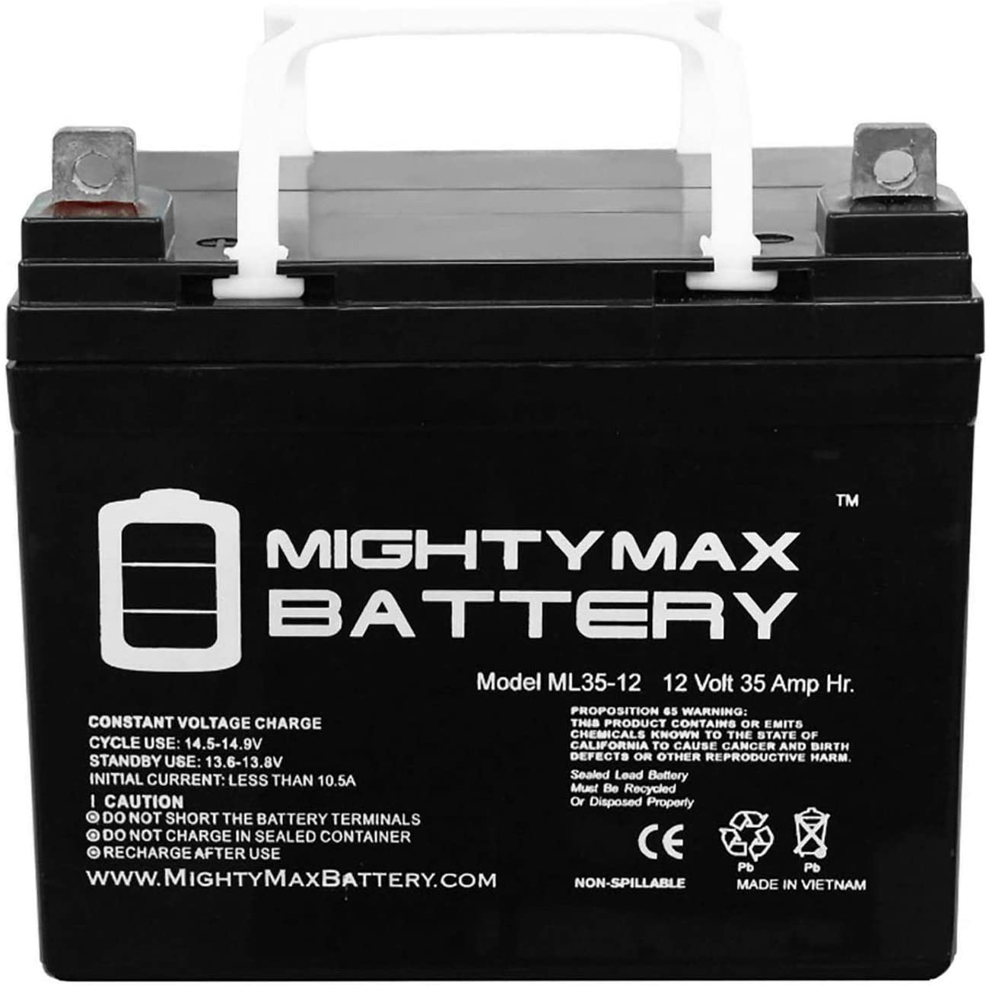
Power Source Research and Analysis
BATTERY​ | PRICE​ | AMP HOURS​ | RESERVE CAPACITY​ | VOLTAGE​ | WEIGHT​ | DIMENSIONSL X W X H​
Power Sonic PS-12550U​ | $152 ​ | 55 Ah​ | ~ 132 minutes*​ | 12 V​ | 36lb​ | 9.04" x 5.45" x 8.98"​
Bass Pro Shops Pro Series Deep-Cycle AGMMarine Battery​ | $179.99 ​ | ~50Ah*​ | 120 minutes​ | 12 V​ | 40lb​ | at or below 10.87” x 6.75” x 8.75”​
Mighty Max Battery ML35-12​ | $63.99 ​ | 35 Ah​ | `~ 84 minutes*​ | 12 V​ | 23.15lb​ | 7.68” x 5.16” x 7.13"​
Notes:
Kenji Present

Slide 17
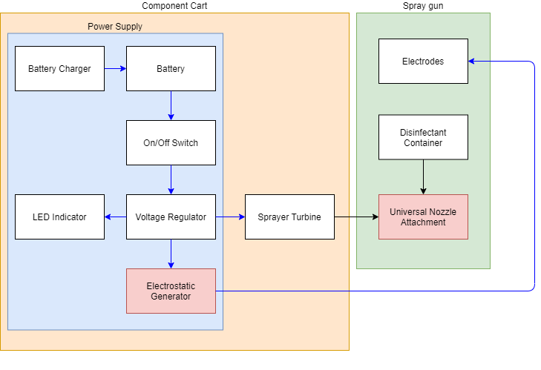
System Block Diagram
Legends
Blue Arrows: Electrical Component Connections
Black Arrows: Physical Component Connections
Larger Blocks: Parts that Houses the Smaller Components Within
Blocks Filled in with Red: Critical Paths
Notes:
Kenji Presents

Slide 18
Winter Break Schedule
Week | Optimistic Schedule | Special Events
1: Nov 29-Dec 5 | Order the parts Work on team website Test out the printed spray attachment | Thanksgiving week Black Friday week
2: Dec 6-12 | Ordered parts should arrive Cart assembly started
3: Dec 13-19 | Website framework completed or mostly worked through
4: Dec 20-26 | Mental Health Break | Christmas week
5: Dec 27-Jan 3 | Cart assembled Electrical components ready to integrate within the cart Finish our Christmas Thank You Notes
Winter Quarter week 1 | Sprayer attachment refinement and website completed
Notes:
Kenji presents, just go over stuff we want to have done

Slide 19
Bill of Materials
Product | Quantity | Price | Reference Link
Battery | 1 to 2 | $63.99 | https://www.amazon.com/dp/B00K8E4LR6
1x1x6' Plain Hot Rolled Steel Solid Angle | 4 | 14.68 | https://www.lowes.com/pd/Hillman-1-in-W-x-1-in-H-x-6-ft-L-Plain-Hot-Rolled-Steel-Solid-Angle/3059249
Thermoplastic Rubber Swivel Caster | 4 | $8.98 | https://www.lowes.com/pd/TITAN-3-in-Rubber-Swivel-Caster/1000596097
HATCHBOX ABS 3D Printer Filament | 1 | $22 | https://www.amazon.com/HATCHBOX-3D-Filament-Dimensional-Accuracy/dp/B00J0H6NNM/
NOCO Genius5 smart charger | 1 | $69.94 | https://www.amazon.com/NOCO-GENIUS5-Fully-Automatic-Temperature-Compensation/dp/B07W8KJH44
Electric Copper Wire Cable (14AWG 30KV) (5M) | 1 | $15.88 | https://www.amazon.com/gp/product/B07CJMGL3F/ref=ppx_yo_dt_b_asin_title_o07_s00?ie=UTF8&psc=1
Negative Ion Generator 12V | 1 | $21.95 | https://www.amazon.com/gp/product/B01GXK9CHW/ref=ppx_od_dt_b_asin_title_s00?ie=UTF8&psc=1
Notes:
Kenji throwaway line and moves on

Slide 20
References
General water attraction principle:
https://www.physicscentral.com/experiment/physicsathome/sink.cfm#:~:text=Water%20molecules%20are%20polar%3B%20one,a%20negatively%20charged%20oxygen%20atom.&text=This%20electrostatic%20attraction%20is%20strong,stream%20by%20a%20noticeable%20amount.
5 Common Disinfectants:
https://www.pjponline.com/top-5-chemical-disinfectants-used-in-hospitals/#:~:text=Currently%2C%20there%20are%20five%20main,%2C%20Phenolics%2C%20and%20Peracetic%20Acid.
Analysis of the market demand for electrostatic sprayers (2019-2025):
https://www.prnewswire.com/news-releases/electrostatic-disinfectant-sprayer-market-size-to-reach-revenues-of-1-9-billion-by-2025--arizton-301120964.html
https://www.grandviewresearch.com/industry-analysis/antiseptics-and-disinfectants-market
Possible competitors:
UV Lamp markets are unreliable: https://www.discovermagazine.com/health/uv-light-wands-are-supposed-to-kill-viruses-but-do-they-really-work
FDA info on UV lamps: https://www.fda.gov/medical-devices/coronavirus-covid-19-and-medical-devices/uv-lights-and-lamps-ultraviolet-c-radiation-disinfection-and-coronavirus
Electrostatic charging:
https://iopscience.iop.org/article/10.1088/1742-6596/1322/1/012032
https://www.processoperations.com/Electrostatic/ES_Chp02d.htm
https://www.physicsclassroom.com/class/estatics/Lesson-2/Charging-by-Induction
https://www.researchgate.net/publication/286975453_Characterization_of_spray_liquids_for_electrostatic_charging

Slide 21
Questions?

