Slide 1
Assessment

Slide 2
Educational Technology & Media
We work with instructors by supporting technology and creating custom media for teaching and learning.
We provide how-to support, documentation, consultations, workshops, and pedagogical advice about online and blended learning.
We’re here to collaborate with instructors to develop the learning experiences you want to create with your students.

Slide 3
Notice of Intent to Record
This session will be recorded and made available to SPU employees who were unable to attend today. We will only record the training portion of this session. The Q & A portion at the end of the training will not be recorded.
If you do not wish to be visible in the recording, kindly turn off your web camera and mute your microphone now.
If you do not consent to be present in the recording session in any fashion, you may exit the session now.
This video session will be published on the ETM website for later viewing
Notes:
Source: https://spu.edu/administration/office-of-student-life/handbook/behavioral-community-expectations/university-policies

Slide 4

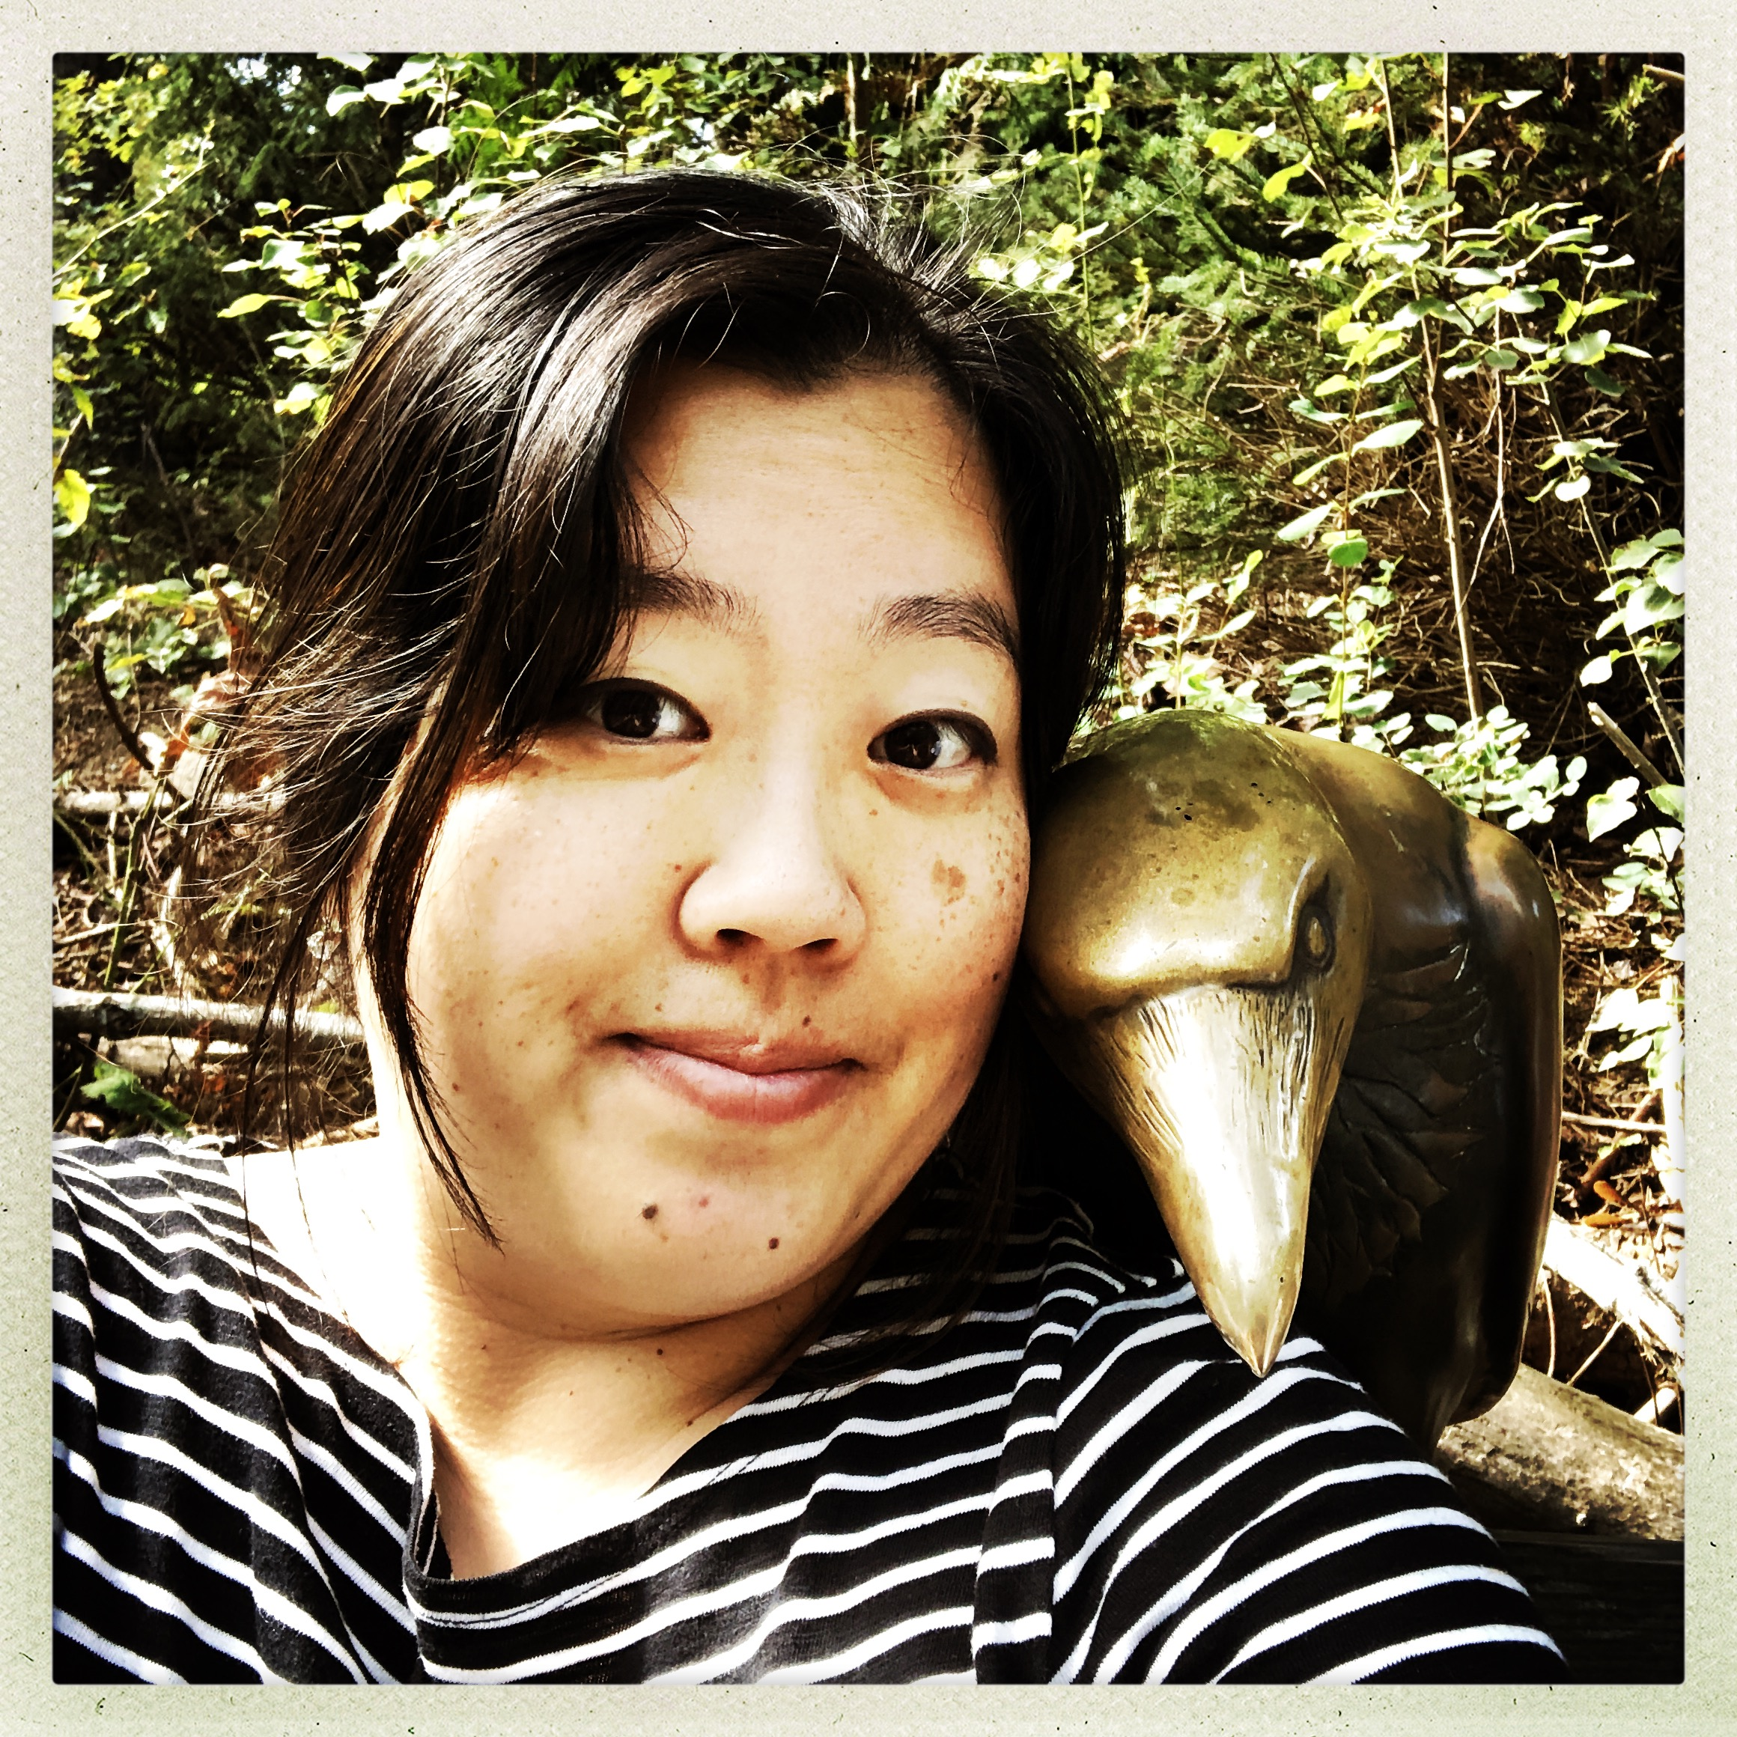

Joining us Today
John Robertson
Digital Education Librarian, Director of ETM
rjr@spu.edu
Karen Park
Associate Director
kpark@spu.edu
Debi Bearden
Instructional Designer
beardend@spu.edu

Slide 5
Session Overview
Types of Assessment
Making Discussions Interactive and Types
Accommodations
Tools You can Use for Assessment
Grading & Feedback
Notes:
Source: https://spu.edu/administration/office-of-student-life/handbook/behavioral-community-expectations/university-policies

Slide 6
Types of Assessment
Notes:
Discussion boards how can they be effective – interactive

Slide 7
The big question...
Formative
Summative
* also Diagnostic and other types

Slide 8
The big question...
Formative
Part of the learning process and self-evaluation
Low /no stakes
Usually 'micro' / granular
Summative
Evaluating the learning process
Usually high stakes
Usually 'macro' / integrative / cumulative

Slide 9

Options for assessement
Assignments and Assessments
  John's perpetual confusion

Slide 10
Options for assessement – take 2
Assignments (file submission or link)
Quizzes and surveys, polls
Discussions (response types)

Slide 11
Weighted Grading
Weighted grading so that groups are automatically adjusted.
Helps clearer grading but can confuse relative point values
Canvas lets you set up assignment groups and this can be one appraoch to include extra credit

Slide 12
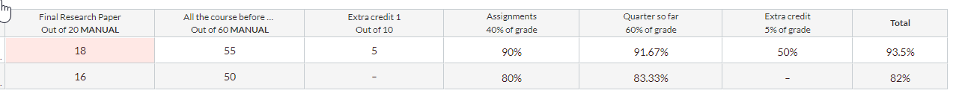
Canvas Gradebook
Assignments
Assignment Groups

Slide 13
Rubrics
Why Rubric?
Clarifying expectations for work
Help students self-assess
Managing grading process and focusing work
Options – points, categories

Slide 14
Principles of Good Feedback
Good Feedback should help students know:
where they want to get to
where they currently are
how to close the gap between those states

Slide 15
Principles of Good Feedback
helps clarify what good performance is (goals, criteria, expected standards);
facilitates the development of self-assessment (reflection) in learning;
delivers high quality information to students about their learning;
encourages teacher and peer dialogue around learning;
encourages positive motivational beliefs and self-esteem;
provides opportunities to close the gap between current and desired performance;
provides information to teachers that can be used to help shape the teaching.

Slide 16

Principles of Good Feedback
The Quick Study: Principles of Good Feedback (plus 39 feedback activities!) https://lx.uts.edu.au/blog/2018/06/15/quick-study-principles-good-feedback-plus-39-feedback-activities/
Nicol and Macfarlane‐Dick “Formative assessment and self‐regulated learning: A model and seven principles of good feedback practice” (2006). Studies in Higher Education Vol. 31, No. 2, April 2006, pp. 199–218 https://www.fammed.wisc.edu/files/webfm-uploads/documents/faculty-dev/seven-principles-of-good-feedback-practice.pdf

Slide 17

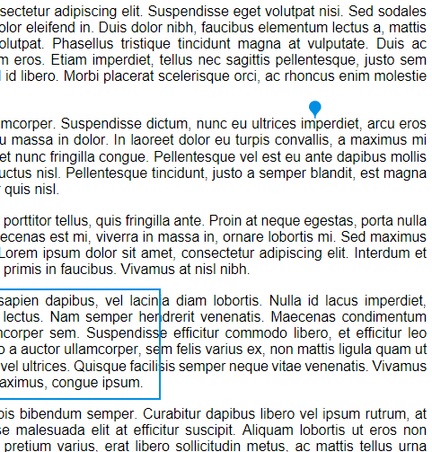
Feedback tools
Speedgrader is your friend
Options
  Annotations
  Rubric
  Text
  Video
  Audio
Remembering accommodations

Slide 18
Making Discussions Interactive
Notes:
Discussion boards how can they be effective – interactive

Slide 19
Question for the Chat…
Have you used discussion boards in your online classroom?
Type Yes or No in the Chat
Notes:
Before I get started, I am wondering your experience level using discussion boards as an instructor in an online learning environment.
Have you used discussion boards in your online classroom? Type yes or no in the chat.
If you feel comfortable elaborating, what did you think about it or how did it go or why you didn’t use it…give us insight into where you are with it today.

Slide 20



What is the Purpose of Discussion Boards?
Interaction!
Student to Content
Student to Student
Student to Instructor
Notes:
Let’s take a minute to think about discussion boards and why we have them in our online courses.
I pose the question “What is the purpose of discussion boards?”
It is really important for you to answer that question before we move on – and before you start designing them for your course or courses.
Why are you using them?
Based on some research that I have done as well as my own experience teaching online and taking graduate courses online, the single reason I think discussion boards exist is to provide interaction.
When you do not see your students face to face or even for short periods over zoom, it is helpful to provide ways for them to interact with each other and with you – and this can then help them interact with the content. Need to remember they are human beings behind the names.
Class conversations can carry on through meaningful online discussion prompts. It takes planning ahead of time, but it can be done well.
As you plan your discussion boards,
It is good to think about how students will interact with the content – learning outcomes
But also how you can encourage their interaction with each other. We are social creatures and we learn a lot from each other.
Lastly, students do want to hear from their instructor in the discussion boards. They are motivated when you respond to their post. You don’t need to take over a discussion, but you can jump in there and provide meaningful feedback or ask probing questions to keep the conversation going.

Slide 21

Discussion Board Ideas
Introduction
Fishbowl-Small groups
Peer Review
List of Names
Video-Audio-Image
Summary
Notes:
Introduction: One way to begin the course is to have introduction post, video give them a few questions to answer, in writing or video intro, add a picture if they feel comfortable, Students could ask follow-up questions of one or two peers to get to know each other
Important to encourage community in the beginning and need for communicating with each other – provide richer discussions later
Fun way – only using emojis to introduce yourself?
Have students Set goals or expectations for the course – not only ice-breaker but gives purpose and thinking about course material as well
Fishbowl/Small groups: Instructor interacting with small group, while others are “watching”
Break class into small groups and this is who they post with during the week.
Different topic for each group – they can look on (fishbowl) but only respond to group
Can make a class size of 60 feel like 5 or 6.
Peer Review: Different type of discussion board – submit work and ask for feedback from peers; assign so that everyone doesn’t respond to one and leave others out– paper, project – break it into steps, peer review could be part of that process.
List of Names: List name of all students, respond to the person listed above them and/or below them
Video/Audio/Image: Add video, add image, add audio (keep in mind accessibility with this – explain HOW to do this)
Summary: As the instructor, look for key points made by students and present at the end of the week/beginning of next week. Especially if a large class, not able to read all posts…loved to see what professor saw was important from my posts. May not be able to do it every week, but it is another way to show that you are in the course.

Slide 22
Writing Discussion Board Questions
Think about what is most important for student to know about the topic
Use open-ended questions
Focus on higher order thinking skills
Ask them to refer to their reading/lecture to support their statements
Notes:
Think about what is most important for student to know about the topic (tie in learning outcomes – what is the goal of the discussion)
Use open-ended questions (avoid yes or no questions, sometimes might have to ask student to explain further) ; have them ask a question at the end of their post in response to someone..
Focus on higher order thinking skills (think about type of question – type of thinking involved
(How, why, in what ways… Predict, if then.. what are some possible consequences… Defend or judge – evaluate…)
Ask them to refer to their reading/lecture to support their statements

Slide 23
Best Practices using Discussion Boards
Emphasize quality over quantity
Set expectations for length of post, type of post and how it will be graded
Plan your discussions in advance but also allow for spontaneous topics
Require original post & reply to minimum number of their peers’ posts
Use variety of methods
Notes:
Emphasize quality over quantity
Purpose of discussion board, do you really need 3 different ones each week – think about being in other classes, etc. An example might be one week is more substantial post required but another is not b/c project is due. Or one week craft post, next week respond to two-three others and compare/contrast. Key is to communicate expectations.
Require original post
Set two different deadlines – one for the first, initial post and one for the responses to peers…meaningful and timely Tues/Wed for first, Friday if want to keep it within the week, others use the weekend… if not set this, write something close to the deadline and there is no interaction. You want to help discussion stay on track and provide the incentive for students to want this as well.
Expectations
How long (words) for initial post, response post (not just, I agree! I disagree! Good job) Ask questions to each other, do you want them to include content/citations with their posts? Model the type of discussions you want students to use
How are you going to grade? Do not want to be laborious for you as instructor – 5% to 40%
Variety
Try a few different ideas but start small. Overwhelming to you to try too many different ideas. (Review Games with CC)
Plan discussions
How to write discussion board questions
Instructors have a planned for the quarter, calendar this topic, do this just as you plan in classroom HELPFUL
Zoom topic might come up and you want students to follow up on
Current event ties into course material… allow for these special learning opportunities

Slide 24
What is the Purpose of Discussion Boards?
Interaction!
Student to Content
Student to Student
Student to Instructor
Notes:
As we wrap up this section about discussion boards,
Do you see the purpose of discussion boards – provide interaction?
Did you learn at least one thing you could do?
Feel free to share in the chat something you learned about doing this or other questions you might have – or we can discuss these at the end with our Q & A time as well.

Slide 25
Accommodations

Slide 26
Specific Accommodations
Disability Support Services (DSS) will communicate with you when a student requires a specific accommodation
Specific accommodations may impact a specific assignment or class activity, not just exams
Equitable experience and opportunity to demonstrate knowledge and skill
If you’re unsure how to meet the specific accommodation, reach out to etmhelp@spu.edu.

Slide 27
Test Accommodations
Extended time is very common
Set these up in advance when possible
You must do it on a per assignment/quiz/exam basis
Make sure test questions are accessible
Quizzes must be published first

Slide 28
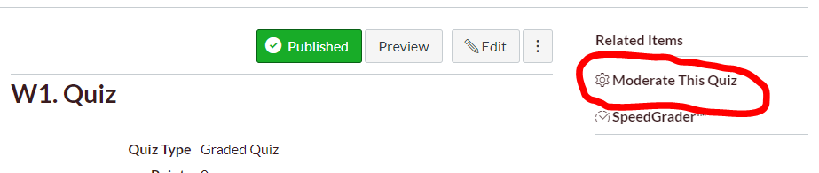
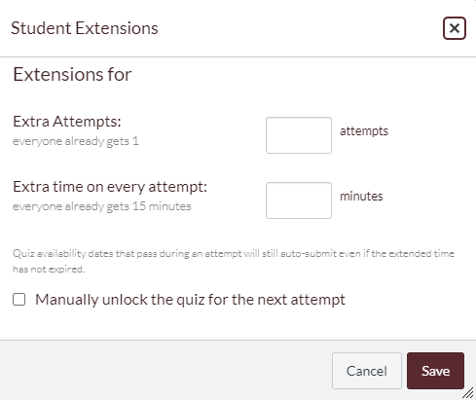
After the quiz is published, click the Moderate this Quiz link
Locate the student(s)and use the Pencil Icon to made adjustments
Time should be in addition to what is already given.

Slide 29
Examples of Test Accommodations
Extended time
Multiple attempts
Taking a test in a quiet environment
Reader or Scribe available for student's test support
Access to applications to during the exam (screen readers, dictation software, Microsoft Word, etc)

Slide 30
Technology

Slide 31
Some tools you might use…
TurnItIn
Respondus Lockdown Browser
Respondus Monitor
PollEverywhere
Panopto video quizzes and timed discussions
Notes:
In addition to the standard Canvas features, like assignments, discussions, quizzes, rubrics, etc. you may also want to consider some other tools to help you assess your students.
Specifically, I want to touch on TurnItIn and the two Respondus tools, because that involves issues of academic integrity.

Slide 32
TurnItIn
It’s not just about academic integrity
TurnItIn is a powerful tool that can also be used to help students improve writing and it’s fully integrated into Canvas.
  Go to an assignment or create a new one. Under Submission Type, choose External Tool, click the magnifying glass to locate a tool and choose TurnItIn.
  Then adjust your TurnItIn settings
Recommend you provide students an opportunity to review the similarity report and use the tool for feedback prior to a big paper submission

Slide 33
Respondus
LockDown Browser
Monitor
Is a desktop browser application that students install
It locks other applications and from running while the browser is open
You can use it without Monitor
Quizzes are still done inside Canvas and there are quiz logs that track mouse movement
Monitor must be used with LockDown Browser
It creates a recording of the student’s testing environment for instructor review
  It may flag parts of a video for review
  Just because there’s a flag, doesn’t mean there’s an issue
It records ambient noise and the student during the time that they’re testing

Slide 34
Add Respondus to a Class
In your class, go to Settings -> Navigation tab and locate Respondus and enable it, then scroll down and press Save
Use the new menu item in your course to choose which quizzes use Respondus as well as view video results and some stats
  You can still use SpeedGrader and access Canvas Quiz Logs if needed

Slide 35
Q&A Time
What do you want to ask us?

