Slide 1
Course Planning
holistic design, backwards design, and forms of interaction

Slide 2
Educational Technology & Media
We work with instructors by supporting technology and creating custom media for teaching and learning.
We provide how-to support, documentation, consultations, workshops, and pedagogical advice about online and blended learning.
We’re here to collaborate with instructors to develop the learning experiences you want to create with your students.

Slide 3
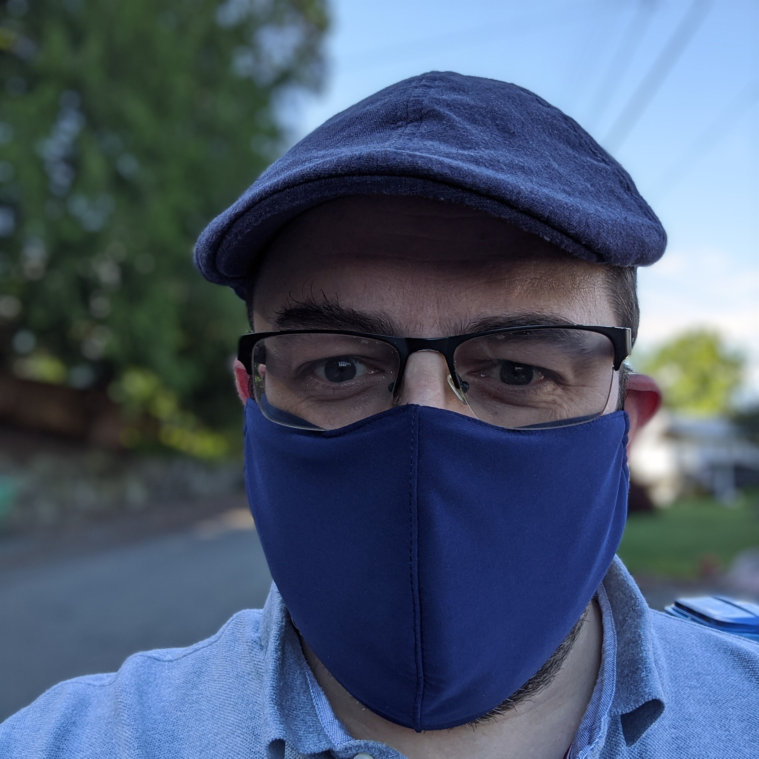
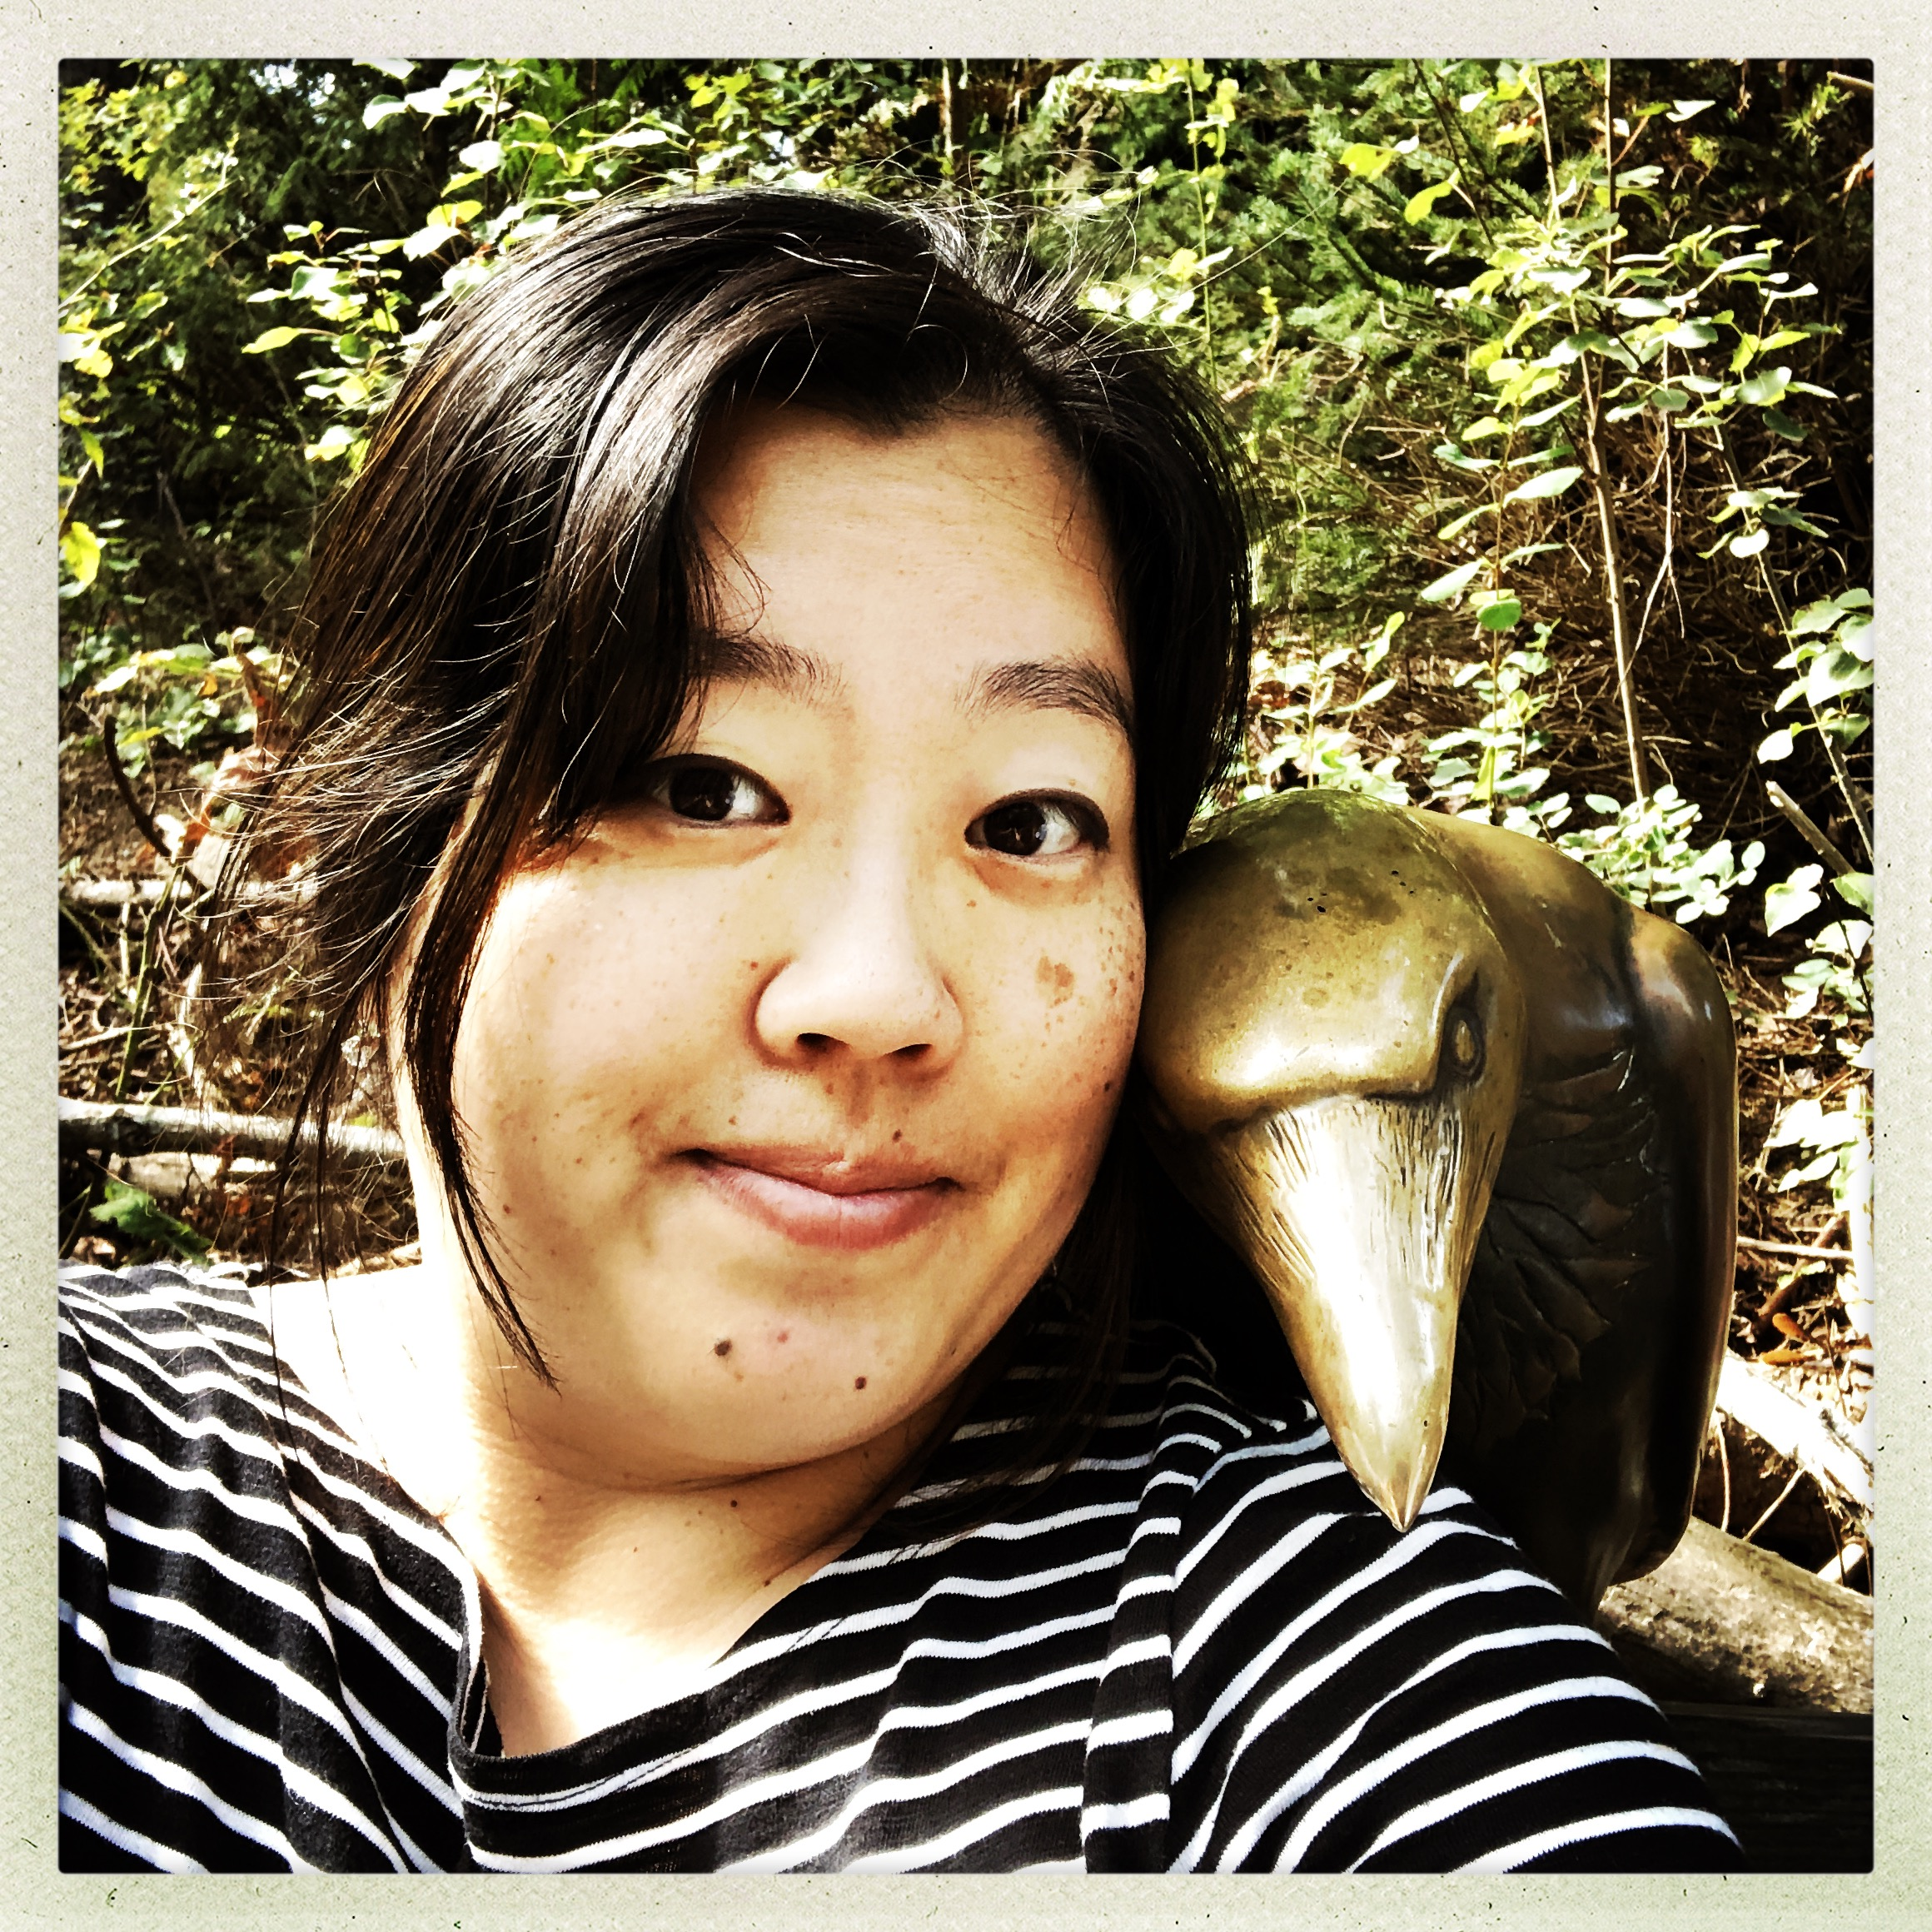

Speaking Today
John Robertson
Digital Education Librarian, Director of ETM
rjr@spu.edu
Karen Park
Associate Director
kpark@spu.edu
Debi Bearden
Instructional Designer
beardend@spu.edu

Slide 4
Session Overview
Course Development
Misconceptions of developing online courses
Backwards planning
SMART Learning Objectives
Course Alignment
Holistic Design
What is “holistic” design?
Pedagogy of Care/Trauma-Informed Care
Accessibility
Being “present” In your Course
Why do this?
Student to Faculty
Student to Content
Student to Student
How is online different?
Culturally Responsive Teaching
Ways to improve
Ways to improve
Ways to improve

Slide 5
Course Development
Notes:
Let's get started by thinking about course development and what's involved in the process.

Slide 6
Common Misconceptions
They take less time to teach
They are easy to build
It’s just posting video lectures
I need to be a “techie”
They’re not interactive
Once it’s built you’re done
Notes:
First, it is good to think about some common misconceptions related to online courses and their development.
Not a list of lectures,
Ok, if not a techie...reach out to ETM to partner with you.
Interactive-Very much can be –Social Media... talk about this later
You're not done—interactions needed, not just a press play and it goes --
Other misconceptions may include:
Not knowing your students
Everybody goes at their own pace
I have to be available 24/7
Everything has to be written

Slide 7
How is online different?
Teaching an online course the first time can take up to 40% more time than F2F, but after subsequent times on average will at least take as much time as F2F
Online courses are not F2F course conversions, it takes time to create a meaningful learning experience
Recording video is just one part of your course content, along with other activities and hands-on practice
It’s not about the latest and greatest tech, it’s about choosing the right tools to deliver your course
Good online courses can be more interactive, because it allows all students to participate more than they might otherwise
Good online courses need thoughtful ongoing tweaking and updating to improve the course and keep it current
Notes:
Workload can seem like more work because it’s not as concentrated, the workload is distributed
Students want to hear from you throughout the course
You don’t have to think of your course according to the time block schedule
Some students may think an online class will be less work than F2F

Slide 8
Backwards Planning
Start with what you want your students to be able to do by the end of the course
What activities will be needed to help students learn the skill or gain knowledge
How will you present your content and what content is needed?
Next think through how you will assess that your students can do those things
Notes:
CHAT: How many of you have heard of backwards design or backwards planning?
Start with where you want students to go…
FINAL Destination on a map – in our planning we want to be systematic and purposeful
Believe me, I am all for a spontaneous trip… but if we don’t plan, missed some things a long the way.
If we don't plan, we will miss key elements of what we want our students to learn a long the way.
Learning Objectives (in a minute…)
Assess learning
How will you know that they got there? They were successful because they could DO …
Entire class about assessements later this month
(quiz, project will show, exams, discussion boards... not just to have them but what are they showing that the student can do? We need to plan intentional measures to show whether students are achieving the learning outcomes or not.
What will help us get there?
Activities
Scaffolding – Break it into smaller steps
(think about final project- break it into 4-5 steps to help students manage time and plan well and NOT last minute – topic, 3 suggested resources, or ideas of who to interview, rough draft, peer review, final draft)
Discussion boards – interaction, but may want to try using audio
Content
How will you present it?
What is critical, need to know, and nice to know.
Think about tools best to present,

Slide 9
SMART Learning Objectives
Specific
Measurable
Achievable
Relevant
Time-bound
Notes:
Learning outcomes focus on specific knowledge, skills, attitudes, and beliefs that you expect your students to learn, develop, or master (Suskie, 2004). They describe both what you want students to know AND be able to do at the end of the course.
Each learning objective must answer the following quesitons: Who, will do, how much or how well, of what, by when?
Specific: What action will be performed...VERBS, higher order or complex verbs when appropriate – Bloom's Taxononmy
Measureable: How will their success be measured? (Avoid Understand, know, appreciate, -- Use define, explain, demonstrate, design, recommend)
Achievable: Within the given time frame (10 weeks... module, zoom meeting,)
Relevant :Alignment to activities is key – see why they are doing this, MOTIVATION
Time-bound: When will the objective be achieved? Time frame (10 weeks, module)
Time-bound means….completing the objective in a certain amount of time, such as “by the end of this unit” or “by the end of this Zoom session.”
In addition to being observable and measurable, learning outcome statements should focus on student action. They are about students showing what they have learned, not about the instructor describing how they are teaching.
Check out Blooms Taxonomy or Fink’s Taxonomy of Significant learning for more information. Learning Outcome Generator is a fabulous tool to help with this.

Slide 10
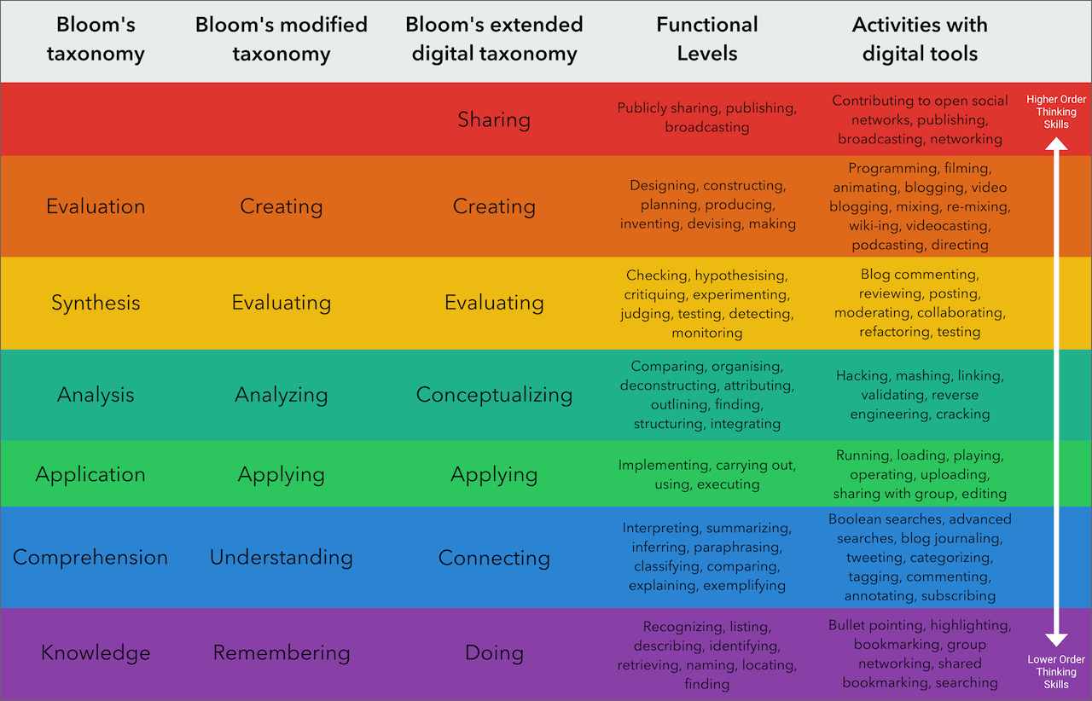
Bloom's Taxonomy

Slide 11
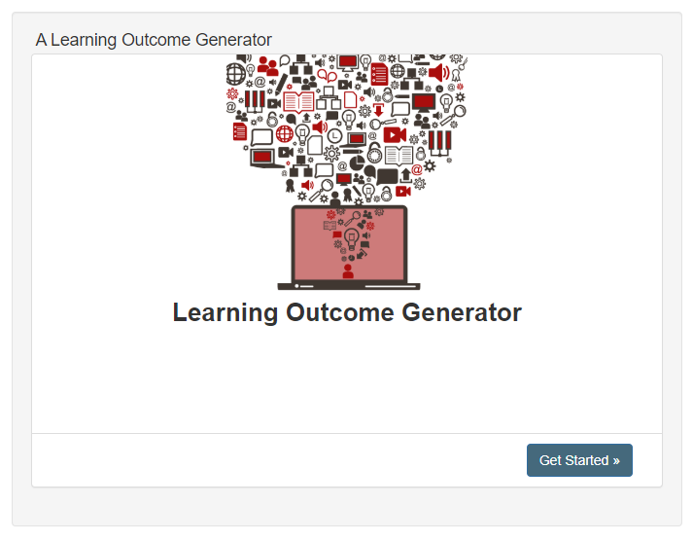
Learning Outcome Generator

Slide 12
Alignment & Prioritization
Alignment is the integration of learning outcomes, assessments, and teaching and learning activities to provide consistency for students.
After working through your learning objectives, you may find you have too much content.
  Try to work through and prioritize your objectives into what’s critical, important and nice-to know
Alignment also supports more accurate construction of course concepts
This includes the technology tools used to deliver content and for students to create their work, so they help support the outcomes and goals of your course
Notes:
WHY do we do this? Takes a lot of time, challenging to re-think this…
Keeps you going in the right direction – on the journey, want to get there
Want assessments to be valid, the evidence that they have met course goals
Course may not be effective – spending time on activities that do not lead to the goals of the course, learners mixed messages if not relevant
Too much content
After having a list of desired learning objectives, you may find that you have more content than is practical. By switching to a learning-centered course and asking yourself “What can and should students learn in relation to this subject” it becomes easier to prioritize your objectives into critical, important, and nice-to-know.
Some additional questions you can ask yourself:
What am I including so that students have the prerequisite knowledge and skills to continue in the discipline?
What am I including only because it's in the textbook?
What am I including in my course because it's central to the discipline, included on a licensure exam, or because I would be personally embarrassed if a student left this course not knowing these things?
What am I including because the person who taught this course before included it?
What am I including because it's something I'm really passionate about?

Slide 13
Course Map
The table below follows the backward design process from left to right. Completing the table in this same fashion will maximize your opportunity to align your learning outcomes with your assessment, practice method, and content.
Make sure to note the types and levels of interaction in the assessment, activities, and content columns.
Learning Objective | Assessment Methods | Learning/Practice Activities | Content Delivery/Exploration Methods

Slide 14
Interactions

Slide 15
What are the types?
Student to Faculty
Student to Content
Student to Student
Notes:
Some examples:
Student to Faculty – watching videos, assignment feedback, announcements,
Student to Content – reading, watching content, discussion boards thinking more about content
Student to Student – group discussion, group project, peer feedback/review-must work together to learn and succeed in our online classes
We will have another session on building community
Strive for this each week--Equal balance!

Slide 16
Holistic Design

Slide 17
Pete Menjares, PhD and SPU Board Member
(2017)
"The biblical witness is clear: Every human being has been created in the image of God and thus has inherent worth and dignity (Gen. 1:27, Ps. 8:5)....
The kingdom of God is inclusive, and people come from the east and west and north and south to participate in it (Luke 13:29)…
The heavenly vision of the redeemed from every people, nation, tribe, and language are united in worship of God (Rev. 7:9)...
These biblical references are a reminder that the people of God are members of one body, diverse, yet united..." (pp. 25-26) and thus, as professors it is our calling that all students, no matter their background, should feel included in courses they take at SPU.

Slide 18
What is holistic design?
When designing a course, considering the needs of a variety of students can help create a richer experience for all students. This approach allows you to more fully include students who might normally be excluded, to introduce more flexibility and creativity into the classroom, and to reduce the need to make special accommodations.
Notes:
Specifically we’re going to focus on Inclusive and Culturally responsive teaching, Caring for students through pedagogy, and improving accessibility in your course.

Slide 19
Culturally Responsive/Inclusive Design
What voices and perspectives are being heard throughout your course?
There should be diversity in course texts, expression, and engagement for students
Creating an inclusive course takes time and hard work
Notes:
In the Columbia's Inclusive Teaching MOOC (Links to an external site.), they recommend that you regularly reflect on your overall class sessions or specific activities with your peers or other trusted individuals you know professionally or personally. This helps create a support network that can provide feedback for improvement and encouragement when you feel like things aren't going as well as they could.
Some Things to Try...
Consider inviting a colleague into your course to provide feedback and food for thought.
Work with ODEI, FLO, or Library & ETM to find resources to support you in the in-person and/or digital aspects of your classroom.
Join FLO's regular book groups or regularly attend other faculty professional development opportunities.
These may not always be directly related to inclusive teaching, but these activities help you connect with your colleagues.

Slide 20
Specific ways to improve inclusiveness
Values and Goals
Explain to students why you chose your learning outcomes and explain the value
Course Content
Provide content being used in class, before the class session
Feedback
Give feedback often
Support
Make sure you provide scaffolding and support to build up to a major assignment
Focus on specific steps students can take to improve.
Find out what your students' value and their goals for the course
Participation
Set ground rules or have students help create ground rules of participation
Create a space in your course for students to pose questions about content or the “muddiest point”
Provide a glossary or key terms or other jargon, metaphors or colloquialism used throughout the materials
Remember to be encouraging
Collect feedback often, including reflections on major assignments
Provide resources for students to become familiar with a technology tool
Talk about areas on campus that provide support

Slide 21
Pedagogy of Care/Trauma-Informed
College students are at a higher risk of experiencing new trauma than members of the general public.
Trauma can happen to both individuals and communities and can even be passed down to younger generations.
Individuals who experience trauma respond in many different ways and each individual's experience is unique

Slide 22
Some examples of trauma our students may be facing:
Poverty and chronically chaotic housing and financial resources
Medical issues (affecting themselves or family members) that are chronic or life threatening or accidents
Death or loss of a loved one
Witnessing or experiencing community violence
Witnessing police activity or having a family member incarcerated
Natural disasters, including the current coronavirus pandemic
Military combat
Acts or threats of terrorism (in person or on TV)
More...

Slide 23
Strategies to Support Students
Empower your students
Check-in Regularly
Prepare for significant Anniversaries
Be Sensitive to Family Structure
Try to avoid Romanticizing Trauma Narratives
Give Supportive Feedback
Connect Students with Support
Notes:
By offering choices for participation and encouraging their sense of agency, educators help students feel some control over their lives.
A simple sincere email ca go a long way.
It a student shares a significant date or event, check in with that student around the time of the anniversary to show you care and help identify needs for support.
When giving feedback, try the feedback Sandwich, by stating and ending with a positive comment.
Connect students with peers or other adults who can provide support. Be prepared to refer students to the Student Support Team, counseling services; even emergency care if needed.

Slide 24
Accessibility
Including student with seen and unseen disabilities is important, regardless of if a student requires a specific accommodation
Some practices that improve accessibility are easier to implement than others.
Focus on what you can accomplish and then work out a plan to steadily improve your course.

Slide 25
Specific Suggestions
Put all of your materials online in your Canvas Course
Provide any class session materials early and give time to transition between resources
Provide training for all the technology tools required in the course
Work with your librarian to provide access to readings and other course resources

Slide 26
Additional Strategies
Makes sure you know how to make test accommodations in Canvas
Make sure all images in your course have alternative text or descriptions, particularly if they convey information
Use a high color contrast, yellow text on a white background will be difficult for anyone to read
Work towards having both captions and transcripts on all video
Check your PDF’s to make sure they’re free of annotations and have selectable text
Familiarize yourself with the tools that can help you make your course accessible
Notes:
Test accommodations are one of the highest specific accommodations our students receive and it can cause a lot of anxiety for students if they’re unsure whether or not they’ve received the appropriate accommodation. Privding them in advance, rather than during testing (you can do both) can help alleviate that concern.

Slide 27
Being “Present” in your Course

Slide 28
Why is being present important?
Success in the online environment is directly related to how present and engaged the instructor is in the virtual classroom
The government defines what types of online courses students can use their financial aid on
  Online courses, for which students may use financial aid, must have “regular and substantive” faculty-student interaction.
Notes:
Instructor presence and communication is what makes the difference between a class being categorized as a distance education class v/s a correspondence course. The US Department of Education and the Higher Learning Commission (HLC) have defined the difference between "distance education" and "correspondence education" based on the "regular and substantive interaction between the students and the instructor."
The definition also notes that the interaction cannot be primarily initiated by the student. The instructor must initiate interaction.
Simply posting recorded lectures or textual materials online, along with exams or quizzes, will not meet the federal (and HLC) guidelines and will be classified as a correspondence course.

Slide 29
Teacher Presence
Teaching presence includes both the planning and forethought that go into building your course and what you do "in the moment" when interacting with your students
In a nutshell, this is about how and when you interact with your students throughout your course
It’s important to stay present throughout the course, not just at the beginning when you write a welcome note or create an instructor video
Your presence keeps students motivated and engaged; students also need your presence in order to move from surface learning to a deeper level of engaged learning.
Notes:
Direct instruction is the more straightforward of the two and would include pre-developed presentations, assessing student work. providing instructive feedback, diagnosing misconceptions, clarifying concepts, and referring students to additional resources or practice opportunities.
Facilitating discourse is more than simply requiring students to post to a discussion and reply to others. It involves regularly reading and providing feedback on student postings, encouraging participation, moving the discussion forward when it stalls or gets off track, identifying and drawing out areas of agreement and disagreement, pointing out linkages, and helping students articulate shared understandings.
Ways you may naturally already have presence:
Introduction video or note
Mini lectures/videos
Written commentary on a topic
Assessment feedback

Slide 30
Cognitive Presence
The quality of cognitive presence reflects the quality and quantity of critical thinking, collaborative problem-solving, and construction of meaning
What are the assignments and activities throughout your course that help students engage with the topic?
Create opportunities for sustained communication about the course content
Notes:
These might be projects, or discussions, experiential or service learning opportunities, etc that help build up to a summative assessment.

Slide 31
Social Presence
If students can make interpersonal connections with others, they are more likely to engage with and remember the course and the content
Think of this in terms of how you’re going to build community in your course
This can happen through group discussion and group projects, but also through peer review, or student to student teaching, presentations, or…?
Notes:
It’s important to balance all three throughout your course, Teacher, Cognitive, and Social presence.

Slide 32
The End
Now let’s have Q&A Time!
Notes:
Split into breakout rooms/groups depending on number of participants and needs.

