Slide 1
Panopto and Zoom:
What’s the Difference?

Slide 2
Agenda
What’s the difference?
Using Zoom
Using Panopto
Zoom, Panopto, Canvas integrations
Best Practices
Aesthetic tips
Questions

Slide 3
What’s the difference?
Synchronous vs. asynchronous (interactivity)
Simple to use vs. flexibility
Meeting vs. learning resource

Slide 4
Using Zoom
Create a Zoom Basic account at https://spu.zoom.us
Request a Zoom Pro account through Banner
Not sure if you’ve already signed up? Check Banner or Canvas

Slide 5
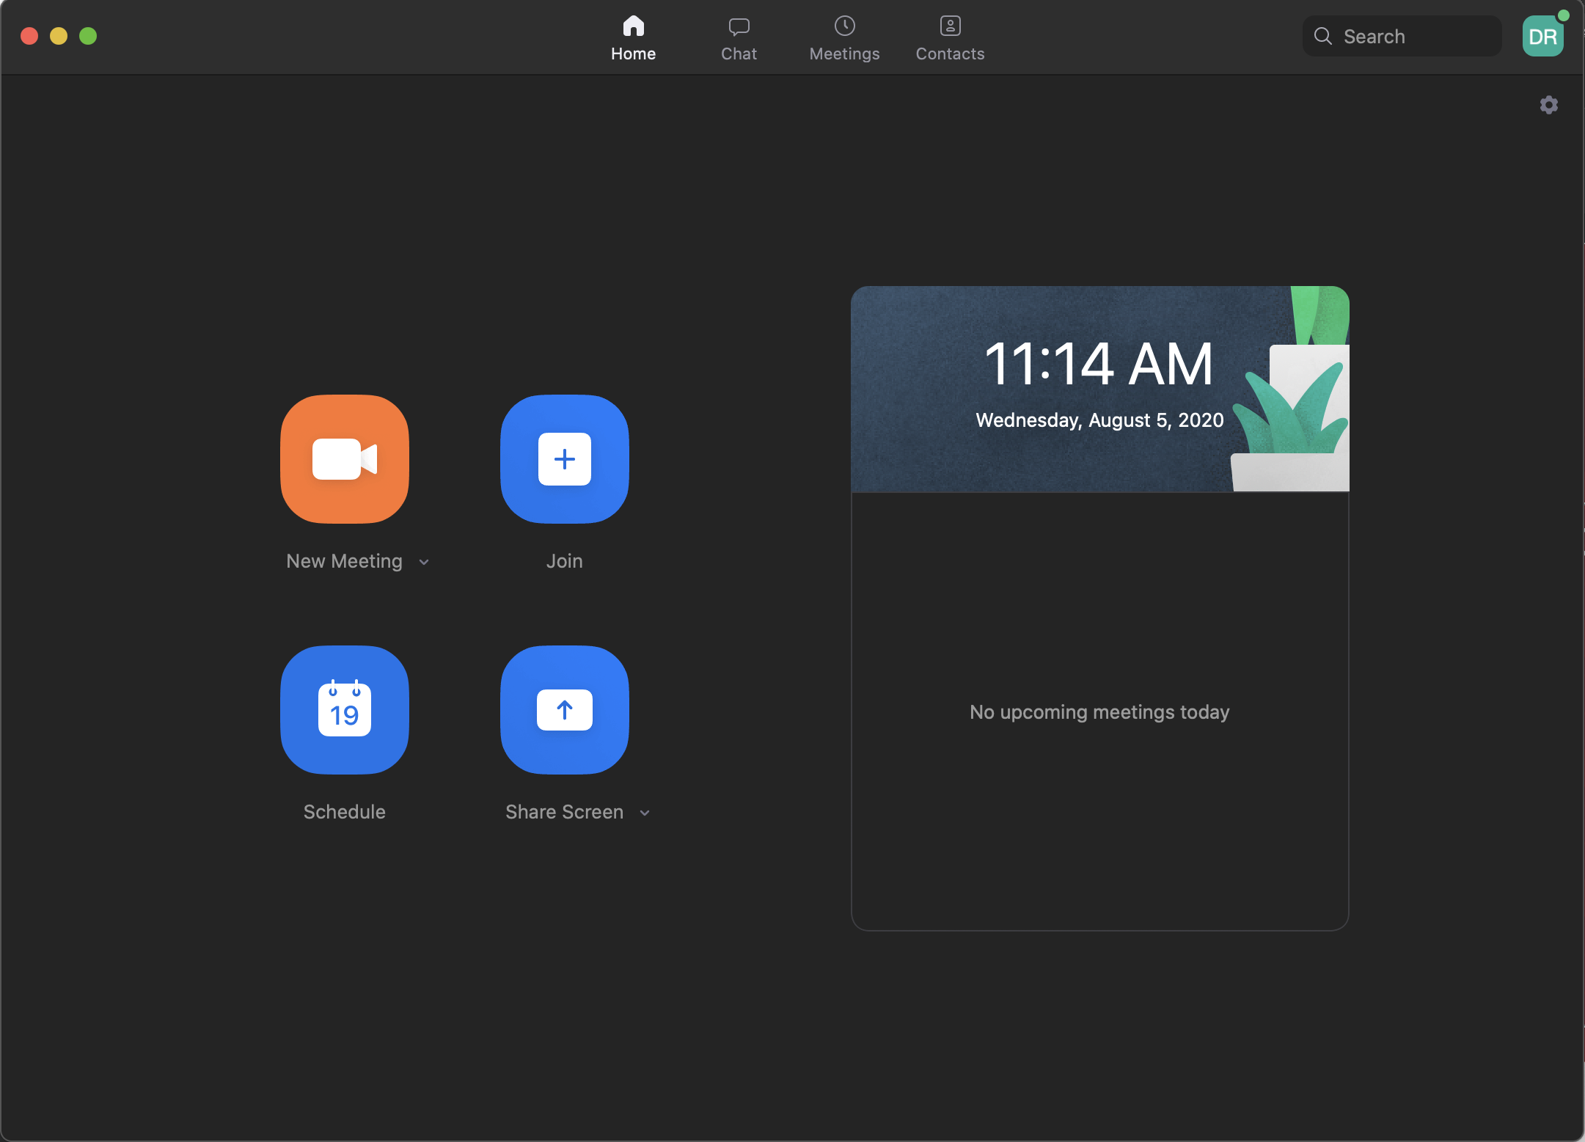
Using Zoom
Notes:
New meeting vs. schedule
Settings: Enable HD (video), Optimize for 3rd party video editor (recording), keyboard shortcuts
Advanced settings

Slide 6
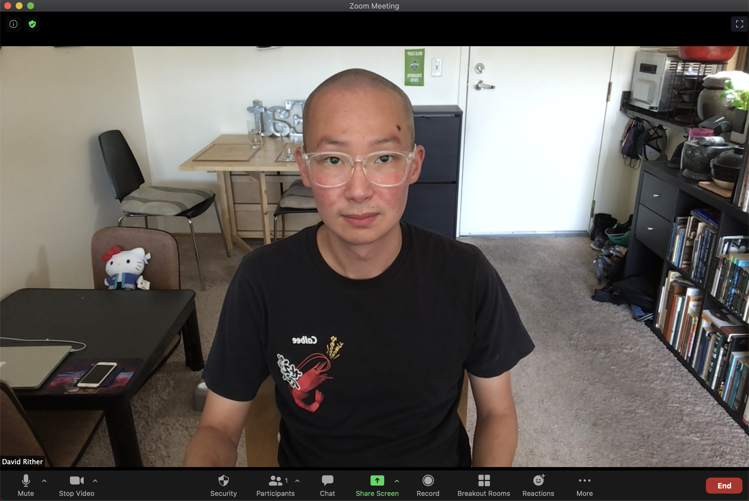
Using Zoom
Notes:
Gallery vs speaker view
Security: lock meeting, waiting room
Participants: can mute, block, mute/unmute all, spotlight, etc
Chat: public vs private (private not entirely private)
Share screen
Record: to cloud, automatic recording
Breakout rooms

Slide 7
Using Panopto
Program vs. web interface
Primary source, secondary source, slides
Managing and editing videos in the web interface
Settings vs. edit tool
Permissions
Notes:
Lecture capture, screencast, PowerPoint slides act as chapters, everything is synched and searchable,
editing tool built in
Can host already created video content
captioning

Slide 8
Zoom, Panopto, Canvas integrations
Zoom: record to cloud uploads to Panopto
Zoom: schedule meetings through Canvas
Panopto: permissions handled through Canvas

Slide 9
Best practices
Zoom security: protect your meeting ID
Zoom: notify students you’re recording
Zoom: ask everyone to mute their microphones
Panopto: permissions (FERPA)
Notes:
Password, waiting room, join before host, only authenticated users can join meetings
Screen sharing, remote control, removed participants rejoin, rename, virtual background
During a meeting: lock meeting, mute, stop video, hold, remove

Slide 10
Aesthetic tips
Better audio is key
Zoom settings
Camera Tips
Lighting
Notes:
Background noise, room, external mic, mic placement
Enable HD, Touch up my appearance
Camera position, composition
Light sources, avoid overhead, don’t mix indoor and outdoor, dim computer screen

Slide 11
Questions?
Email ritherd@spu.edu
Panopto Videos: https://bit.ly/39WwHGq
Zoom Videos: https://bit.ly/3c9pPax
Better Looking Videos: https://bit.ly/2PoQkPR

