Slide 1
Importing and Adapting
the Remote Teaching Template

Slide 2
Educational Technology & Media
We work with instructors by supporting technology and creating custom media for teaching and learning.
We provide how-to support, documentation, consultations, workshops, and pedagogical advice about online and blended learning.
We’re here to collaborate with instructors to develop the learning experiences you want to create with your students.

Slide 3
Notice of Intent to Record
This session will be recorded and made available to SPU employees who were unable to attend today. We will only record the training portion of this session. The Q & A portion at the end of the training will not be recorded.
If you do not wish to be visible in the recording, kindly turn off your web camera and mute your microphone now.
If you do not consent to be present in the recording session in any fashion, you may exit the session now.
This video session will be published on the ETM website for later viewing
Notes:
Source: https://spu.edu/administration/office-of-student-life/handbook/behavioral-community-expectations/university-policies

Slide 4


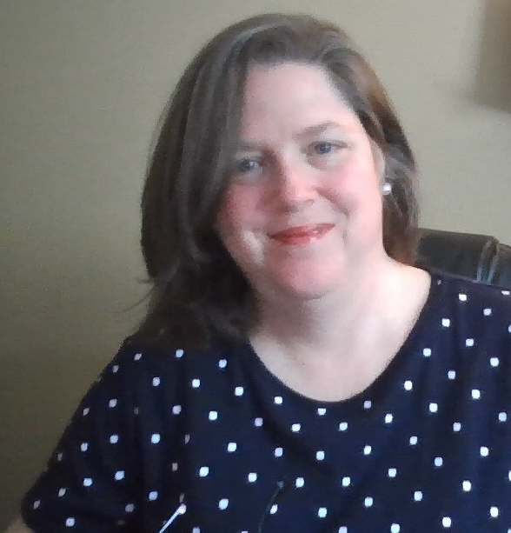
Joining us Today
John Robertson
Digital Education Librarian, Director of ETM
rjr@spu.edu
Karen Park
Associate Director
kpark@spu.edu
Debi Bearden
Instructional Designer
beardend@spu.edu

Slide 5
Session Overview
Why use a template?
What a template is and what it isn’t?
How to find the template and import it
Merging in your own Content
  How not to kill your course
Notes:
Source: https://spu.edu/administration/office-of-student-life/handbook/behavioral-community-expectations/university-policies

Slide 6
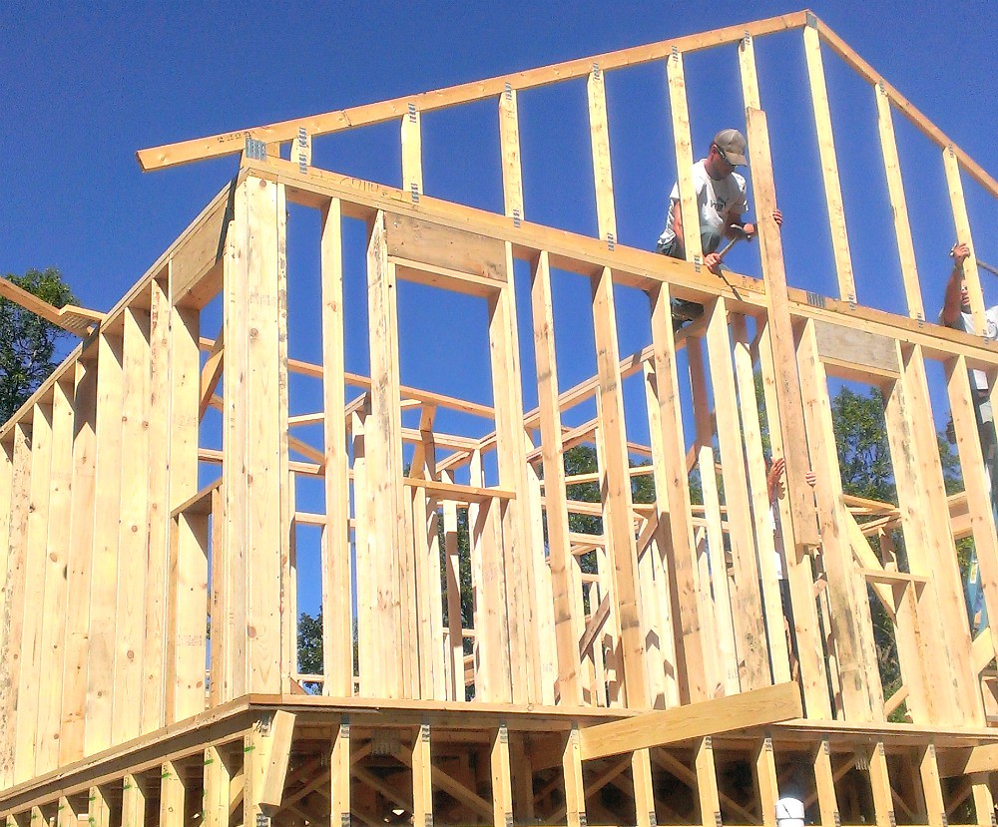
Why use a template?
This Photo by Unknown Author is licensed under CC BY
Notes:
Today is more about how to import the template
But want to explain a little bit about the why behind the what before we get started.
So let’s answer the question, Why use a template?
Feel free to type in the chat why you think you would use the remote teaching template…
Remote Teaching Template
All about good design – instructional design
The remote teaching template is a framework Etm has provided for you to enter in the pieces or learning objects for your course
But in that framework
A place to add your voice, to add context to why you have the piece there.
For example,
In Learning Materials
You may include a few short lecture videos about using data in a spreadsheet.
Instead of just including the links to the videos, before each one, write a sentence or two explaining what the student should be listening for in the video. All of the skills students learn before reading an article or a book, you are doing the same thing for watching a video.
If you have a link to an article that you want students to read, give them some context about why you chose the article or introduce them to the key points BEFORE they start reading.
You are doing a couple of things here --- activating prior knowledge, but also helping learners provide connections with what is to come.

Slide 7
Remote Teaching Template
What a template is:
What a template isn’t:
Framework
Organizational Tool
Visual Design “Gift”
Adjustable
Random Elements
Complete Course
Automatic
Difficult to Import
Notes:
Framework: Support you as you teach online – provides the structure, you need to add the learning elements, home page about your course, overview & Summary for each week, learning materials, assignments & rubrics, discussion boards
Organizational Tool: Not a long list of links to scroll through
Organize learning materials in central place
Easy for students to find
Also so they know where to find in other courses
Reduces their cognitive load
Website, multiple points of access
Visual Design “gift”- Helpful buttons, banner images (can be replaced if desired –Dom can help if needed – not take the entire page for scrolling purposes,
Adjustable – to meet your needs as an instructor section not use can be deleted; In Vice Provost Price’s Principles of Student Engagement email she discusses the parts that she recommends including the overview for each week, assignments submission and grading/feedback.
What it isn’t
Random Elements – Karen will elaborate more on this, but the template has been designed on purpose, based on effective instructional design principles
Overview, summary
Good elements for teaching and supporting learning
Complete Course: it is a framework, not your learning objects. You need to include videos, text to explain them or concepts, Your voice needs to be in the course
Back to my building example, we are sharing the frame of the house, you need to add the sheetrock, paint and fixtures for the finished product.
Automatic: template not all done, you will need to go back to course to give feedback to students, answer questions in discussion boards, Not a slow cooker where you can start it and come back to dinner already made for you ☺ -- need to be in the course. It is not an automatic course design.
Difficult to import: why we are here today! Show you how easy it can be to import and have it ready to add your learning materials and provide great learning experiences for students

Slide 8

Remote Teaching Template
Is in the Canvas Commons
  Your school/program may have a specific template too
Modelled after Oregon State University Online School’s template
  Modified to include SPU things
  Added content per MagnaPubs Teaching Online
  Referenced an Online Course Rubric too, during the development

Slide 9
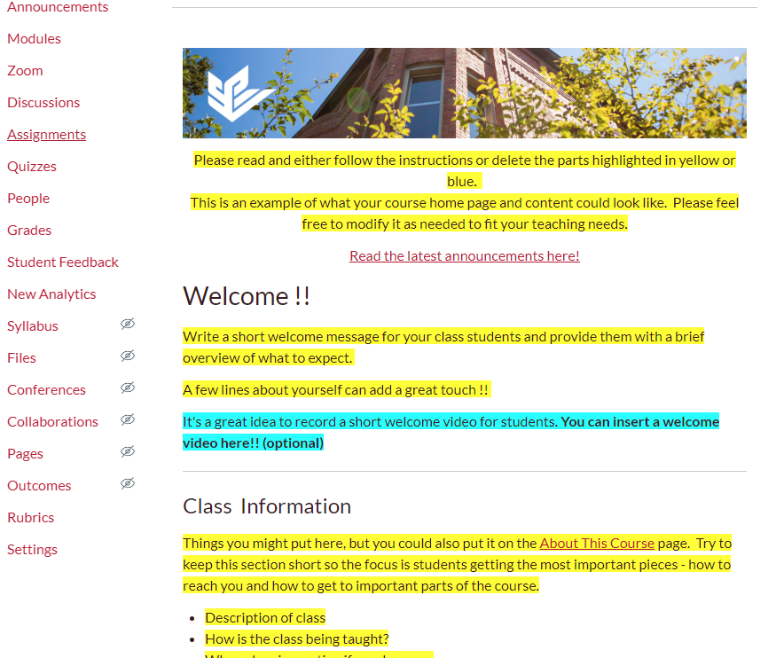
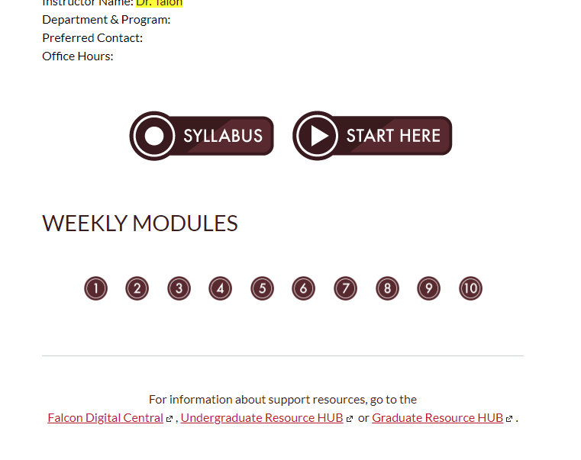
What does it look like?
There’s a home page!
It has buttons!

Slide 10
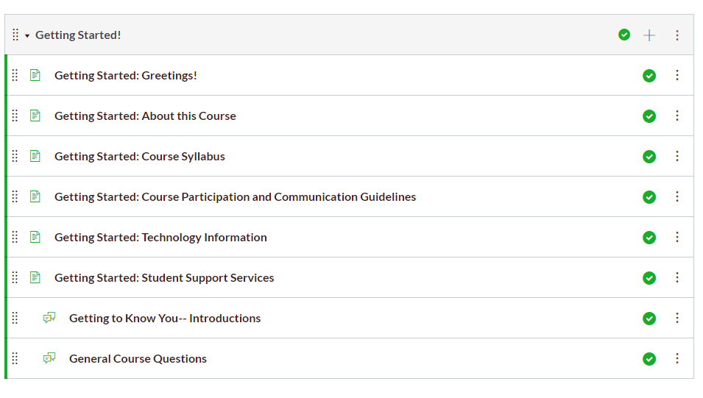
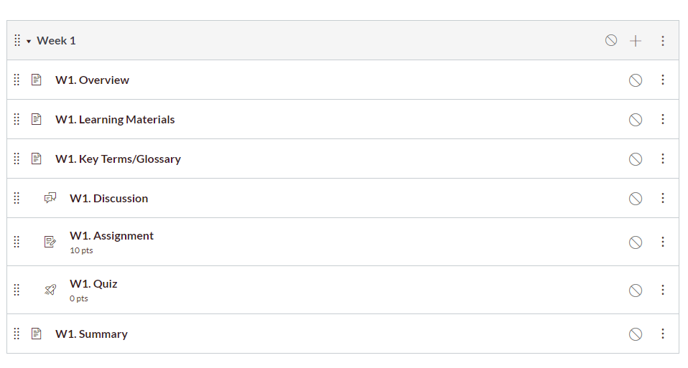
More~
There’s a Getting Started Module!
There are weekly modules!

Slide 11
How much do I have to use?
Strongly recommend your course has the following:
  Home Page
  Getting Started Module (use this space to welcome students, set expectations, create community, etc.)
  Every module has an Overview and a Summary
  A discussion board or boards for students to ask questions
    you can also use these to collect information about topics students want covered in the next session or points that are confusing

Slide 12

How do I get the Template?

Slide 13
In your Course…
On the Home page, click Import from Commons
1
Filter by SPU
2
Click the Remote Teaching Template
3
You can preview it before pulling it over
Click import and check the box next to the course(s) you want to use this template in
4

Slide 14
Tips
It’s easiest if your course is empty
If you already started to work on your course, connect with ETM first, so you don’t overwrite your content
  One way is to export your content so you have a back up first
  We can also pull content from our beta or test version, depending on when you made changes
ETM can help you pull specific parts of the template over

Slide 15
It’s demo time!

Slide 16
Q&A Time
What do you want to ask us?

