Slide 1
Zoom & Panopto

Slide 2
Educational Technology & Media
We work with instructors by supporting technology and creating custom media for teaching and learning.
We provide how-to support, documentation, consultations, workshops, and pedagogical advice about online and blended learning.
We’re here to collaborate with instructors to develop the learning experiences you want to create with your students.

Slide 3
Notice of Intent to Record
This session will be recorded and made available to SPU employees who were unable to attend today. We will only record the training portion of this session. The Q & A portion at the end of the training will not be recorded.
If you do not wish to be visible in the recording, kindly turn off your web camera and mute your microphone now.
If you do not consent to be present in the recording session in any fashion, you may exit the session now.
This video session will be published on the ETM website for later viewing
Notes:
Source: https://spu.edu/administration/office-of-student-life/handbook/behavioral-community-expectations/university-policies

Slide 4


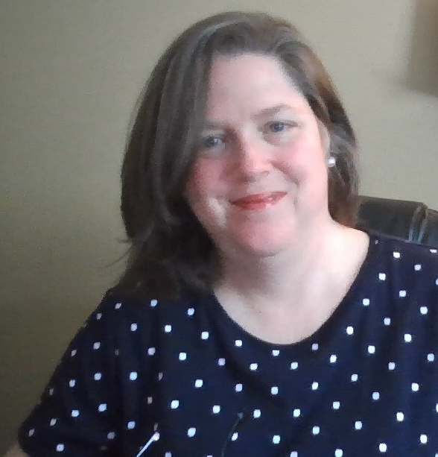
Joining us Today
John Robertson
Digital Education Librarian, Director of ETM
rjr@spu.edu
Karen Park
Associate Director
kpark@spu.edu
David Silcox-Rither
Videographer/Sr. Instructional Designer
ritherd@spu.edu
Debi Bearden
Instructional Designer
beardend@spu.edu

Slide 5
Session Overview
This session will cover:
The process to setup both Zoom and Panopto, as well as the basic steps to get started
Best recording practices for a quality video
Introduction of new features or changes
Best practices for using the tool in class, “avoid Zoom fatigue” and “Make your Zoom session work for you”
Q&A Time at the end
Notes:
Source: https://spu.edu/administration/office-of-student-life/handbook/behavioral-community-expectations/university-policies

Slide 6
Q&A Time
What do you want to ask us?

