Slide 1


Slide 2
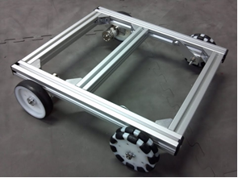
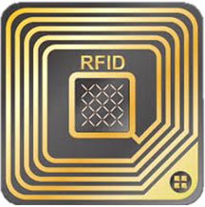
Proposed Critical Path Device
Electrical RRP
RFID Tag
Create a system of sensors with different functions
Power and control three ultrasonic sensors, two infrared(IR) sensor, and one radio frequency identification(RFID) sensor; all integrated with PSoC 6 microprocessor architecture
Ultrasonic Sensors will be able to detect distance to object in front of them
IR sensors will be able to count RPM wheel
Mechanical RRP
Wheel/Base Frame
Build frame/wheel structure which acts as a base for the robot
Ability to turn around corners, travel in a straight line, and support system load
The bot will have to move at reliable, safe speeds and navigate accurately
Notes:
Leanna

Slide 3
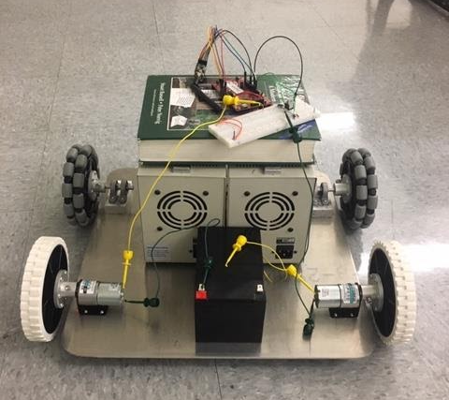
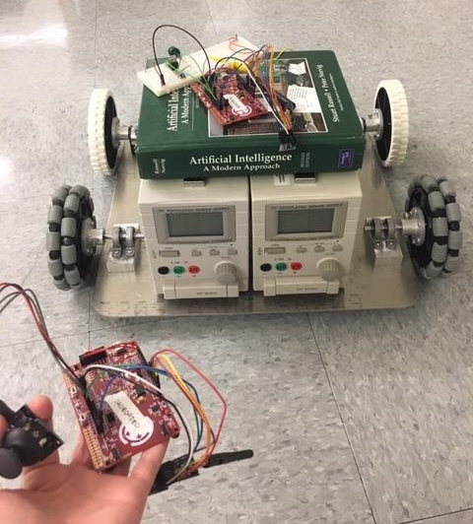
Risk Reduction Prototype
Mechanical RRP
Notes:
Joanna

Slide 4
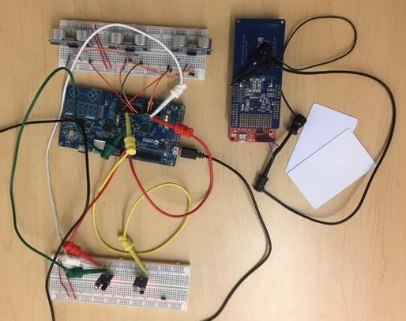
Risk Reduction Prototype
Electrical RRP
Ultrasonic Sensors
RFID Sensor
PSoC 6 controls Ultrasonic and IR
RFID Cards
IR Sensors
Notes:
Nick

Slide 5
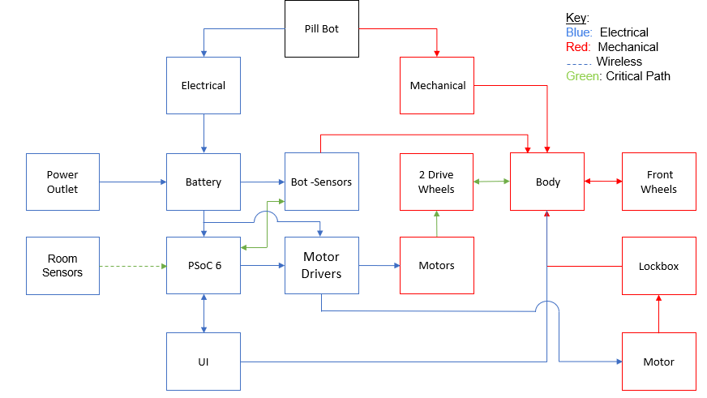
Concept Review - System Block Diagram
Notes:
Erin

Slide 6
Engineering Analyses
Mechanical Analyses
Total Mass – Determine approximate weight of components in order to build a rough CAD model
Stress/Strain – Apply Finite Element Analysis to determine what kind of stresses can be applied to the bot before failure (how easily can Pill Bot be broken into)
Center of Mass – Determine the system’s center of mass to determine the stability (likelihood of tipping) when turning and accelerating
Stability – Use the center of mass and speed requirement to determine the stability of the bot as it maneuvers around the facility, turning corners and accelerating
Torque – Compute the torque required to turn the wheels under the given mechanical load
Motor Power – Find out how much power will be required to move the robot at a speed of approximately 2 ft/s when the system is fully loaded, which is estimated to be 45 lbs.
Heat Transfer – Determine how much all the electrical components will output in the confined space and calculate heat loss out of the enclosure to the environment to ensure that the medication is properly insulated and not harmed
Electrical Analyses
Power Capability – Compute how much power each component will draw continuously over a twelve-hour time span in delivery mode and over a nine-hour time span in sleep mode to determine minimum reasonable wattage to be provided by the power source.
Power Capacity- Compute the amperage to be provided by the power source for the time spans indicated under power capability so that components work at their desired performance to determine minimum reasonable battery capacity.
Attenuation- Determine the decrements of wireless communication attenuation over range for each ultrasonic and RFID sensor to determine physical thresholds for mounting to the bot.
Notes:
Joanna

Slide 7
Total Mass Analysis
Most materials were weighed as they came in: 17.5 lbs measured
Remaining materials estimations were made for:
  Lockbox and medications: 9.5 lbs
    Pills: 0.5 lb
    Individual bottles: 2.25 lbs
    Aluminum 6061-T6 medicine container: 6.75 lbs
  Exterior Materials - Aluminum 6061-T6: 5 lbs
  Metal Plates for top and bottom: 8 lbs
  UI and lock box motor: 5 lbs
Total is estimated to be 45 lbs
Notes:
Joanna

Slide 8
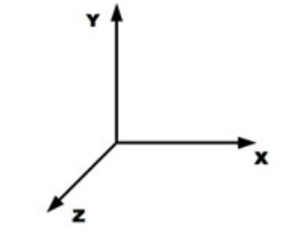

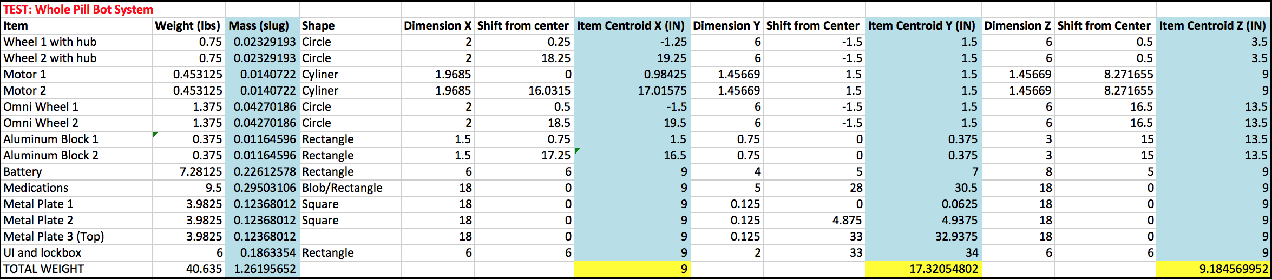
Center of Mass Analysis
Notes:
Joanna

Slide 9
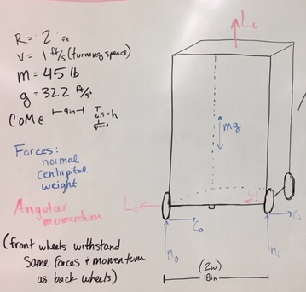
Stability
(c₀-ci) =mv²R
(n₀-n_{i)} =mg
Then, torques in the z (out of the board) direction:
(n₀-n_{i})w-(c₀-c_{i})h = Lv/R
where L is the total constant magnitude angular momentum of the wheels:
L=I⍵ (x4 wheels)
I=mr²(mass and radius of wheels)
⍵=vr
Solving for normal forces on the inside and outside wheels:
n₀=gmRw+hmv2+Lv2Rw
n_{i}=gmRw-hmv2-Lv2Rw
At ni= 0 (normal force on the wheels on the inside of the curve)
* A speed of approximately 6 ft/s would be required to tip the bot as it turns around a corner of R = 2ft.
Notes:
Leanna

Slide 10
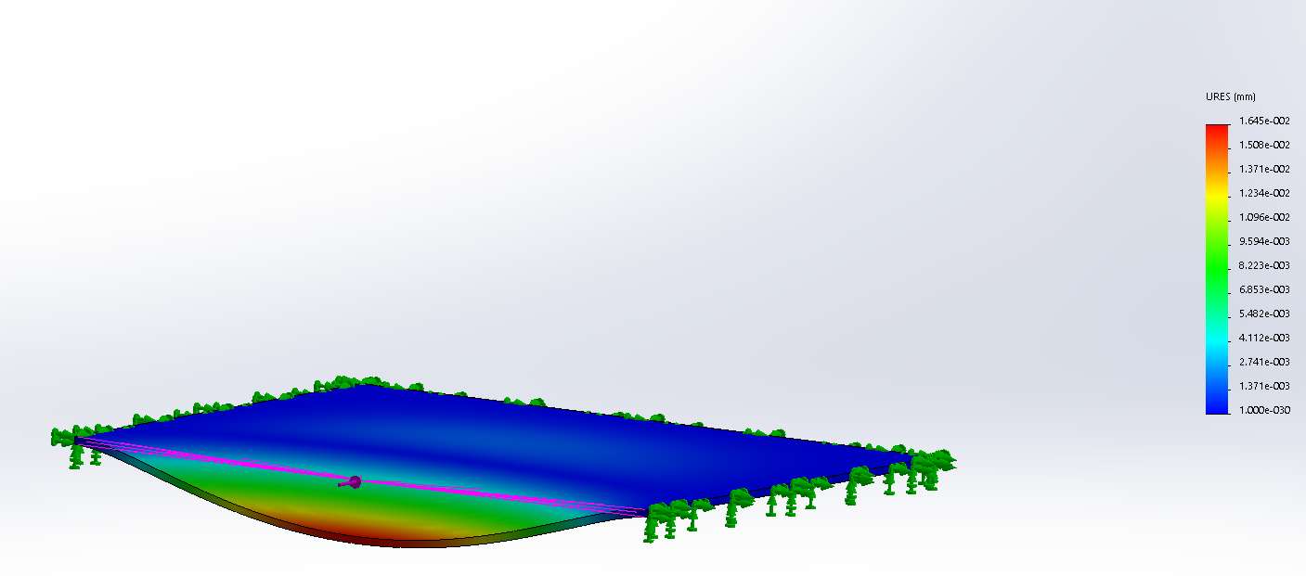
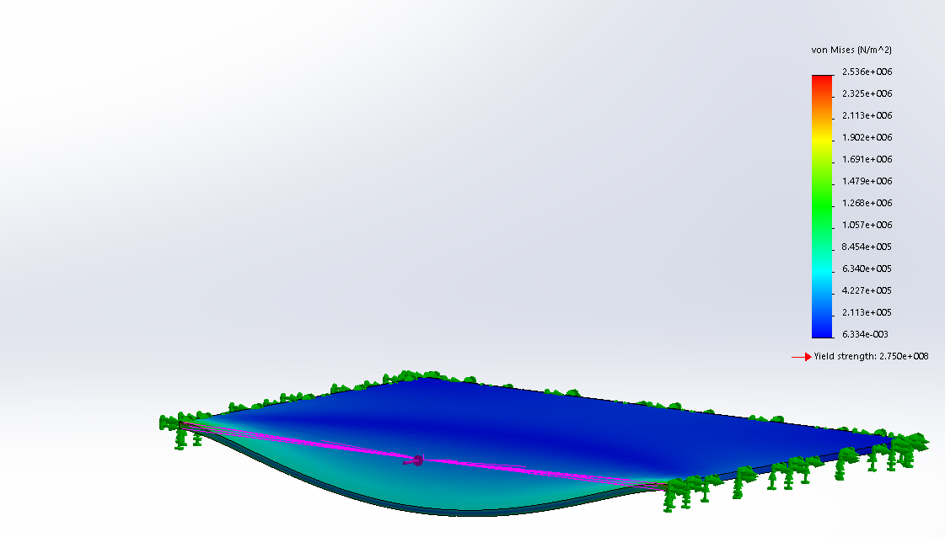
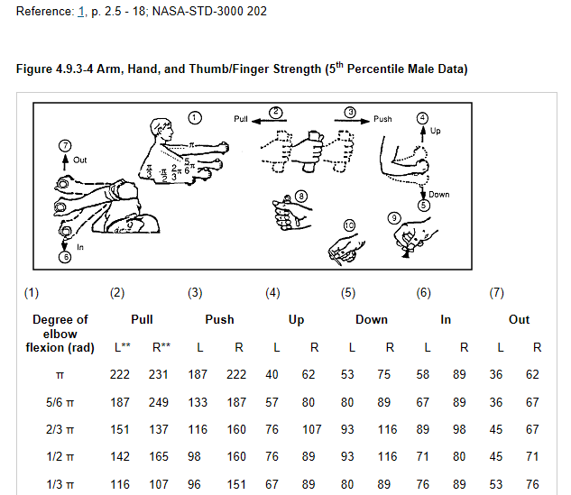
Stress and Strain Analysis
A SolidWorks simulation was conducted to certify that a person with a significant amount of strength (222 N) would not be able to break into the medication lockbox using a screwdriver.
Deflection: 0.0165 mm
Stress: 2.536 * 10^6 N/m^2
Notes:
Lorena

Slide 11
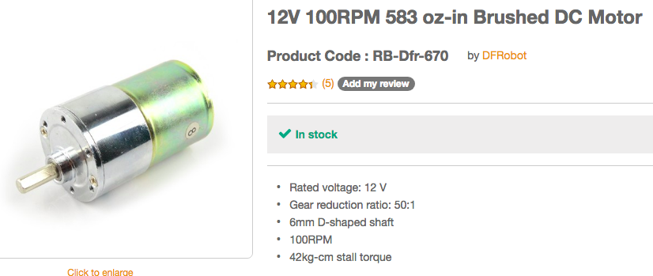
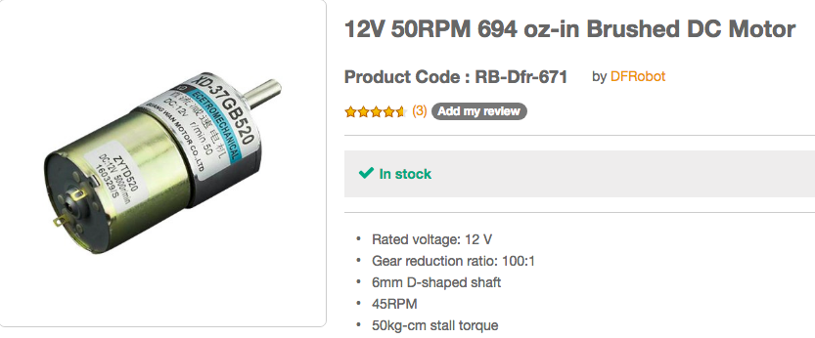
Torque Analysis
T = F * r
f_{r} = c * N
N = m * g
At constant speed:
T = rcmg
T =( (3in/12)(0.35)(50lbs)(32.2 ft/s²)) x (0.03108 lbf-ft)
During Acceleration:
T = ((3in/12)(0.35)[(50*372)(50*1/2 ft/s²)]
T = 4.4 lbf-ft
T = 4.7 lbf-ft
Notes:
Leanna

Slide 12
Motor Power Analysis
Power required for the robot to travel at 1 ft/s* with a total system load of 45 lbs
0.263A = Measured current under these demands
Maximum power has been provided by the manufacturer motor specifications.
P_{meas} = 12V * 0.263A = 3.16 W
P_{max} = 5.00 W
Notes:
Erin

Slide 13
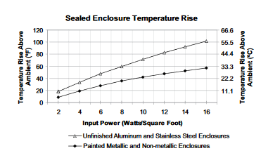
Heat Transfer Analysis
Losses in the battery:
Heat on discharge:
P = I_{max}²R_{internal} = (3.60 A)² *(0.0165 Ω) = 0.214 W(heat loss)
Losses in the motor:
P_{out} = τ •ω = ((9kgcm)(0.0981Nm/1 kgcm))*((45rpm)*(2π rad/1 rev)*(1 min/60s) ) = 4.159 W
P_{in} = V • I = 12V *0.417 A = 5 W
η = P_{out} / P_{in} = (4.159 W / 5 W )* 100 = 83.2 %
P_{loss} = P_{in} - P_{out} = 4.159 W - 5 W = -0.841 W (heat loss)
Q_{Total dissipated heat within} / A = 1.054 W / 22.5 ft² = 0.05 W/ft²
ΔT ≈ 5 °F [1.8 °C]
Notes:
Lorena

Slide 14
Electrical Analysis
Power Capability
Current drawn from PSoC (Sleep Mode) = 0.022mA
E_{sleep} = 5V * 0.022mA * 9 = 0.99 mWh
E_{delivery} = 12V * 0.263A * 12 = 37.82 Wh
Attenuation
ultrasonic _{min}: 0.5 in.
ultrasonic_{max}: 69.5 in.
RFID_{min}: 0 in.
RFID_{max}: 3.75 in.
Power Capacity
I_{sleep} = 0.022mA * 9 = 0.20 mAh
I_{delivery} = 0.263A *12 = 3.26 Ah
Notes:
Erin

Slide 15
Critical Design Specifications - ME
Spec ID | Requirement | Threshold (Shall) | Objective (Should) | Validation Method | Met | Notes
M001 | Alignment | Wheels parallel within 2 degrees | Wheels parallel within 1 degree | Tools such as a digital leveler and protractor | Partially
M002 | Speed | Travel at least 1 ft/s | Travel at least 2 ft/s | Measure speed of robot and verify it meets required speed | Yes | 1.28 ft/s with 45 lb load
M003 | Turning Radius | R < 3.5 ft | R < 1 ft | Measure R of tightest possible circle that the bot can make | Partially | 1.75 ft radius, but slower than 1 ft/s
M004 | Stability | Support at least 45 lbs without tipping (at 1 ft/s) | Support at least 65 lbs without tipping (at 1 ft/s) | Load with specific weight and observe movement | Yes
Notes:
Joanna

Slide 16
Critical Design Specifications - EE
Spec ID | Requirement | Threshold (Shall) | Objective (Should) | Validation Method | Met | Notes
E001 | Ultrasonic Object Detection | D ≥ 12 in. | D ≥ 24 in. | Measurement of maximum distance at which each ultrasonic sensor will detect an object in front of it. | Yes | 0.5 in. ≤ D_{meas} ≤ 69.5 in.
E002 | IR Line Counting Accuracy | ≥ 90% of lines/rotations counted (a wheel will be marked with a single line to document a full rotation) | ≥ 99% of lines/rotations counted (a wheel will be marked with a single line to document full rotation) | Document and compare the number of lines counted on a wheel rotated in front of the sensor. | Yes | 100% lines counted for 3 iterations (100 lines per)
E003 | RFID Receiver Range | D ≥ 4 in. | D ≥ 8 in. | Measurement of maximum distance at which RFID receiver would read an RFID tag. | No | Range limited by hardware, not software; D_{meas} ≤ 3.75 in.
Notes:
Erin

Slide 17
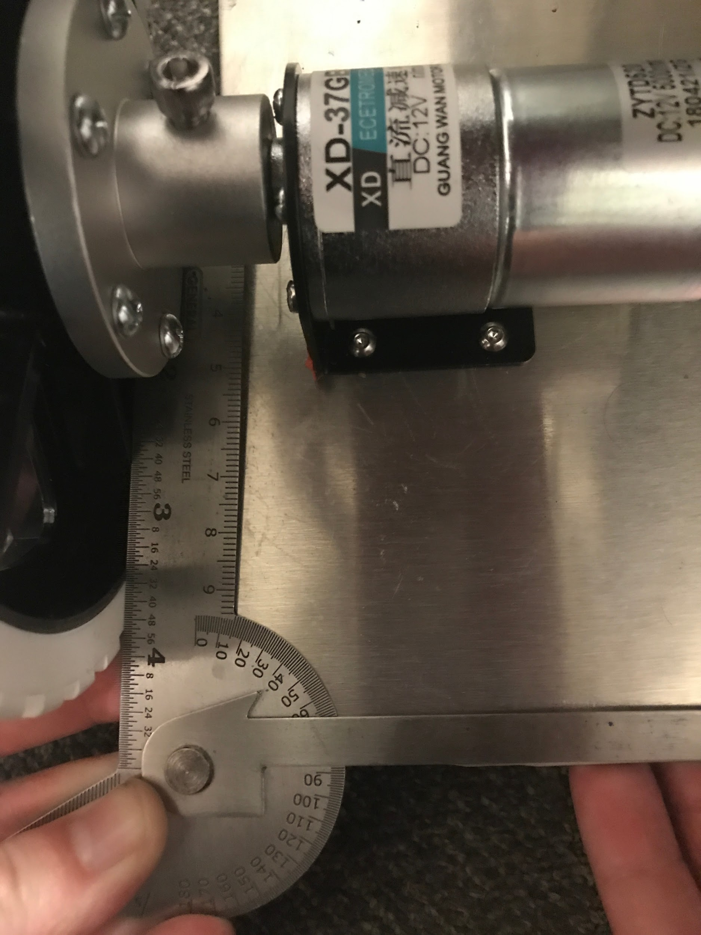
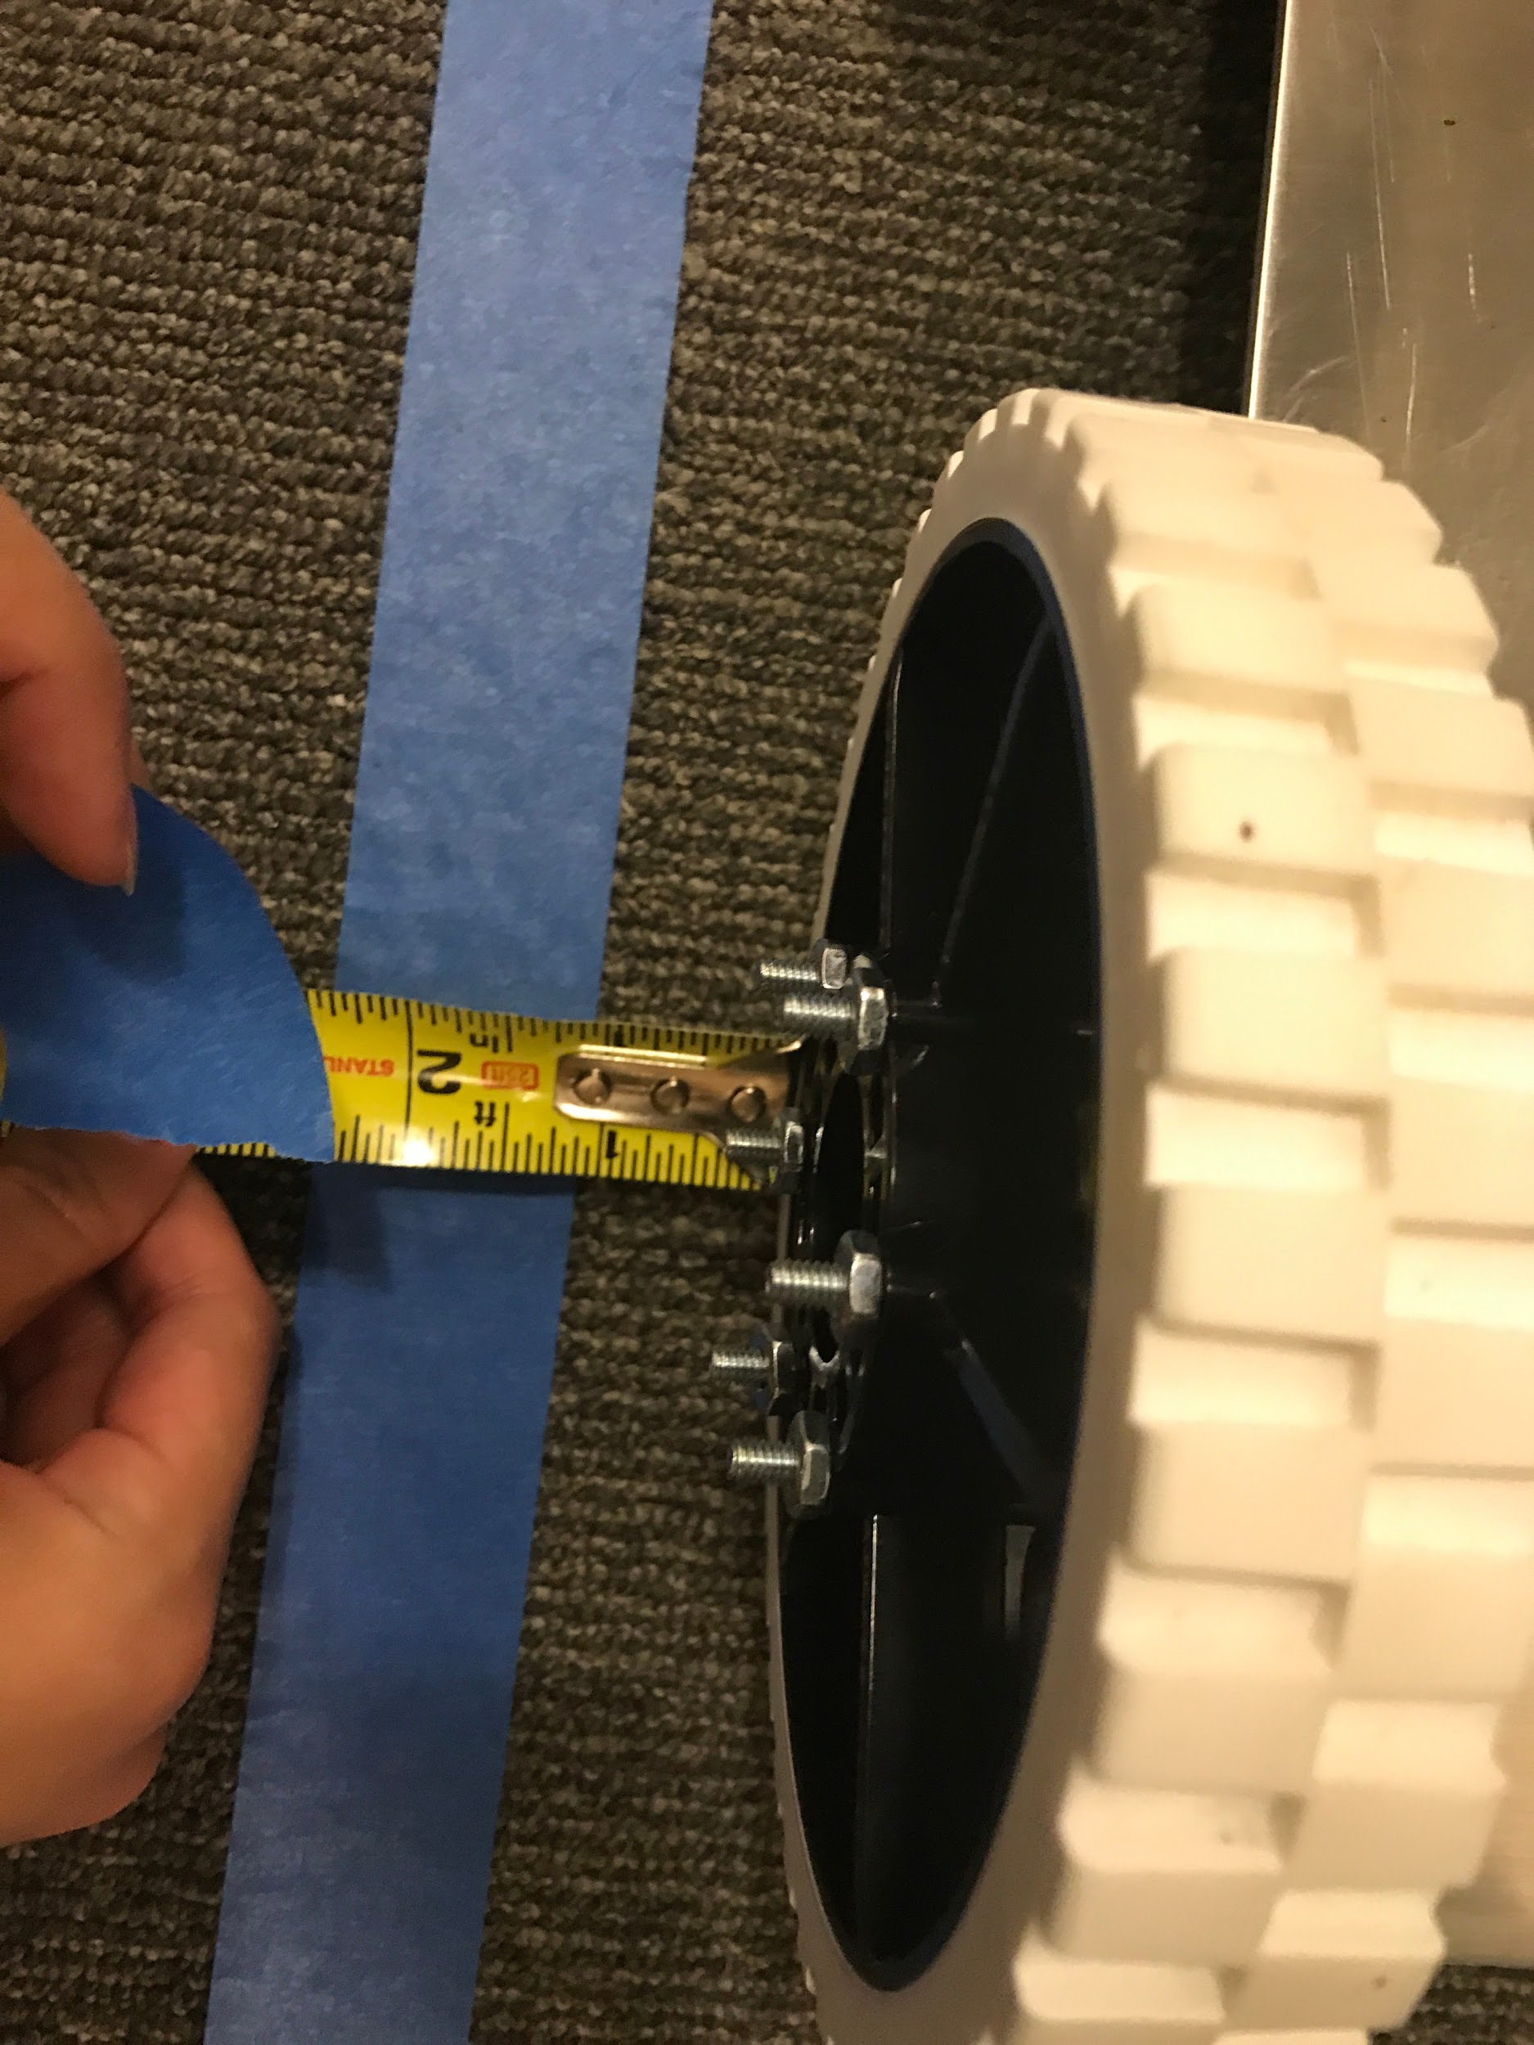
Verifying Specifications - M001
ID | Threshold | Objective | Observed
M001:Wheel Alignment | Wheels parallel within 2° | Wheels parallel within 1° | Left drive wheel: 88° Right drive wheel: 89°
Verified by using a protractor to measure the angle between the plate and the edge of the wheel
Also verified by measuring the distance deviated to the right or left of a straight path. The measured deviation was 1in to the right
Notes:
Leanna

Slide 18
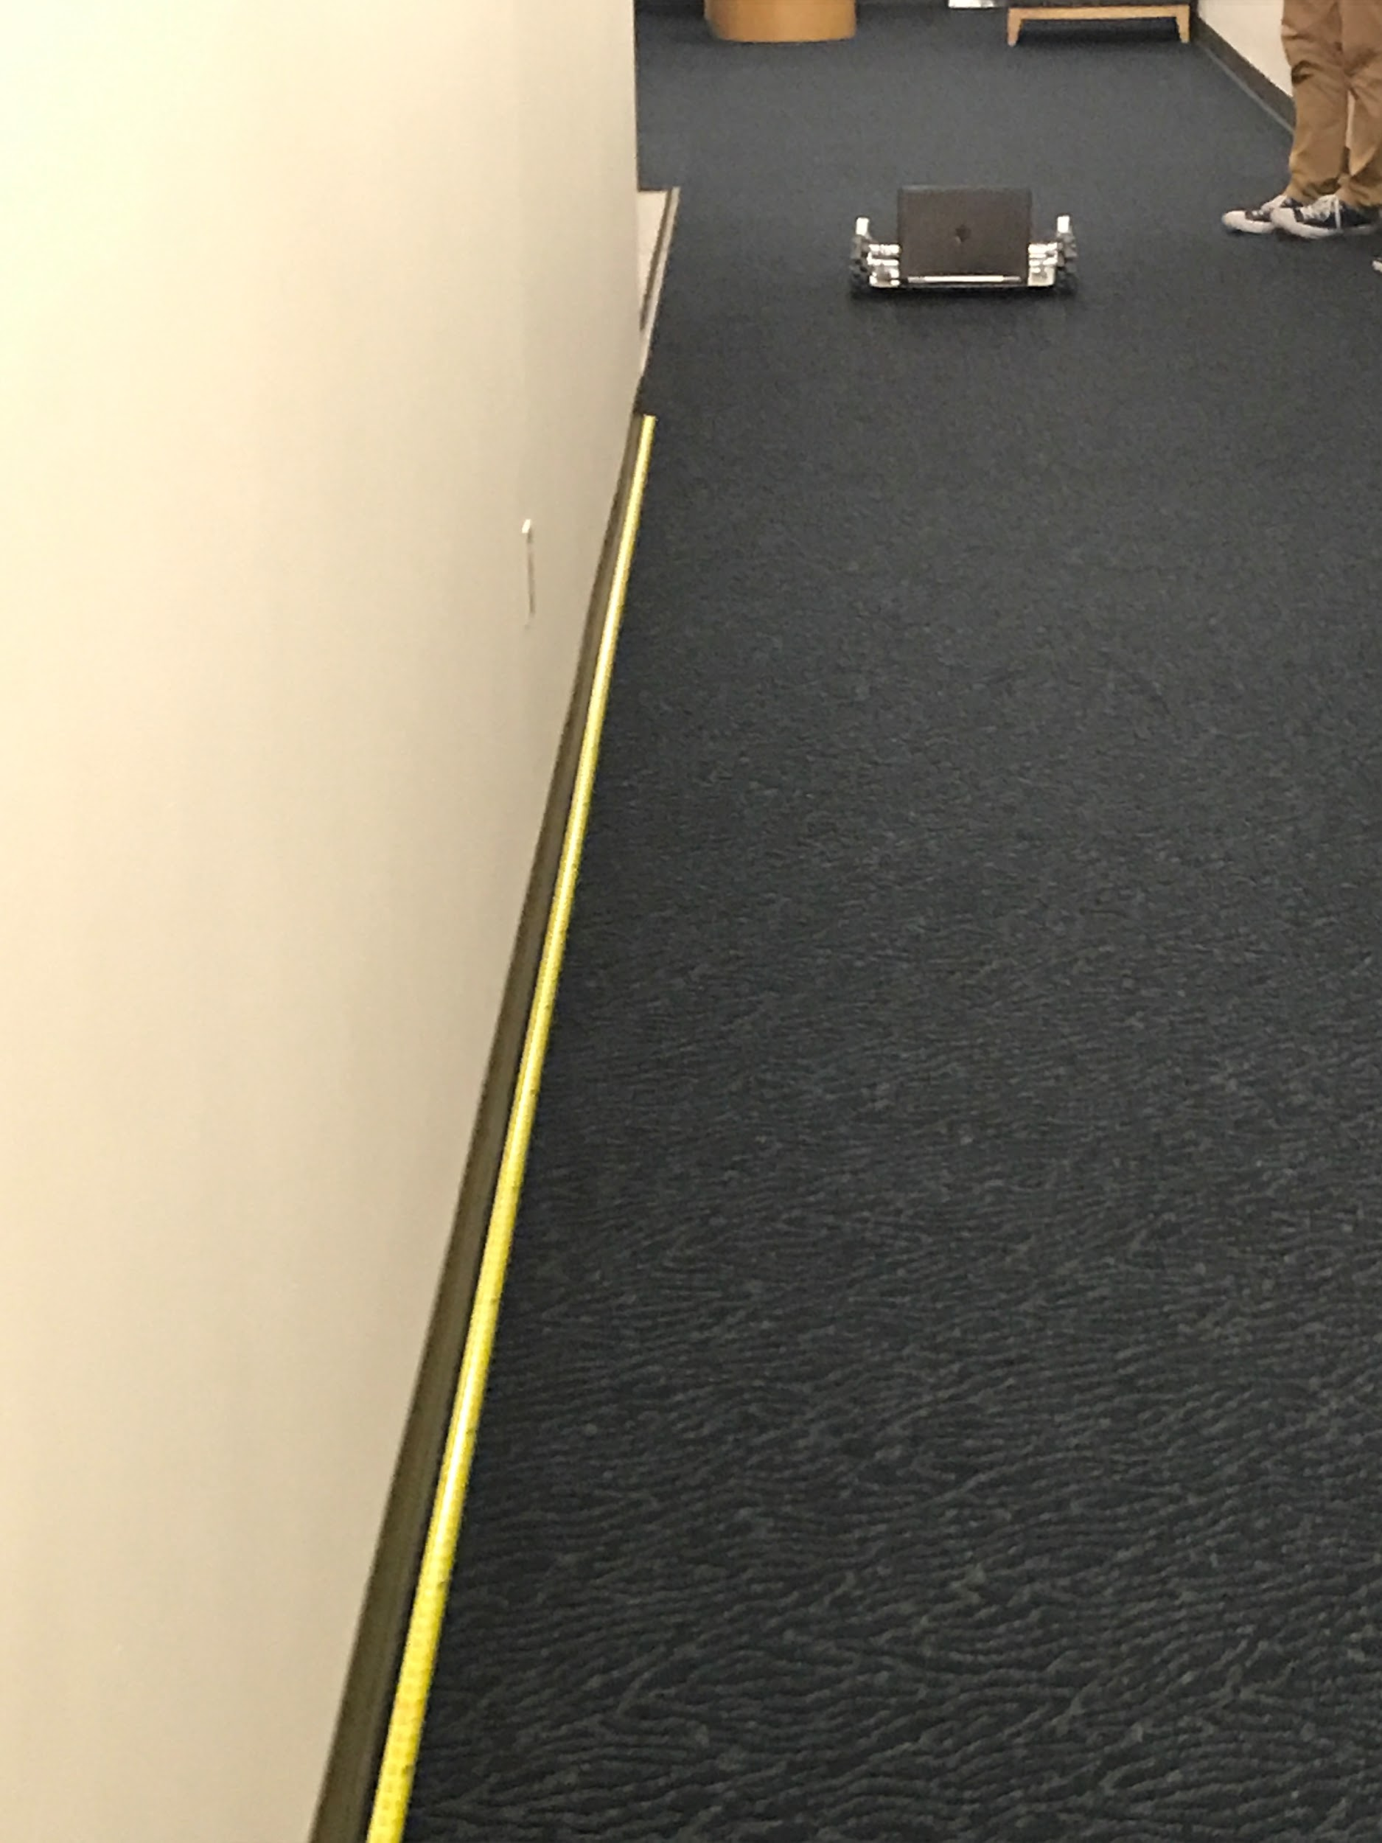
Verifying Specifications - M002
ID | Threshold | Objective | Observed
M002:Speed | Travel at least 1 ft/s | Travel at least 2 ft/s | Travelled at 1.28 ft/s
Verified by observing and timing the displacement of the bot loaded with 45lbs and supplied with 100% power.
The bot took 7.8 seconds to move 10ft
Notes:
Leanna

Slide 19
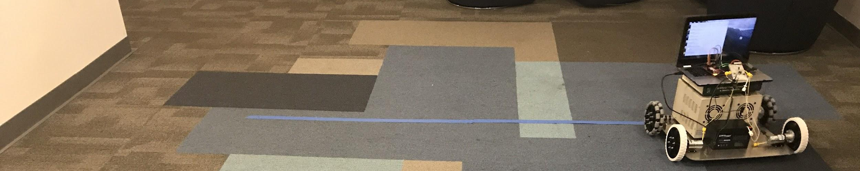
Verifying Specifications - M003
ID | Threshold | Objective | Observed
M003:Turning Radius | R < 3.5 ft | R < 1 ft | R= 1.7 ft at 0.9 ft/s
Verified by observing whether the bot turned within 3.5ft radius while moving at 1 ft/s.
The bot took 12.33 seconds to turn around a 129 in (11 ft) circumference.
Notes:
Lorena

Slide 20
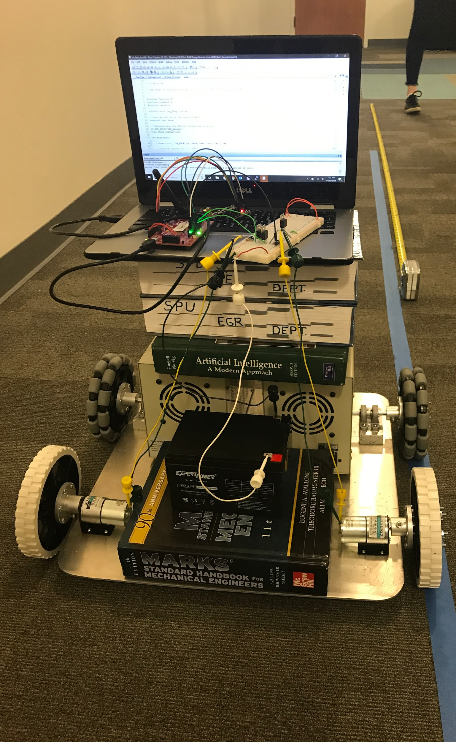
Verifying Specifications - M004
ID | Threshold | Objective | Observed
M004:Stability | Support at least 45 lbs without tipping (at 1 ft/s) | Support at least 65 lbs without tipping (at 1 ft/s) | 45lbs (1.28 ft/s) 65lbs (1.23 ft/s)
Verified by loading the bot with 45 lbs and 65 lbs respectively and recording the time taken to travel 10ft.
The bot took 7.8 seconds to travel 10ft with a mass of 45 lbs and 8.12 seconds to travel 10ft with a mass of 65 lbs
Mechanical RRP loaded with 65 lbs
Notes:
Lorena

Slide 21
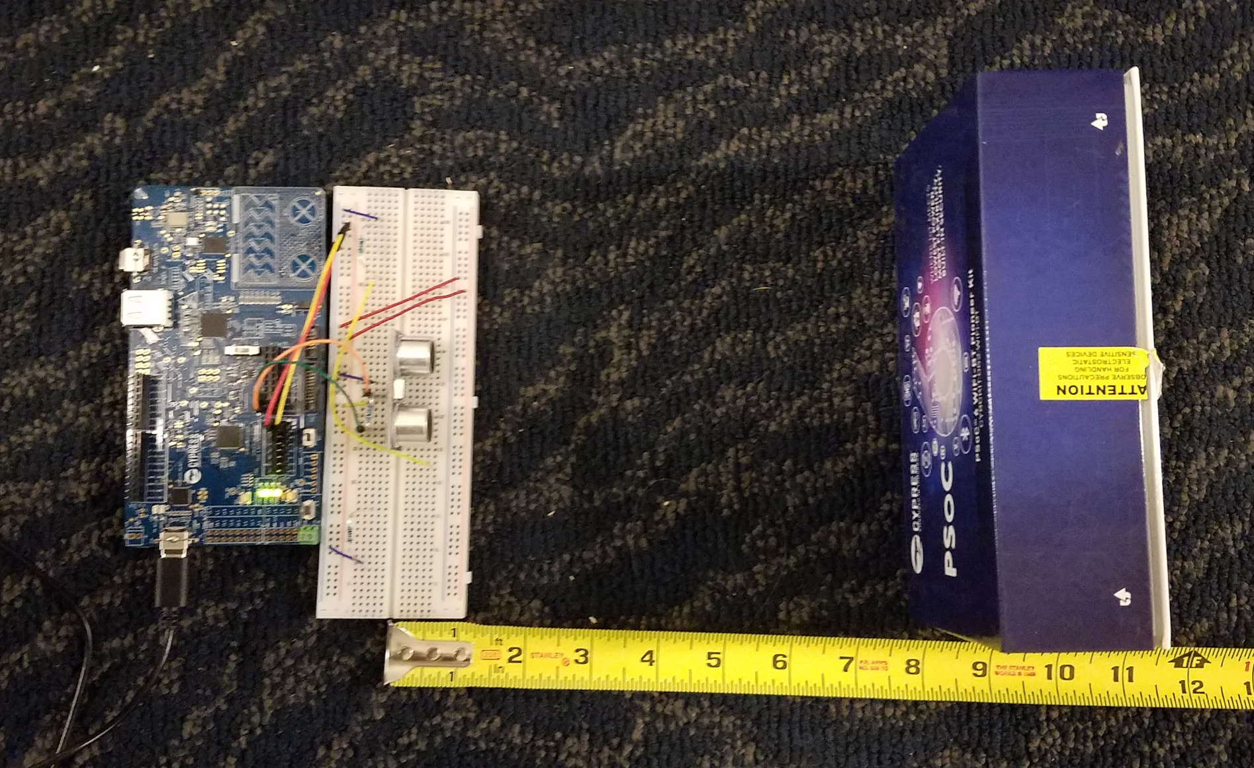
Verifying Specifications - E001
ID | Threshold | Objective | Observed
E001: Ultrasonic Object Detection | D ≥ 12 in. | D ≥ 24 in. | 0.5 in. ≤ D_{meas} ≤ 69.5 in.
Verified by placing an object in front of the sensor and moving the object away while observing the output from the sensor on screen
The Ultrasonic sensor was able to consistently show accurate distance readings for distances between 0.5 inches to 70 inches; out of that threshold the values start jumping sporadically
Notes:
nick

Slide 22
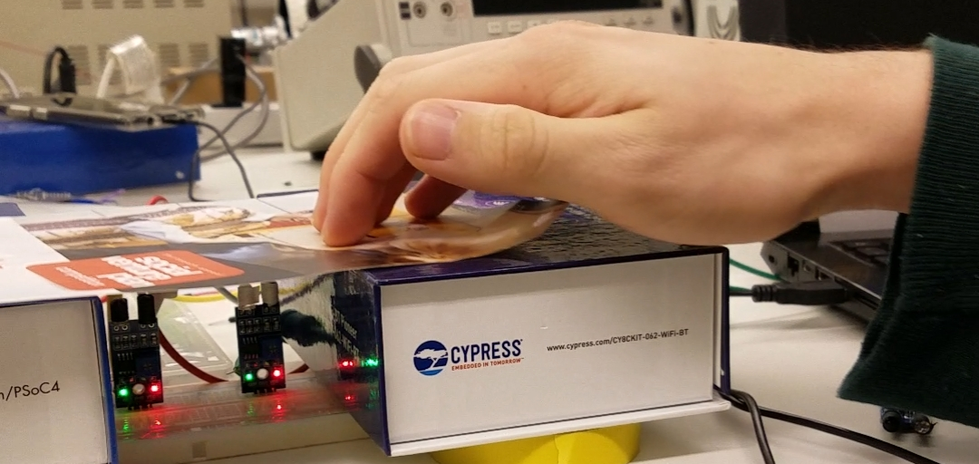
Verifying Specifications - E002
ID | Threshold | Objective | Observed
E002: IR Line Counting Accuracy | ≥ 90% of lines/rotations counted (a wheel will be marked with a single line to document a full rotation) | ≥ 99% of lines/rotations counted (a wheel will be marked with a single line to document full rotation) | 99.6% lines counted for 3 iterations (100 lines per)
Verified by drawing a black line on white paper to simulate the line on the wheel, then run the line over the sensor to then count the lines
After passing the line over the sensor a total of 100 times, the sensor was able to pick up all 100 count
Notes:
nick

Slide 23
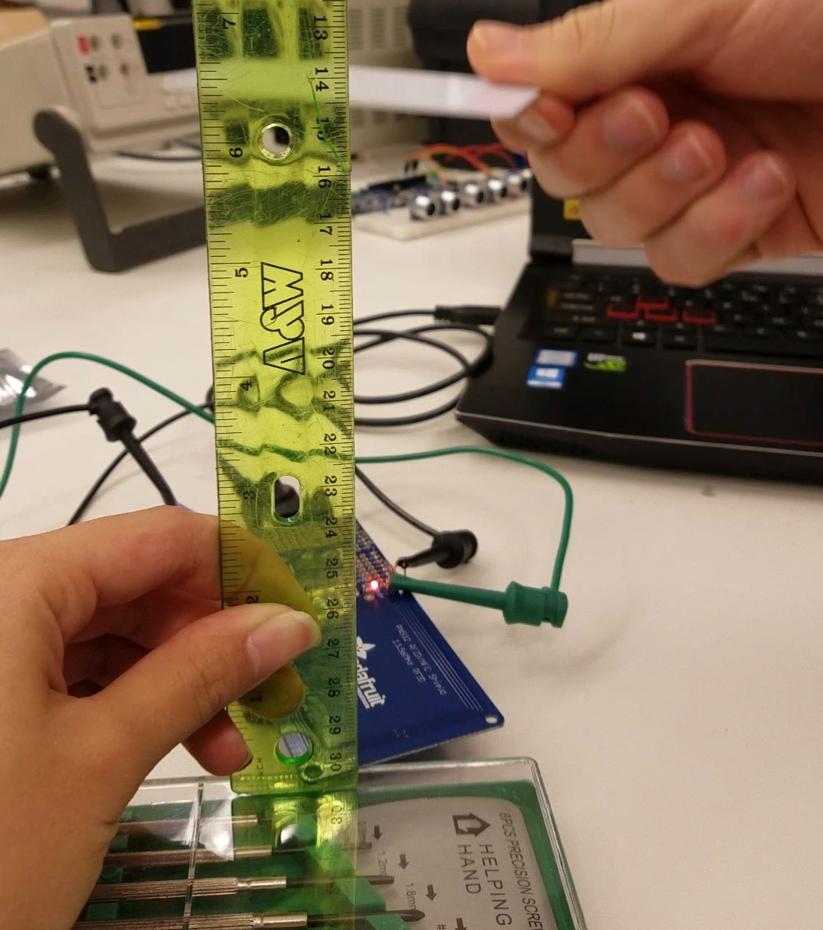
Verifying Specifications - E003
ID | Threshold | Objective | Observed
E003: RFID Receiver Range | D ≥ 4 in. | D ≥ 8 in. | D_{meas} ≤ 3.75 in.
Verified by setting up the RFID reader and then moving the RFID card closer to the module until it was able to read the identification number
The sensor was able to pick up the RFID card identification number when it was 3.75 inches above the RFID reader module
Notes:
nick

Slide 24
Winter Schedule
Winter Break:
New motors
Internal bracing structure and locking mechanism
Memory device/module
H bridges
PSoC 6 Stampboard
Outer protective material selection
Immediate Tasks (First Week):
Create preliminary fabrication plan and drawings for entire Pill-Bot structure/body
Create plan for integrating sensors to Pill-Bot
Update CAD drawings
Notes:
Lorena

Slide 25
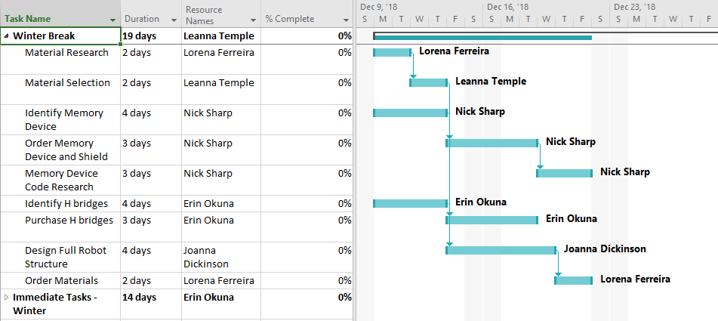
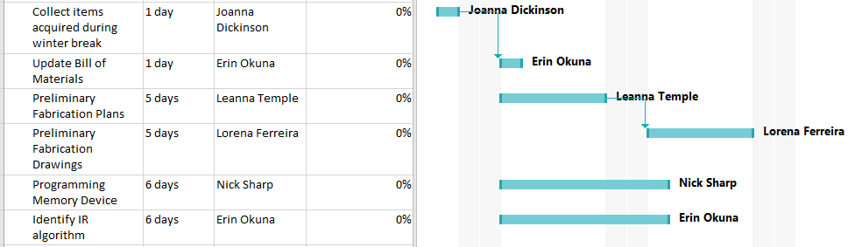
Winter Schedule
Notes:
Lorena

Slide 26
Questions?

Slide 27
References
https://msis.jsc.nasa.gov/sections/section04.htm#_4.9_STRENGTH
https://images-na.ssl-images-amazon.com/images/I/B1jErlL43zS.pdf
https://rcbenchmark.gitlab.io/docs/en/dynamometer/theory/how-to-measure-brushless-motor-and-propeller-efficiency.html
https://pediatriceducation.org/2013/06/03/what-ambient-temperature-is-appropriate/

Slide 28
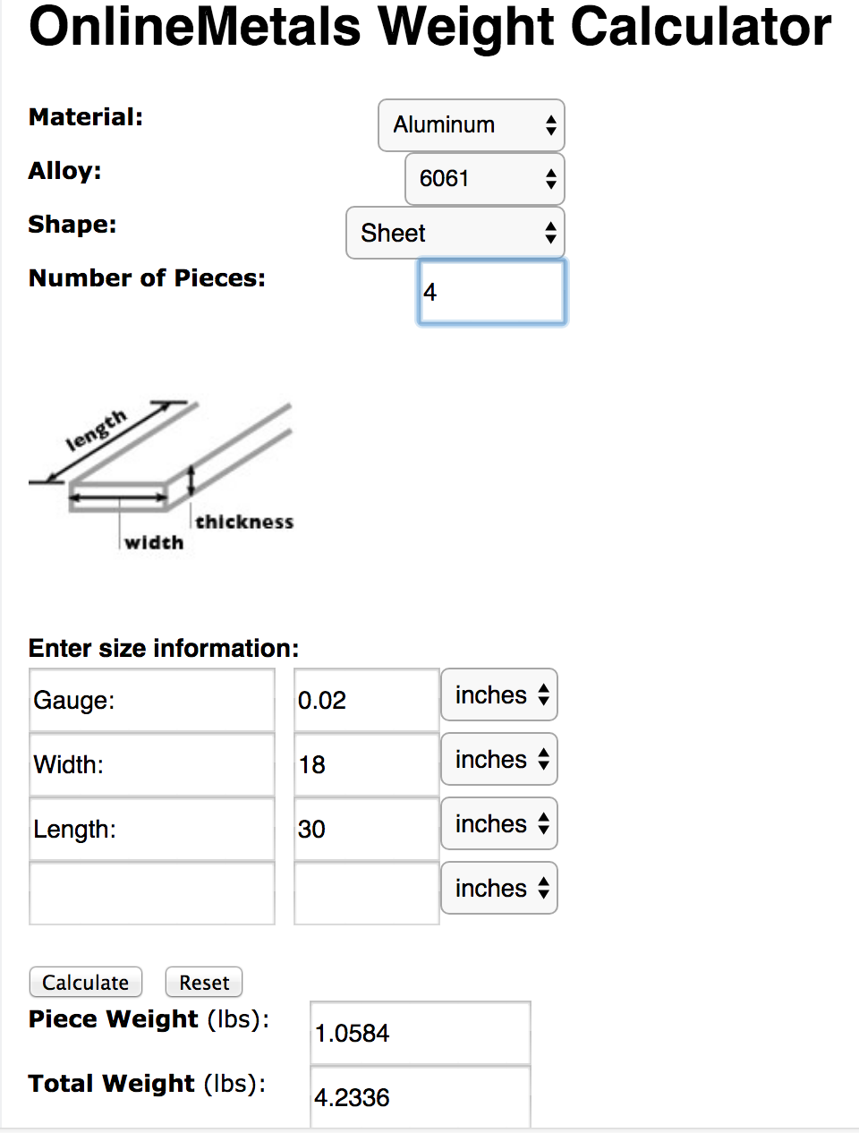
Additional Slides- Total Mass - Exterior Material

Slide 29
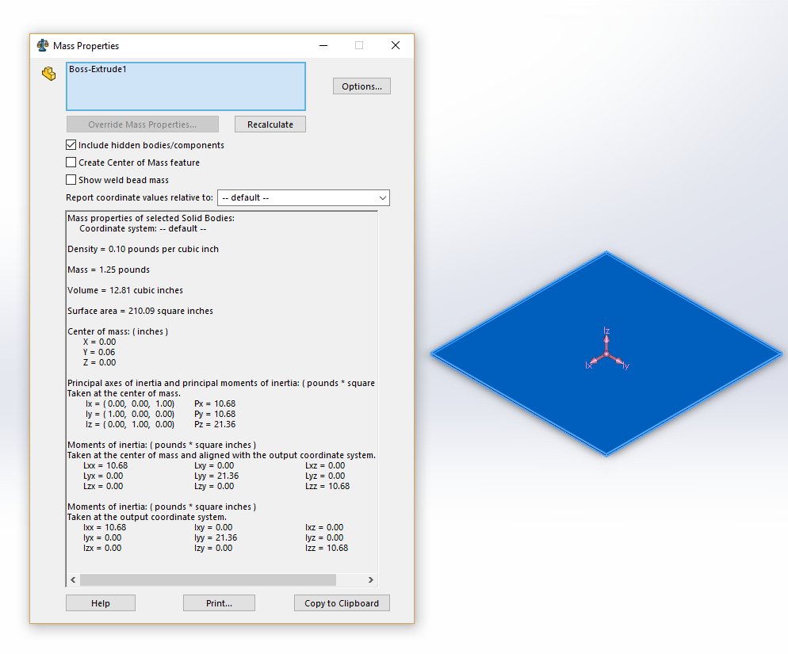
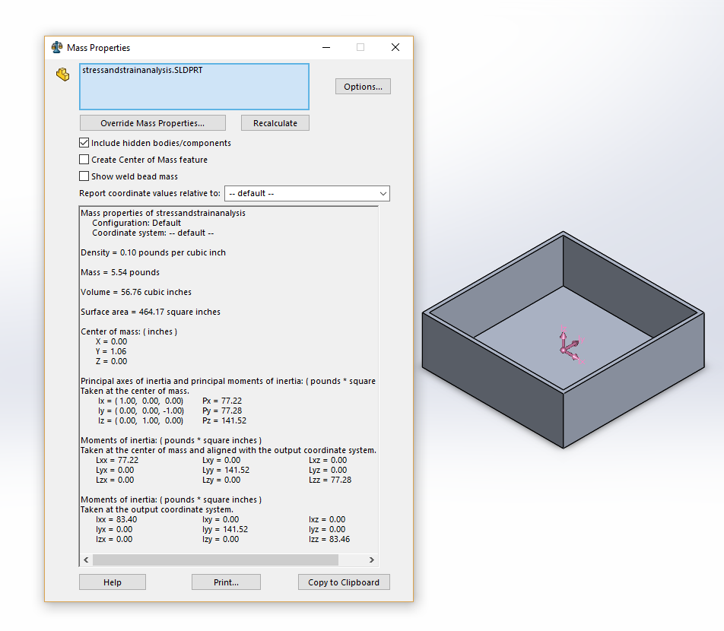
Additional Slides- Total Mass Analysis - Medications
360 Pills were weighed: 0.5 lbs
Empty pill bottle weighed: 1 oz X 36 bottles = 2.25 lbs
Above materials: 1.25 + 5.5 lbs = 6.75 lbs
TOTAL: 9.5 lbs

Slide 30
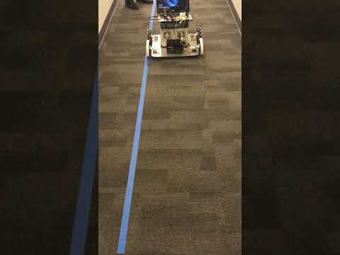
Additional Slides - Speed Verification

Slide 31
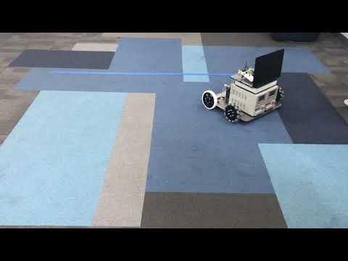
Additional Slides - Turning Radius Verification

Slide 32

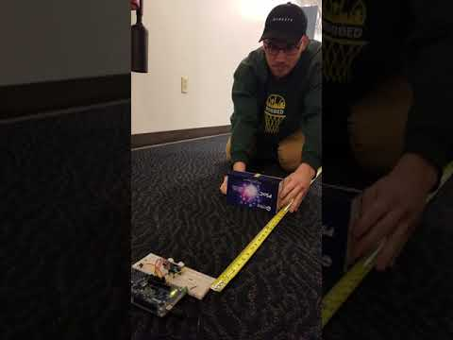
Additional Slides - Ultrasonic Distance Verification

Slide 33

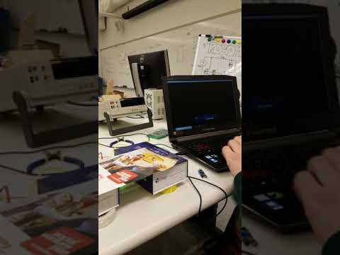
Additional Slides - IR Distance Tracking Verification

Slide 34

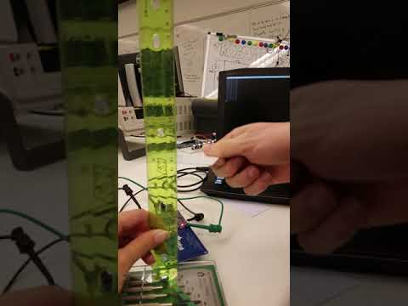
Additional Slides - RFID Tag Reader Verification

