Slide 1
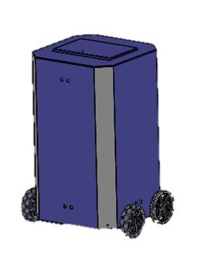
The Robo-Medics
Joanna Dickinson, Lorena Ferreira, Erin Okuna,
Nick Sharp, Leanna Temple
1/29/19

Slide 2

Pill Bot
Robo-Medics: Joanna Dickinson (ME), Lorena Ferreira (ME), Erin Okuna (EE), Nick Sharp (CPE), Leanna Temple (ME)
Objective:
To design a simple robot that will deliver prescribed pills to patient's rooms at specified times.
A 2002 study by the American Association of Medicine revealed 19% of doses are incorrectly delivered.
It is also common for patients to receive medication at the wrong times due to medical emergencies or insufficient staffing.
Possible customers include: hospitals, nursing homes, hospice care, etc.
Concept:
A robot that is placed within medical facilities and navigates to specific rooms at designated times to deliver medication to nurses/patients.
Pharmacist/nurse loads daily medications
into secured lockbox
Pill Bot autonomously delivers medications
to locations at specified times
Pictured Right: Concept robot
Approach:
Navigate by placing RFID sensors in each room
UI for user-controlled schedule
Locked pill box requiring nurse code in order to access
Two independent motors control mobilization & turning
Sensors to detect obstacles
Budget and Schedule:
Budget:
Mechanical Components - $970
Electrical Components - $675
Estimated Total - $1,700 ($812 spent to date)
Total External Funding: $0
Schedule:
Initial Prototype Completed - March 10th
Final Prototype Completed - May 30th
Notes:
Leanna

Slide 3
Functional Specifications
Safety and Security
Spec ID | Requirement | Threshold (Shall) | Objective (Should)
SS-01 | Lockbox Protection | Withstand at least 200 in-lb | Withstand at least 250 in-lb
SS-02 | Object Detection | 2.5ft | 4ft
SS-03 | Electrical Component Access | Will not be accessible during normal use
SS-04 | Nurse Verification | Unlock 75% of the time | Unlock 95% of the time
SS-05 | Cleanability | Will be sterilizable (will resist degradation by bleach and alcohol)
S-03 | Capacity | 12 Compartments | 24 Compartments
Notes:
Nick
Leanna

Slide 4
Functional Specifications
Ease of Use
Spec ID | Requirement | Threshold (Shall) | Objective (Should)
U-01 | Data Entry | Be equipped with a cable | Program wirelessly
U-02 | Medication Identification | Will have LED compartment indication
U-03 | Room Display | Screen will display correct room number
Notes:
Nick

Slide 5
Functional Specifications
Efficiency
Spec ID | Requirement | Threshold (Shall) | Objective (Should)
E-01 | Speed | At least 1.5 ft/s | At least 2 ft/s
E-02 | Battery Usage | 4 hours w/o charge | 8 hours w/o charge
E-03 | Home Base | Within 3 ft of outlet | Within 1 ft of outlet
E-04 | Charging Time | Fully charge within 16 hrs | Fully charge within 8 hrs
Notes:
Erin

Slide 6
Functional Specifications
Maneuverability
Spec ID | Requirement | Threshold (Shall) | Objective (Should)
M-01 | Stability | Support at least 45 lbs without tipping | Support at least 60 lbs without tipping
M-02 | Turning Radius | R < 2 ft | R = 0 ft
M-03 | Acceleration/Deceleration | At least 1 ft/s^2 | At least 1.5 ft/s^2
Notes:
Joanna

Slide 7
Functional Specifications
Accuracy
Spec ID | Requirement | Threshold (Shall) | Objective (Should)
A-01 | Distance Calculation | 80% Accuracy | 95% Accuracy
A-02 | Navigation | Detect and process 80% of RFIDs scanned | Detect and process 95% of RFIDs scanned
A-03 | Room Verification | Correct room 90% of the time | Correct room 98% of the time
A-04 | Delivery Time | 3 min. Within scheduled delivery time | 1 min. Within scheduled delivery time
Notes:
Nick

Slide 8
Functional Specifications
Size
Spec ID | Requirement | Threshold (Shall) | Objective (Should)
S-01 | Weight | < 60 lbs | < 45 lbs
S-02 | Dimensions | <24’’x 24’’x 40’’ (BxWxH) | <20’’x 20’’x 38’’ (BxWxH)
S-03 | Capacity | 12 compartments | 24 compartments
Notes:
Joanna

Slide 9
Functional Specifications
Cost and Appeal
Spec ID | Requirement | Threshold (Shall) | Objective (Should)
C-01 | Production Cost | < $1500 | < $1000
AP-01 | Visually Suitable | 60% | 85%
Notes:
Lorena

Slide 10

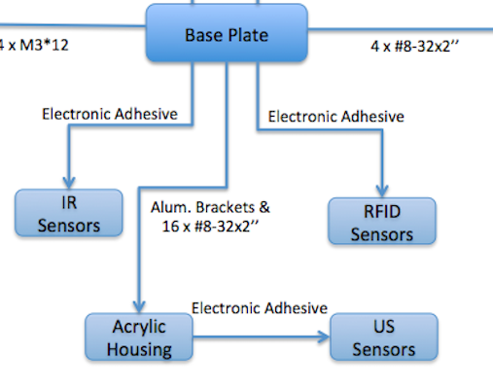
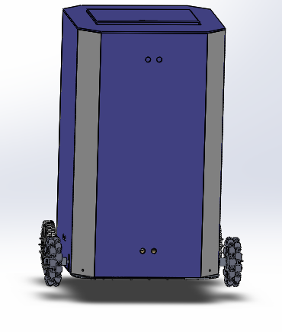
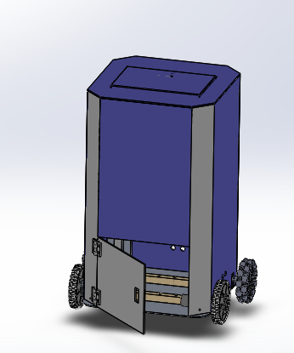
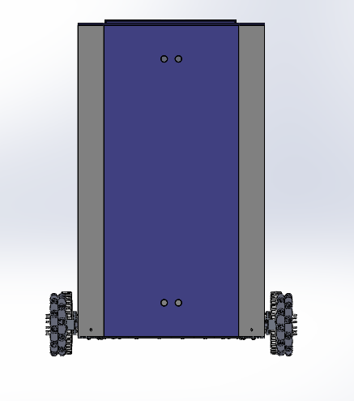
Mechanical Drawings
Housing
Notes:
Lorena

Slide 11
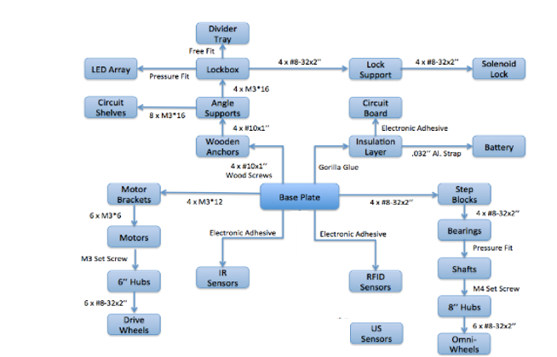
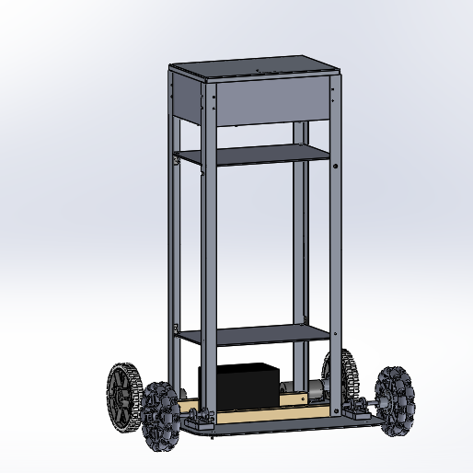
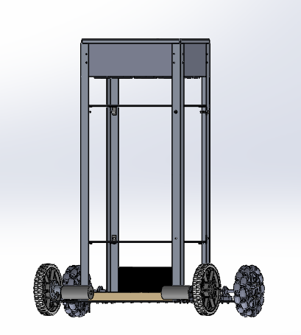
Mechanical Drawings
Notes:
Joanna

Slide 12
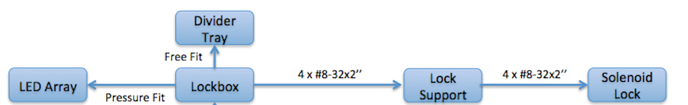
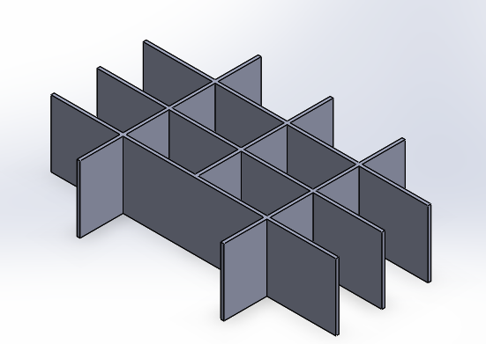
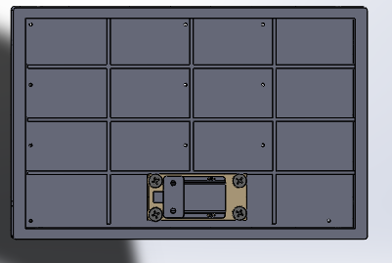
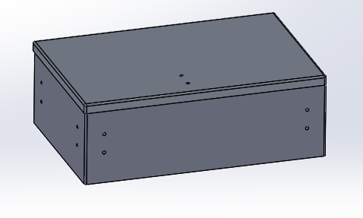
Mechanical Drawings
Lockbox and Locking Mechanism
Notes:
Leanna

Slide 13
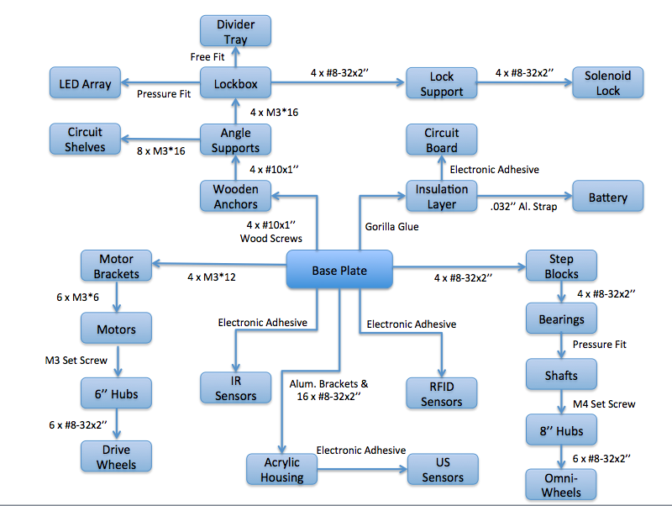
Mechanical Drawings
Notes:
Leanna

Slide 14
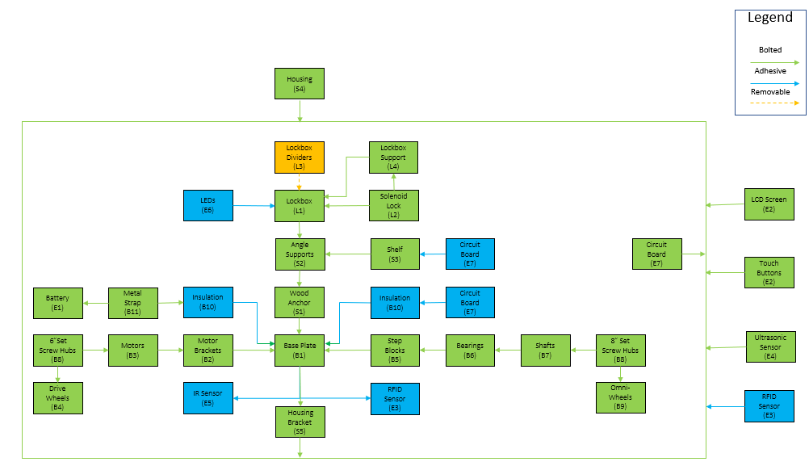
Mechanical Block Diagram
Notes:
Leanna

Slide 15
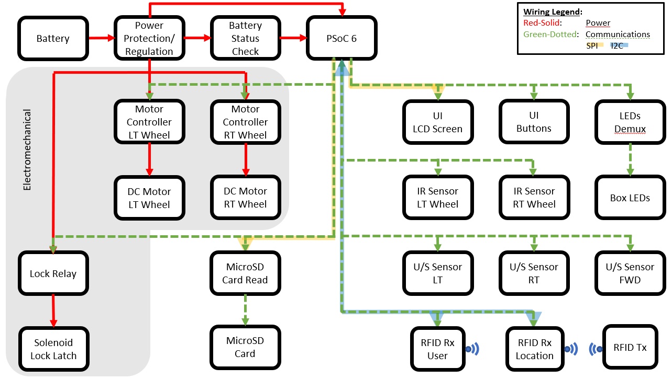
Electrical Block Diagram
Notes:
Erin

Slide 16
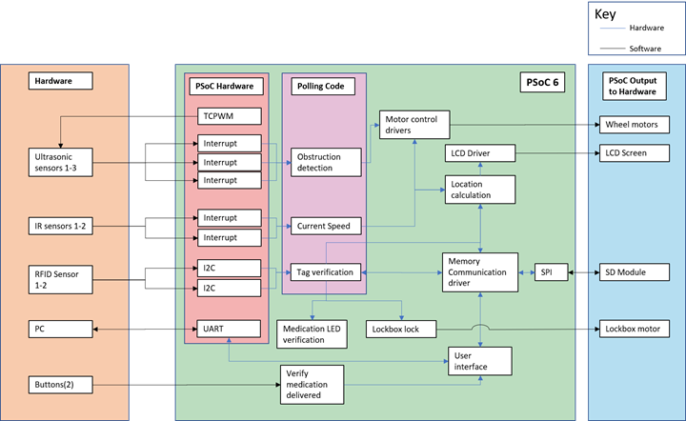
Software/Firmware Diagram
Notes:
Nick

Slide 17
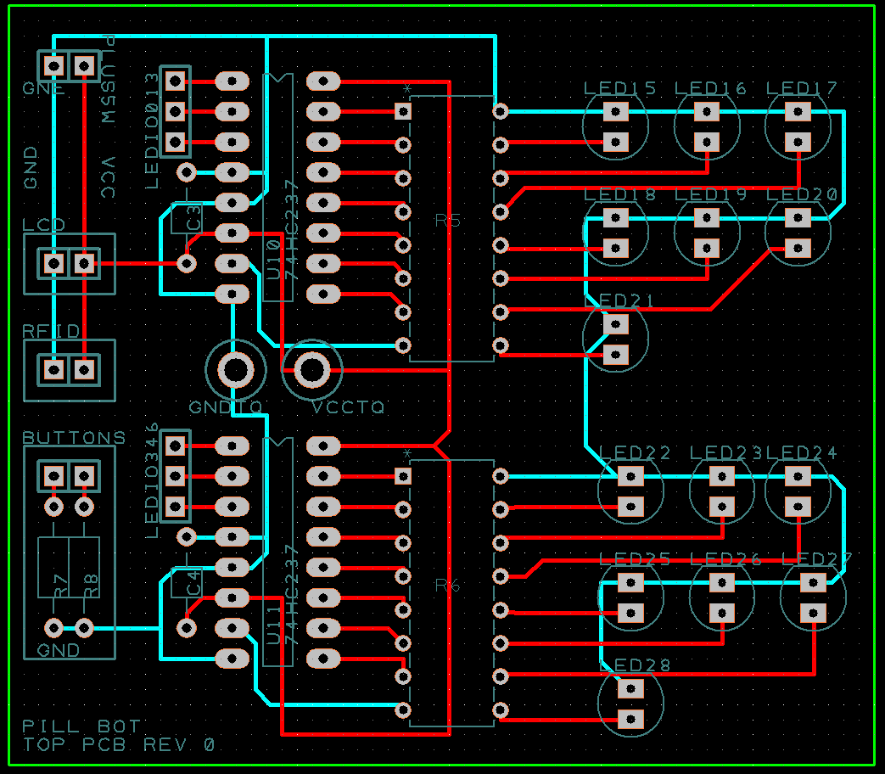
PCB Design - Upper PCB
Notes:
Erin

Slide 18
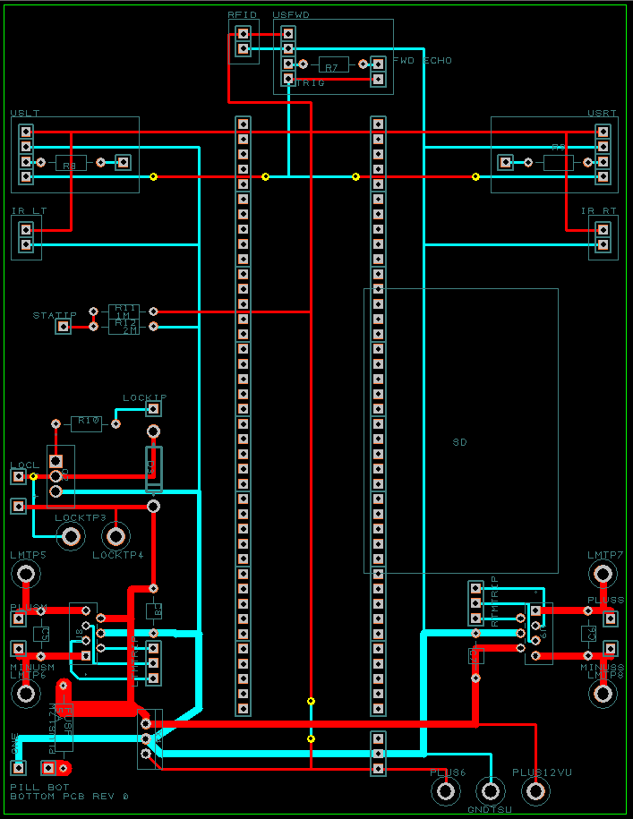
PCB Design - Lower PCB
Notes:
Erin

Slide 19
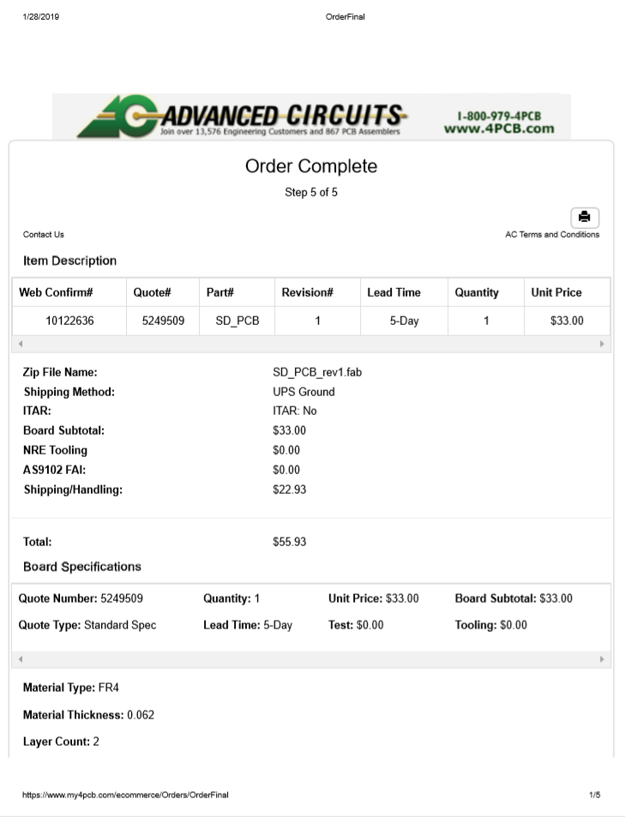
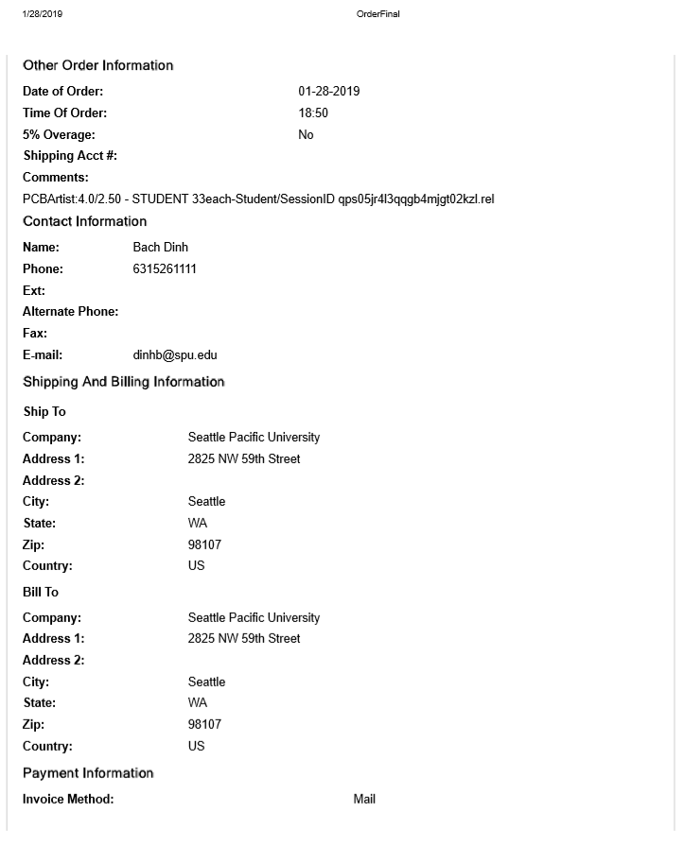
PCB Receipt
*Combined PCB schematics and ordered with another group
Notes:
Erin

Slide 20
Engineering Analyses List
Updated analyses in red, unchanged analyses in green
Mechanical Analyses
Torque
Motor Power
Heat Transfer
Stability
Center of Mass
Total Mass
Stress/Strain
Electrical Analyses
Power Consumption
Power Capacity
Sensor Range
Notes:
Lorena

Slide 21
Total Mass Analysis
CAD model with appropriate assigned materials weighed: 40.40 lbs
Remaining materials estimations were made for:
    Pills: 0.5 lbs
    Individual bottles: 2.25 lbs
    Circuits and wiring: 5 lbs
Updated total is estimated to be 48.15 lbs
Notes:
Joanna

Slide 22
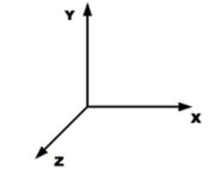
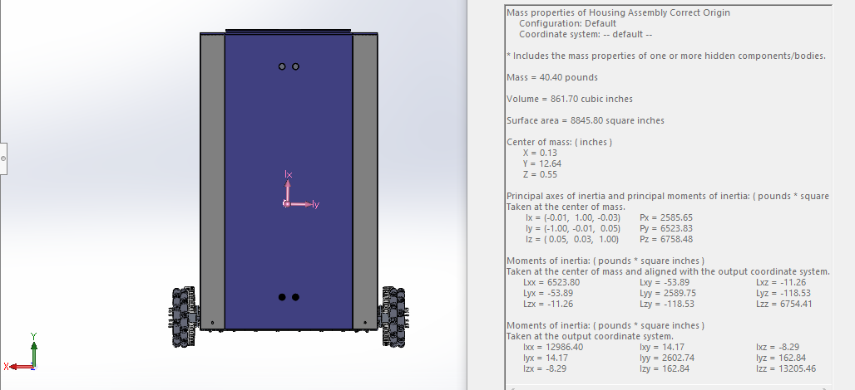
Center of Mass Analysis
Notes:
Joanna

Slide 23
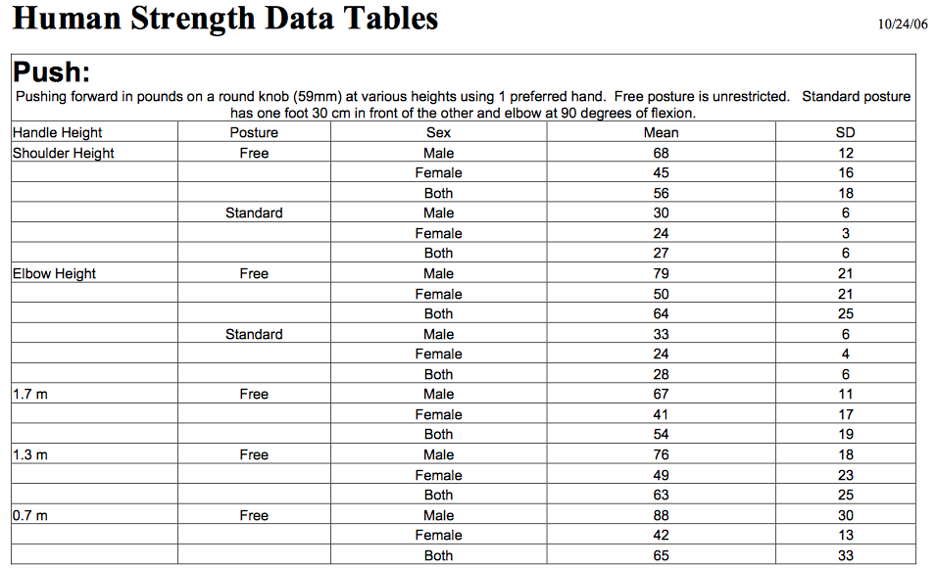
Stress and Strain Analysis
Updated forces to analyze: 250 in*lbs using a small screwdriver, for 90th percentile male
RIT’S Edge Data
Notes:
Leanna

Slide 24
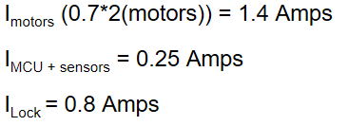
Power Capacity Analysis
Currents drawn during sleep mode and delivery mode were previously calculated under analyses for motor power and power capability.
When running the bot for an 8 hour shift, it is calculated that the battery will need a minimum capacity of 7.664 Ah.

Slide 25
Project Demonstration Plan
At the end of winter quarter Robo-Medics will demonstrate an autonomous robot that:
Can hold its own weight plus the weight of medication.
Meets the above size and speed specifications.
Is able to navigate through a pre-programmed path/route.
Is able to detect objects in its environment and avoid collision.
Is equipped with a locking mechanism that opens the lockbox when an RFID card is scanned
The Robo-Medics are concerned about the lockbox protection, object detection, and appeal requirements. At the end of winter quarter the Robo-Medics will demonstrate that the medication delivery robot has the ability to detect objects, travel at specified velocities and move along a designated path. However, the navigation and object detection coding will be improved during spring quarter.
Notes:
Nick

Slide 26
Project Status
Next Components to Purchase:
Acrylic Plates
Acrylic Panels
Plastic welding adhesive
Waiting to obtain:
PSoC 6
PCB
According to schedule:
Current progress suggests that the objectives set forth this quarter are viable
Notes:
Leanna

Slide 27
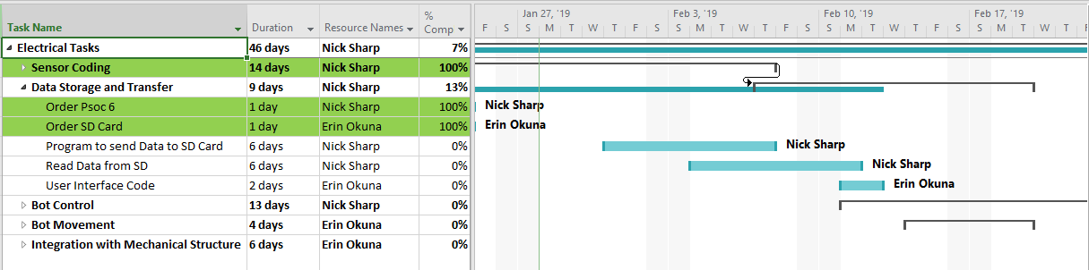
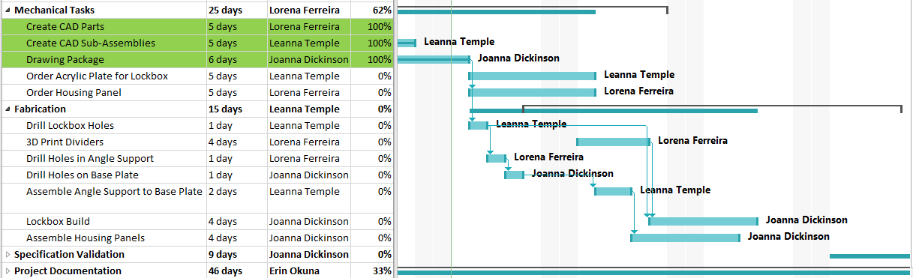
Winter Schedule
*Completed tasks highlighted in green
Notes:
Lorena

Slide 28
Questions?

