Slide 1
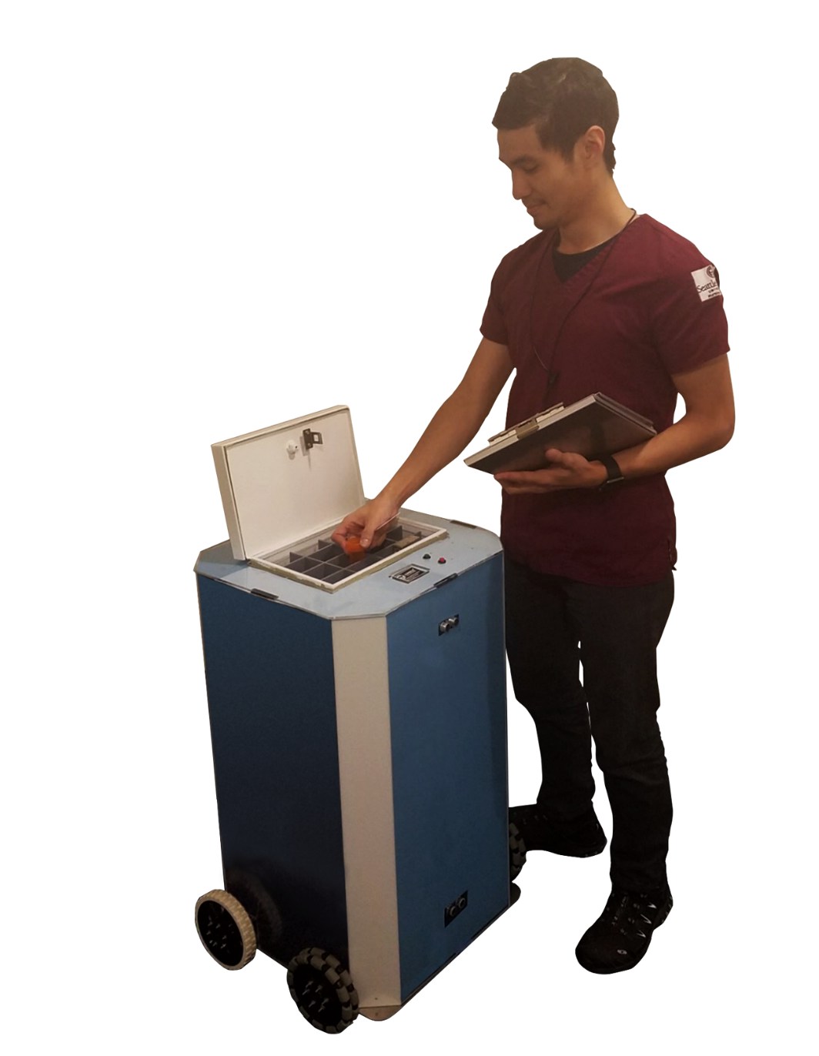
The Robo-Medics
Design Review 3.1
May 14th, 2019
Joanna Dickinson
Lorena Ferreira
Erin Okuna
Nick Sharp
Leanna Temple

Slide 2
Functional Specifications
* Passed specs are in highlighted in green, partial pass in orange, failed specs in red
Size
Spec ID | Specification | Status
S-01 | Weight - The entire pill bot should weigh no more than 45 lbs and shall weigh no more than 60 lbs. | Assembled system weighs 44 lbs
S-02 | Dimensions - The Pill Bot structure should measure no greater than 20’’x 20’’x 38’’ and shall measure no greater than 24’’x 24’’x 40’’ (BxWxH). | Assembled system measures 22” x 18” x 33”.
S-03 | Capacity - The lockbox should have the capacity to hold 24 separate medication assignments and shall have the capacity to hold 12 separate medication assignments. | Lockbox has the capacity to hold 14 separate medication assignments.
Notes:
Joanna

Slide 3
Functional Specifications
* Passed specs are in highlighted in green, partial pass in orange, failed specs in red
Maneuverability
Spec ID | Requirement | Status
M-01 | Stability - The system, moving at 1.5 ft/s and turning at 0.5 ft/s, shall support a load of at least 45 lbs without tipping, and should support a load of at least 60 lbs without tipping. | The system travels at 2.13 ft/s and turns at 1.1 ft/s without any sign of tipping,
M-02 | Turning Radius - The system shall have a minimum turning radius of 2 ft while traveling at approximately 0.5 ft/s, and should have a have a minimum turning radius of 0 ft while traveling at approximately 0.5 ft/s. | The turning radius of the system is 1’5” at 1.1ft/s
M-03 | Acceleration/Deceleration - The system shall have an acceleration/deceleration of at least 1 ft/s^2 after detecting an object, and should have a have an acceleration/deceleration of at least 1.5 ft/s^2. | The system is able to accelerate at 3 ft/s^2 and decelerates at 6 ft/s^2
Notes:
Joanna

Slide 4
Functional Specifications
* Passed specs are in highlighted in green, partial pass in orange, failed specs in red
Ease of Use
Spec ID | Specification | Status
U-01 | Data Entry - The device shall be equipped with a cable that will connect the bot directly to the USB port of a computer for data entry. The device should be able to be programmed wirelessly so the bot can move around while the data is updated. | PSoC is equipped with USB port.
U-02 | Medication Identification - The device will light up an LED when the box is unlocked to show which compartment of medication is for the specified patient. Each patient will have a specific location within the bot’s lockbox. When the lockbox is unlocked an LED will light up to show the nurse where the medication is. This will help remove any user error when the pills are distributed. | LED lights up to indicate which compartment medication should be taken from
U-03 | Room Display - The device will display the current room number for which the pills are to be delivered. | LCD screen works and prints text, but is not linked with specific rooms
Notes:
Lorena

Slide 5
Functional Specifications
* Passed specs are in highlighted in green, partial pass in orange, failed specs in red
Cost and Appeal
Spec ID | Specification | Status
C-01 | Manufacturing Cost - The total production cost shall be less than $1500 and should be less than $1000. | $1170 for total production cost
AP-01 | Visual Suitability - When a sample group of people with experience in medical facilities are asked about Pill Bot’s appeal, at least 60% shall agree that Pill Bot is visually suitable for a medical facility environment, and at least 85% should agree that Pill Bot is visually suitable for a medical facility. | 65% (13/20) of people said that the Pill Bot’s appearance was suitable for a medical facility
Notes:
Lorena

Slide 6
Functional Specifications
* Passed specs are in highlighted in green, partial pass in orange, failed specs in red
Safety and Security
Spec ID | Specification | Status
SS-01 | Lockbox Protection - Lockbox shall be able to withstand at least 200 in-lb and should withstand at least 250 in-lb without allowing access to the pills. | Stress/strain analysis showed that given 250 in*lbs torque minimal deflection occurs.
SS-02 | Object Detection - Pill Bot shall identify and avoid hazardous objects (walls, doors, people, etc.) within 2.5 ft of itself. Pill Bot should identify and avoid hazardous objects within 4 ft of itself. | Pill Bot’s ultrasonic sensors are able to detect objects and stop motors 1.5 ft away from object, falls below the desired 2.5 ft.
SS-03 | Electrical Component Access - Pill Bot’s internal electrical components will not be directly accessible during normal use. | Housing and hinged door cover electrical components during use.
SS-04 | Nurse Verification - Pill Bot’s lockbox shall automatically unlock when the correct RFID is scanned 75% of the time. The lockbox should automatically unlock when the correct RFID is scanned 95% of the time. | The RFID was scanned and tested. It successfully unlocked the lockbox 100% of the time.
SS-05 | Cleanability - The Pill Bot system will be sterilizable. The panels will be resistant to degradation by bleach and alcohol and sealed with an IP-68 compliant sealant on all closed edges. | Lockbox interior structure consists of non-abrasive polycarbonate panels that are resistant to degradation by bleach and alcohol (not exterior panels).
Notes:
Leanna

Slide 7
Functional Specifications
* Passed specs are in highlighted in green, partial pass in orange, failed specs in red
Efficiency
Spec ID | Requirement | Status
E-01 | Speed - The system shall be able to travel at a velocity of at least 1.5 ft/s, and system should be able to travel at a velocity of at least 2.0 ft/s | The Pill Bot is able to travel from one room to the other at a speed of 2.13 ft/s
E-02 | Battery Usage - The system battery shall support 8 hours of continuous operation with a 50% duty cycle, and should support 12 hours with a 50% duty cycle. | 11 hours and 8 minutes of continuous operation
E-03 | Home Base - When a delivery cycle is completed, the bot shall return to its “home base” charging station within 3 ft of its designated wall outlet. | Code is written and path is programmed, but we have not been able to conduct this test
E-04 | Charging Time - The system’s battery shall fully recharge within 16 hours of being plugged in and should fully recharge within 8 hours. | 12 hours and 10 minutes of charging time
Notes:
Erin

Slide 8
Functional Specifications
* Passed specs are in highlighted in green, partial pass in orange, failed specs in red
Accuracy
Spec ID | Requirement | Status
A-01 | IR Distance Calculation - The system shall calculate distance travelled over 10 feet with at least 80% accuracy, and should calculate distance travelled over 10 feet with 95% accuracy. | The Pill Bot was able to calculate distance travelled with 98% accuracy
A-02 | Navigation - The system shall detect and process 80% of the floor location RFID cards scanned and should detect, and process 95% of the floor location RFID cards scanned. | The RFID scanner detected and processed 95% of the floor location RFID cards
A-03 | Room Verification - The system shall arrive to the correct room 90% of the time, and should arrive to the correct room 98% of the time. | Programmed path code is complete, have not been able to successfully test without technical malfunction
A-04 | Delivery Time - The system, coming from home base or its previous room location, shall arrive to the correct room within three minutes of the scheduled delivery time, and should arrive to the correct room within one minute of the scheduled delivery time. | Internal clock is programmed, but has not been able to bn tested due to malfunction.
Notes:
Nick

Slide 9
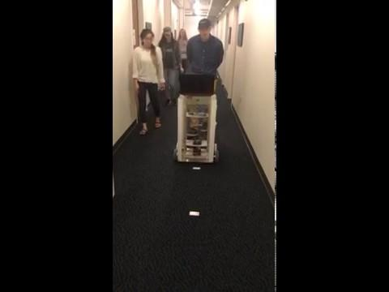
Videos - Distance Detection
Notes:
Joanna

Slide 10
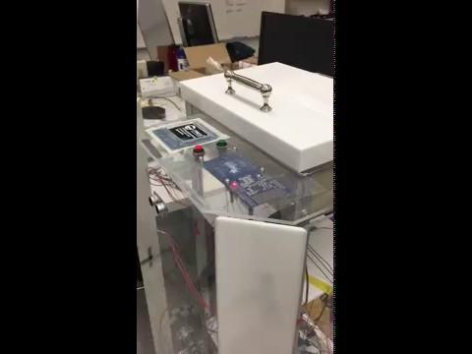
Videos - Lockbox & LED
Notes:
Nick

Slide 11
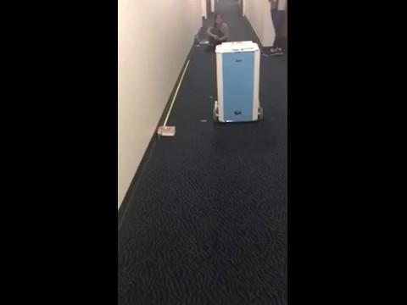
Videos - Linear Motion
Notes:
Lorena

Slide 12

Videos - Object Detection
Notes:
Leanna

Slide 13
Videos - LCD Screen
Notes:
Erin

Slide 14
Questions?

